Slide 1

Consumer behaviour and decision-making
Created by Iryna Zhukevych
PhD in Pedagogical Sciences
Associate Professor
Це фото; автор: Невідомий автор; ліцензія: CC BY-ND

Slide 2
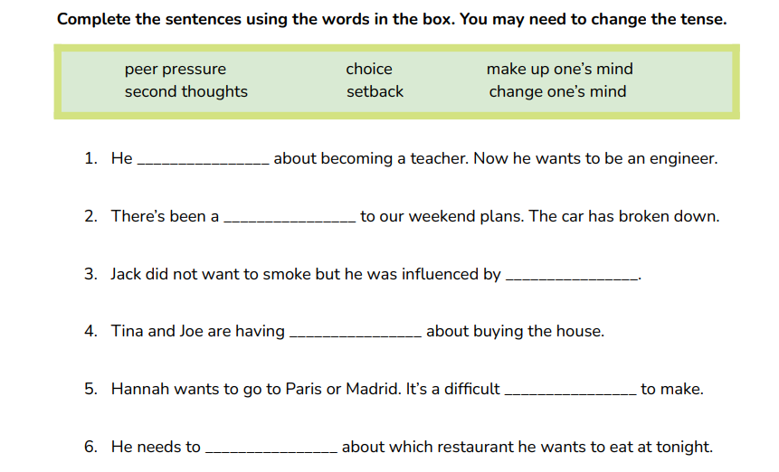
DECISION MAKING VOCABULARY

Slide 3
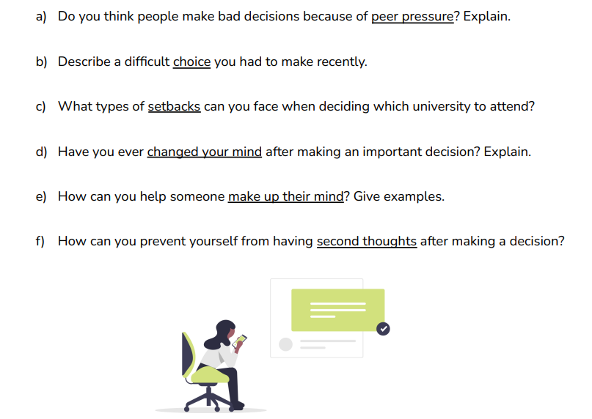
Discuss the following questions

Slide 4
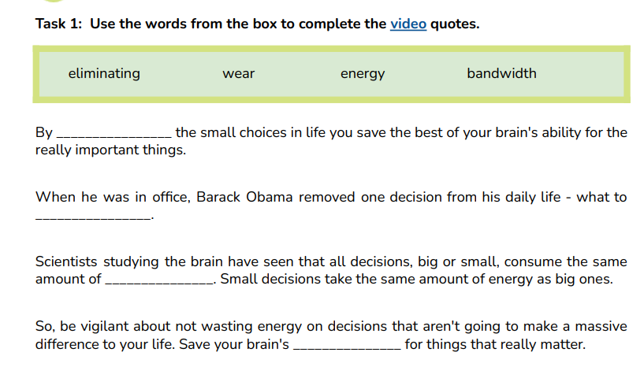
TIP 1: REMOVE SMALL CHOICES
https://www.youtube.com/watch?v=_0onFbc5FQM

Slide 5
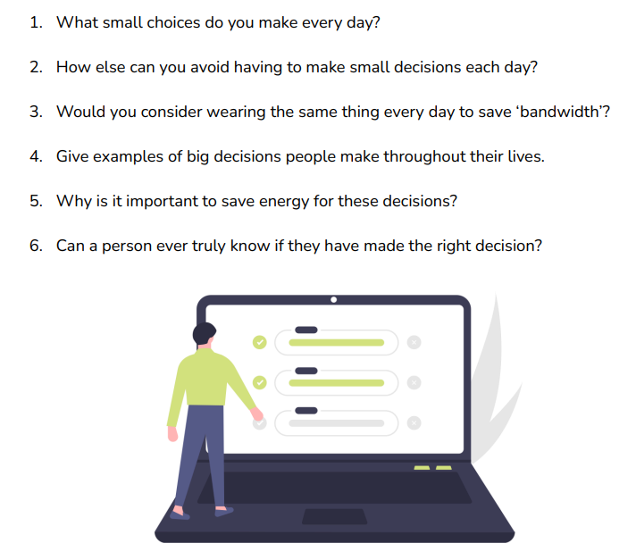
Discuss the following questions

Slide 6
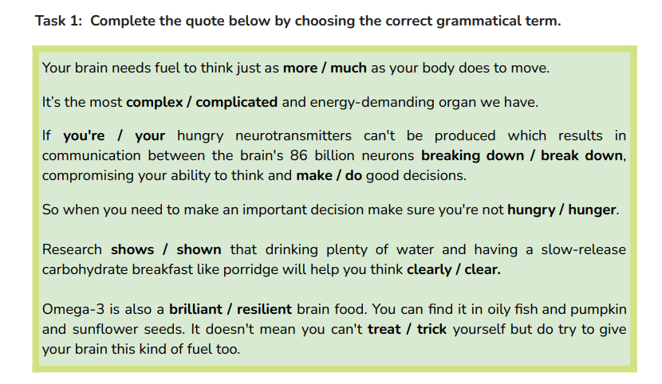
TIP 2: FUEL YOUR BRAIN

Slide 7
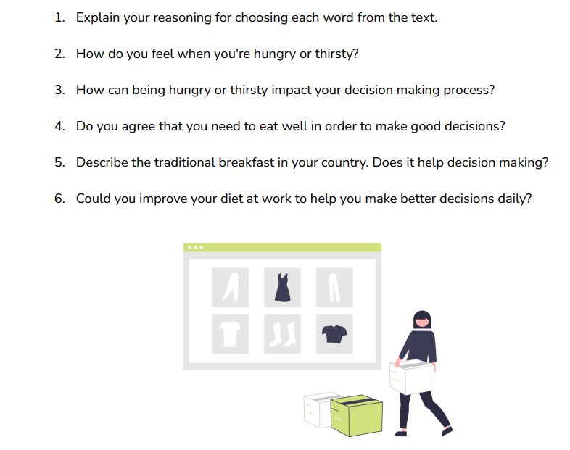
Discuss the following questions

Slide 8
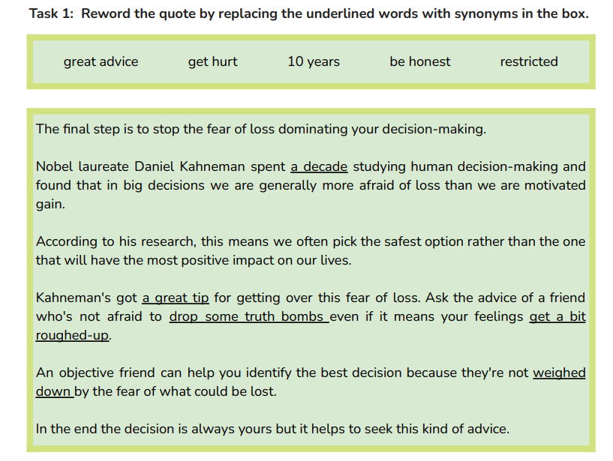
TIP 3: LOSE THE FEAR

Slide 9
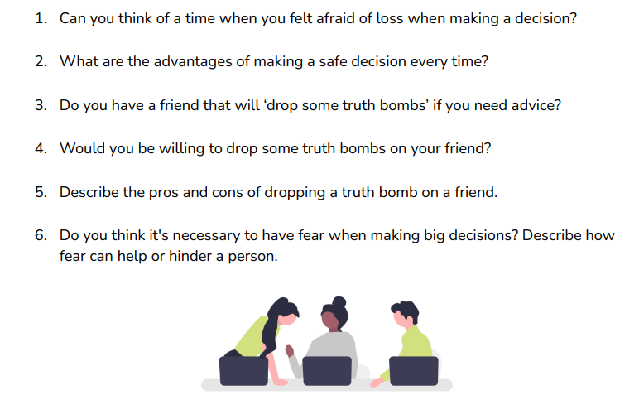
Discuss the following questions

Slide 10
