Slide 1

Proposal Writing.
Making Decisions.
Created by Iryna Zhukevych
PhD in Pedagogical Sciences
Associate Professor

Slide 2
What makes a good proposal?
Have you ever written or read a proposal?

Slide 3

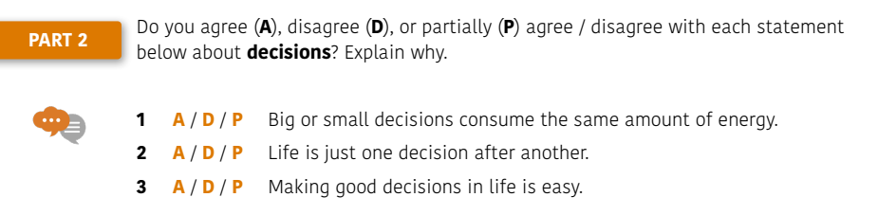
Це фото; автор: Невідомий автор; ліцензія: CC BY-SA

Slide 4

Watch the video
“How to make better decisions”
https://www.youtube.com/watch?v=_0onFbc5FQM
Це фото; автор: Невідомий автор; ліцензія: CC BY

Slide 5
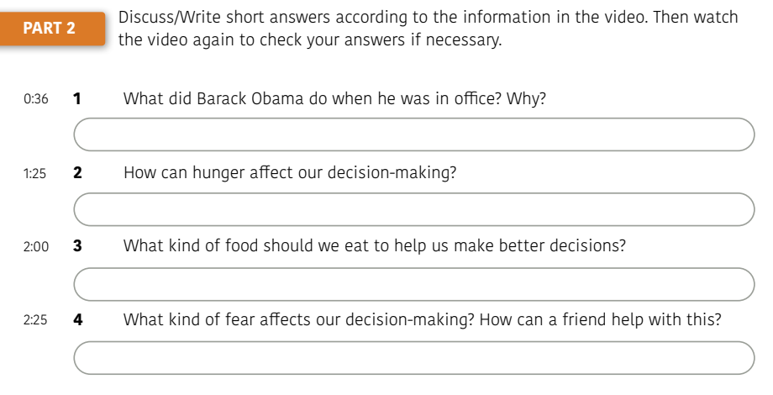

Slide 6
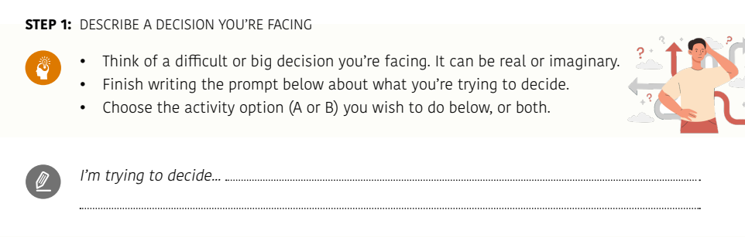

Slide 7
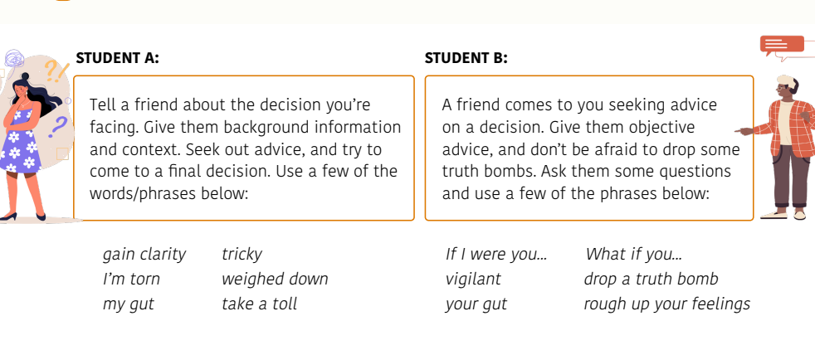
Take one of the roles below and do the role play

Slide 8

Have you ever had to make a decision based on a proposal? What was the proposal about, and what factors influenced your decision?
Це фото; автор: Невідомий автор; ліцензія: CC BY

Slide 9
Understanding FOBO: Fear Of a Better Option
What is the main concept introduced in the video regarding decision-making?
How does the speaker differentiate between FOMO and FOBO? Provide examples.
Describe how technology contributes to FOBO according to the speaker.
What are the three types of decisions mentioned in the video? Briefly explain each.
What strategies does the speaker suggest for making no-stakes decisions?
In the context of low-stakes decisions, what is the recommended method for outsourcing decision-making?
How should one approach high-stakes decisions according to the video? List the steps involved.
What is the importance of committing to a decision once it is made?

Slide 10

Speaking Cards
https://wordwall.net/myactivities

