Slide 1

PROGRAMMING IN ELECTRONICS

Slide 2
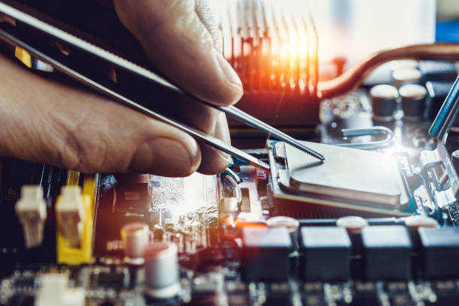
QUESTIONS TO ANSWER
Questions:
What electronic devices do you use every day (e.g., smartphones, smart TVs, washing machines)?
Do you know how these devices “know” what to do?
Why do you think programming might be important in electronics?

Slide 3
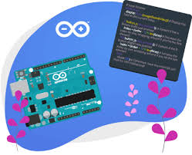
TERMS
Programming: Writing instructions (or code) that tell electronic devices what to do.
Code: The language of instructions that devices can understand.
Embedded Programming: A type of programming for devices with specific functions, like a washing machine or car system.
Device: Any electronic tool or machine, like a smartphone or a TV.
Software: The programs or code that a device uses to perform tasks.

Slide 4


Detailed Explanation of Programming in Electronics
What is Programming in Electronics?
Programming in electronics involves writing code that allows devices to perform tasks automatically or in response to user commands.
Types of Programming in Electronics:
Embedded Programming: Used for devices that perform specific functions, like a microwave or car engine system.
Applications: Electronics programming is used in daily devices like washing machines, TVs, mobile phones, and even cars.
Programming Languages:
Common programming languages in electronics include C, Python, and Java. Each language has different uses and strengths, depending on the type of device.
Visual Aids:
Show images of common electronic devices with arrows pointing to where programming might be used.
Use a diagram showing the steps from writing code to how the device follows the instructions.

Slide 5
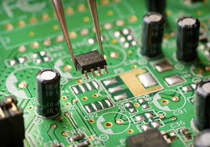
DISCUSSION QUESTIONS
Why is programming important for the electronics we use every day?
How do you think embedded programming helps devices perform tasks automatically?
What are some examples of devices that rely heavily on programming to function?
How would you explain the importance of programming to someone who doesn’t know what it is?
Do you think everyone should learn the basics of programming? Why or why not?

Slide 6
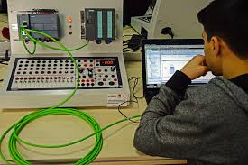
Programming and Electronics Brainstorm
choose an electronic device they use often (e.g., smartphone, washing machine, car).
think about and write down how programming might help that device work better or perform its tasks.
explain in simple terms how programming is important to that device’s function.

Slide 7
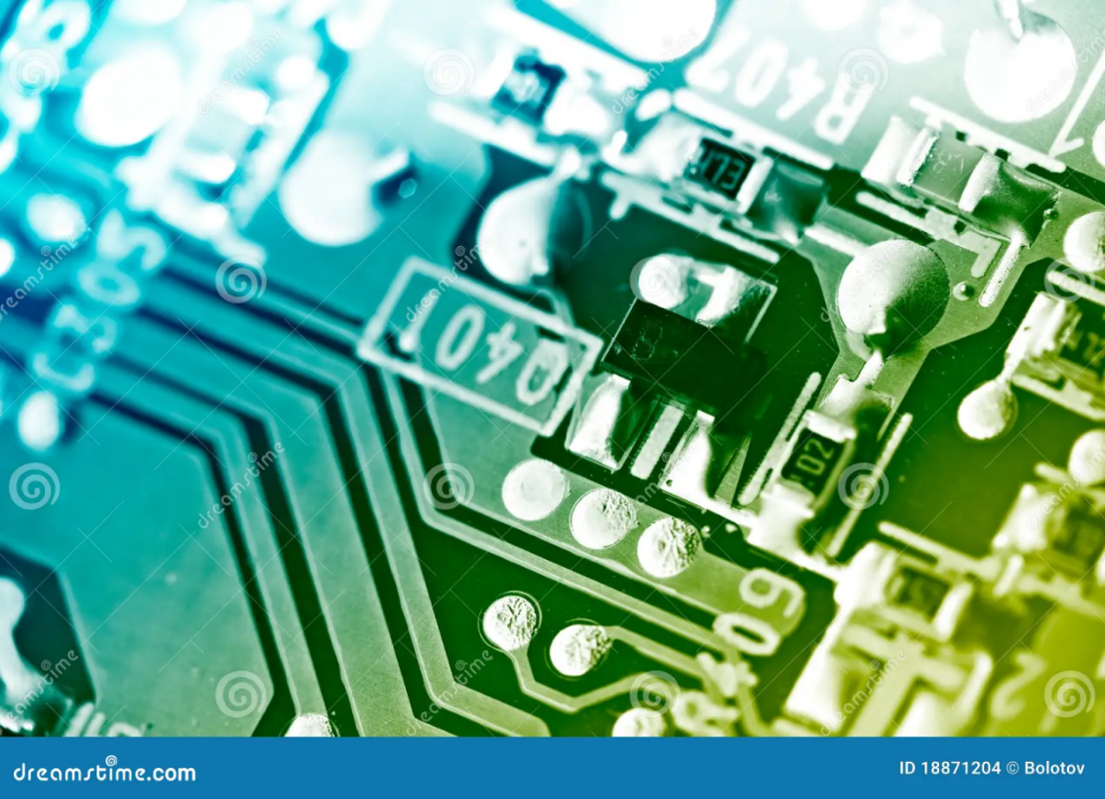
True or False
Code tells electronic devices what to do.
Embedded programming is used only for computers.
Programming languages like C and Python are used in electronics.
Programming is not necessary for modern devices.
Software includes the programs a device needs to work.

Slide 8
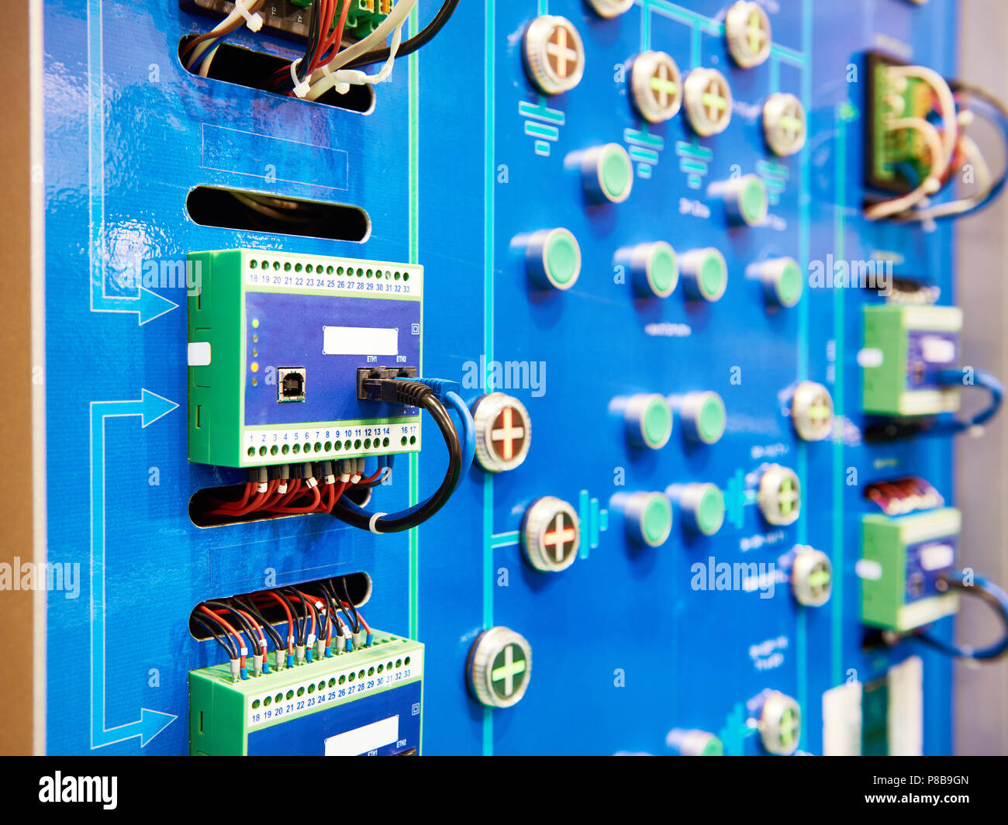
Conclusion and Recap
Programming in electronics is about writing instructions that devices follow to work properly.
Embedded programming is used for specific devices to make them work automatically.
Many of the devices we use every day, like phones and washing machines, rely on programming to function.

