Slide 1
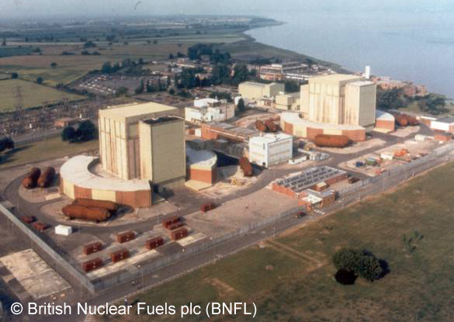
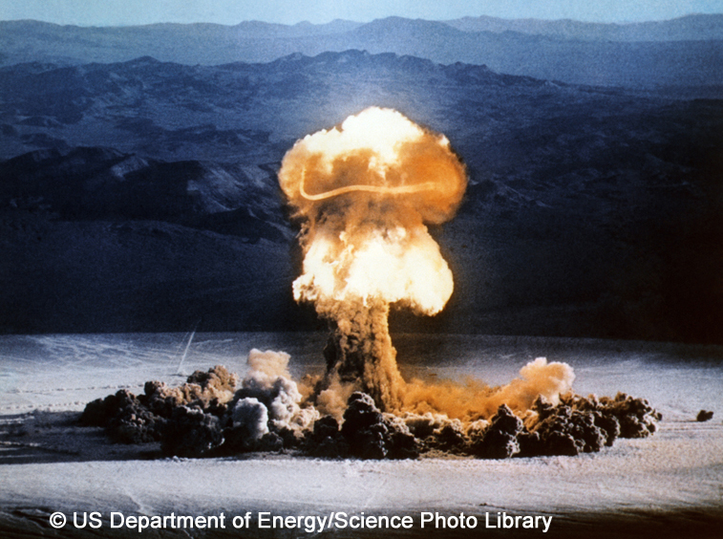
Nuclear fission
The particles in the nucleus of an atom are held together by strong forces.
Some atoms, such as uranium, have a very large unstable nucleus, which can split into two smaller nuclei.
This splitting is called fission and releases huge amounts of nuclear energy.
The release of nuclear energy is exploited in nuclear power stations and some atomic bombs.
Notes:
Acknowledgements
Top right: Aerial view of Berkeley power station.
Credit: British Nuclear Fuels plc (BNFL)
Bottom right: Atomic bomb explosion. Mushroom cloud produced by the detonation of XX-10 Priscilla, a 37-kiloton atomic bomb, on 24 June 1957. This was part of Operation Plumbbob at the Nevada Proving Grounds, USA. XX-10 Priscilla was suspended from a balloon about 200 metres above the Nevada desert before detonation. Atomic or nuclear bombs work by releasing the energy within the nucleus of atoms. Fission bombs contain enriched uranium or plutonium. When an atom absorbs a neutron, it splits into smaller atoms, releasing energy (in the form of heat and radiation) and more neutrons, which propagate a chain reaction.
Credit: US Department Of Energy/Science Photo Library

Slide 2
Nuclear fission
A uranium nucleus is split by bombarding it with neutrons. This fission forms two new elements and two neutrons.
The new neutrons can cause other nuclei to split, which releases even more neutrons. This is a chain reaction.

Slide 3

Nuclear fusion
Atomic nuclei can join together, which also releases huge amounts of energy. This joining together is known as fusion.
Nuclear fusion is the process that releases energy inside stars such as the Sun.

Slide 4
Nuclear energy summary

