Slide 1
Heterogeneous Distributed Access Network with Satellite Radio Channels
Irina Tymchenko, Evgeniya Svetsinskaya, Ilya Kubasov, prof. Konstantin Sunduchkov
Institute of Telecommunication Systems, National Technical University of Ukraine “KPI”,Kyiv, Ukraine
E-mail: k.sunduchkov@gmail.com
Notes:
This paper presents an overview of modern satellites. Different trends in the development of satellite radio channels are shown. The problem statement of the research of satellite radio channels for the application them in satellite networks of wireless access to base stations on a motorway or along railways is formulated.

Slide 2
Introduction
It is known, that mobile communication when subscribers driving at a speed of 250÷350 km/h, whether on the highway or railway express, based on traditional methods (handover technology) establishing of communication between a base station (BS) and the mobile terminal (MT) for network subscribers having 1000 or more can’t simultaneously provide services to each subscriber to a data rate of 10÷20 Mbit/sec.
Notes:
Используя традиционные
методы установления связи
невозможно одновременно
предоставлять услуги каждому
абоненту (емкость сети 100 и
более) со скоростью передачи
данных 10 ÷ 20 Мбит/с.

Slide 3
Introduction
«Smart house»
In the "smart house" an abundance of information is born
At any moment of time it may be requested by the subscriber
To adjust the control program of the house
Distributed database
large amounts of data
high speed data transfer, etc.
«Direct» channel
is required distribution networks up to several tens of Gbit/s at speed of movement of 250-350 km/h
Notes:
Talking about the 5G format in mobile communications first of all must be imagined what it can give mobile subscribers. In the "smart house" is born an abundance of information that, at any moment of time may be requested by the subscriber (including the mobile terminal) for surgical intervention in the mode of «on-line» to adjust the control program of the house. Extreme situations are not the only reason, which needs arise in high speed data transmission.
Solving problems with the use of distributed database, or the problem of parallel computing using multiple computers placed on any particular area have large amounts of data, high speed data transfer, etc.
Organization of "direct" channel delivery of requested information by subscribers in the mobile terminals (MT), moving with high speeds up to 250 km/h on the highway and up to 350 km/h in the express trains, in the presence of the network in 1000 ÷ 2000 MT is required distribution networks, as will be shown below, up to several tens of Gbit/s.

Slide 4
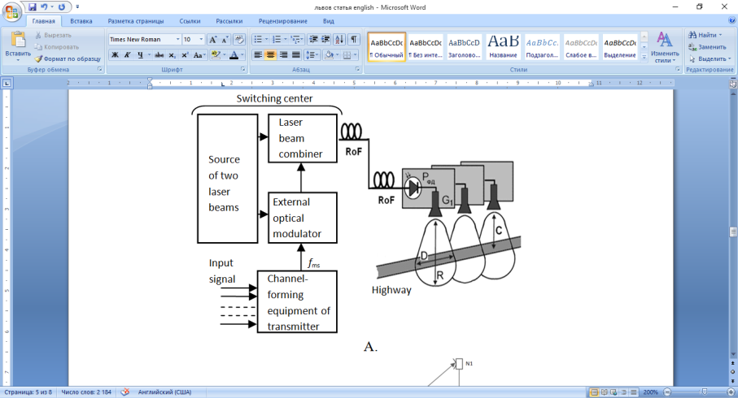
Architecture heterogeneous network architecture delivering signals to each base station
Channelization equipment is located in the switching center.
Formation of subcarriers occurs by OFDM technology (2000 subcarriers).
The fiber optic line consists of:
Magistral network (Kiev - the middle of the track).
Distribution network (the middle of the track - each BS).
Notes:
Каналообразующая аппаратура расположена в коммутационном центре (switching center).
Формирование поднесущих по технологии OFDM (2000 поднесущих).
Оптоволоконная линия состоит из:
Магистральная сеть (Киев – середина трассы).
Распределительная сеть (середина трассы- каждая БС).
Допустимая потеря кадров для сохранения качества.

Slide 5
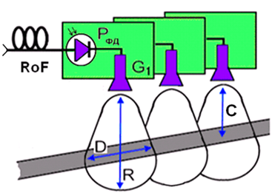
Scheme of the base station
A base station comprises two elements:
a photodiode
a horn antenna.
Base station performs only the function of converting of two laser beams in the RF millimeter-wave signal and to cover the highway track.
Simplification of the base station is reduced its cost by 2 orders and removed the problem of the economic feasibility of the project.
Notes:
Базовая станция состоит из двух элементов: фотодиод и рупорной антенной.
Базовая станция выполняет только функцию преобразования двух лазерных лучей в сигнале миллиметрового РФ и покрыть автомагистрали трек.
Упрощение базовой станции уменьшается его стоимость на 2 порядка и удаляется проблему экономической целесообразности проекта.

Slide 6
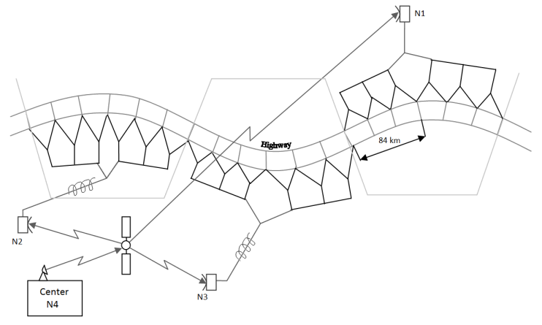
Architecture heterogeneous network architecture delivering signals to each base station
Architecture heterogeneous network delivering digital signals services to a large number of subscribers (1-2 thousand subscribers) at 10÷12 Mbit/sec each is to provide the network bandwidth of 24 Gbit/s
(2000 subscribers × 12 Mbit/s = 24 Gbit/s)
that the QAM-64 (Km = 6) would require the operating frequency band of 4 GHz (24 Gbit/s : 6 → 4 GHz).
It determine the nature of distribution networks.
Notes:
Архитектура гетерогенной сети доставки цифровых сигналов услуги большому числу абонентов (1-2 тыс абонентов) при 10 ÷ 12 Мбит / с каждому, чтобы обеспечить пропускную способность сети в 24 Гбит / с (2000 × абоненты 12 Мбит / с = 24 Гбит / с), КАМ-64 (Км = 6) потребуется полосу рабочих частот 4 ГГц (24 Гбит / с: 6 → 4 ГГц). Это определяет характер распределительных сетей.

Slide 7
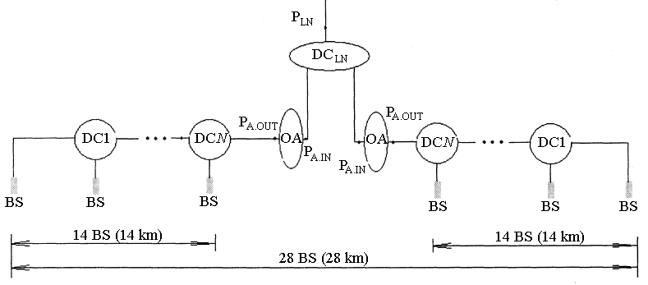
First level
The first level includes land of 28 km on the highway.

Slide 8
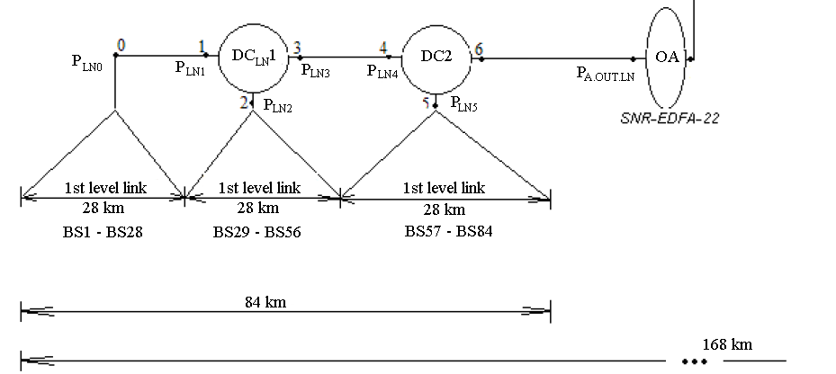
Second level
The second level is repeated six times topology first level and covers land of 168 km on the highway length.

Slide 9
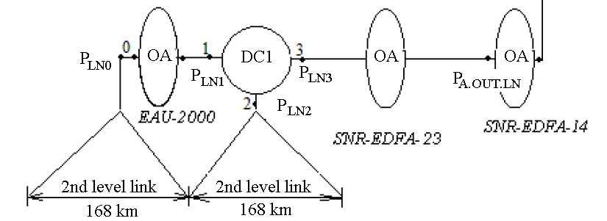
Third level
The third level topology repeats four times the second level and covers land of 672 km on the highway length, which is more than enough for the Kiev-Odessa highway.

Slide 10
Satellite radio channels
Name and source of publication | Number of transponders |  | Modulation | Capacity of the transponders
 | Ku | Ka
KA-SAT | 53 | 3 | DVB-S2 (QPSK and 8PSK, 16APSK and 32APSK) | 237,5 MHz
Express-АМ8 | 16 | - | DVB-S (QPSK) and DVB-S2 (8PSK), АPМ-32 | 54 MHz
Express-АМ5 | 40 | 12 | DVB-S (QPSK) and DVB-S2 (8PSK, 16APSK) in the АМС regime | 110 MHz
Eutelsat 3D | 53 | 3 | DVB-S2/QPSK | 36, 54, 72 и 108 MHz
ViaSat-1 | - | 56 | DVB-S (QPSK) and DVB-S2 (8PSK) | 240 MHz
Thor 7 | 11 | 25 | DVB-S2 (АPМ-16) | 100-500 MHz
Jupiter 1/ Echostar 17 | - | 60 | IPoS/DVB-S2 with the АМС regime | 500 MHz

Slide 11
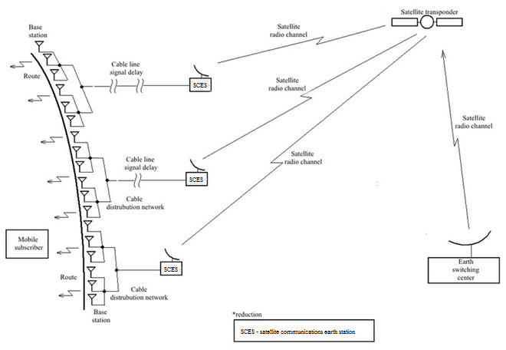
Distributed heterogeneous access network with satellite radio channels
The general scheme of interactive heterogeneous telecommunication system consists of
earthly switching center,
a satellite transponder,
several satellite earth stations,
several laser modulators and signal delay lines,
synchronous fiber-optic network,
a plurality of base stations along the highway,
the mobile terminal.
Notes:
Общая схема ИГТС состоит из земного коммутационного центра, спутникового ретранслятора, нескольких земных станций спутниковой связи, нескольких лазерных модуляторов и линий задержки сигнала, синхронной оптоволоконной сети, множества базовых станций вдоль трассы, мобильного терминала.

Slide 12
Conclusions
The paper presents the parameters of the "direct" channel of the future of mobile communications networks. Therefore there are following requirements on the number of subscribers (2000), on the operating frequency band (4 GHz), movement speed of subscribers (200-300 km/h), etc. The following shows that these parameters may be provided magistral network by satellite radio channel and distribution networks of fiber-optic lines.
Satellites development trends were observed in mastering the higher high-frequency bands, in use higher quantity of multi-position modulation types, in increase the capacity of their transponders and in increase the total duration their working capacity.
Modern satellites in its parameters allow the creation of transport networks for the distribution of large amounts (up to a thousand and more) multimedia mobile services for customer service on the highway and in the express trains.
Notes:
В работе приведены параметры «прямого» канала будущих сетей мобильной связи, из которых следует требование по количеству обслуживающих абонентов (2000), по полосе рабочих частот (4 ГГц) на скорость движения абонентов (200-300 км/ч) и т.д. Ниже показано что такие параметры могут быть обеспечены магистральной сетью спутниковым радиоканалом и распределительными сетями оптоволоконных линий.

