Slide 1
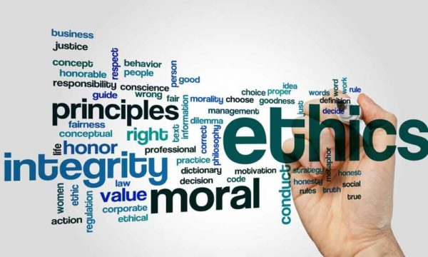
Business Ethics
Created by Iryna Zhukevych
PhD in Pedagogical Sciences
Associate Professor
Це фото; автор: Невідомий автор; ліцензія: CC BY

Slide 2

What is Business Ethics?
https://www.youtube.com/watch?v=_sF1CEA-UUs
1. What are the fundamental differences between personal ethics and business ethics as discussed in the video?
2. How does the speaker suggest that personal experiences influence an individual's ethical standards?
3. In what ways does the video indicate that ethical expectations in the workplace may differ from those in personal life? Provide specific examples mentioned.
4. Reflecting on your own experiences, how do you define what it means to be ethical in a professional setting?
5. Describe the importance of seeking assistance when faced with ethical dilemmas in the workplace according to the video.

Slide 3

Market Leader. Advanced
Course Book
Unit 6. p. 52-53, ex. A-H.
Audio tracks 2.20-2.22

Slide 4

Scenario 1
You notice a colleague in the office spending a couple of hours online shopping during the workday.

Slide 5

Scenario 2
You know that one of the people on the sales team has charged a customer more for the product they bought than it cost.

Slide 6

Scenario 3
Your male manager always invites a female colleague out for lunch, but not anyone else in the team. You think he is paying for the lunches with company money.

Slide 7
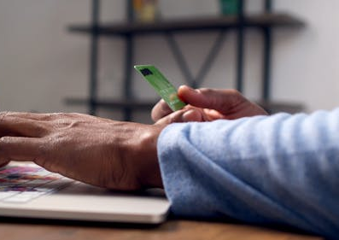
Scenario 4
You are an engineering office manager, and one upper-level manager has repeatedly used the company credit card for personal expenses. How do you handle the situation?

Slide 8

Scenario 5
You're a candidate for hire at a great company as a Purchasing Manager, but you plan to move across the country in a year. Do you reveal that during the interview?
Це фото; автор: Невідомий автор; ліцензія: CC BY

Slide 9

Scenario 7
Working in HR, you have a position available in the marketing department. The position does not ideally suit the needs of the candidate. Do you disclose all the information, or just disclose the information which would attract the candidate?
Це фото; автор: Невідомий автор; ліцензія: CC BY-SA

Slide 10

Business Ethics
The Impact of Ethics on Business
https://www.youtube.com/watch?v=A9i8dwKC7TE&t=62s
1. What are the key differences between legal obligations and ethical responsibilities for businesses, as discussed in the video?
2. How does treating employees well contribute to a company's ethical standing? Provide specific examples mentioned in the video.
3. Explain the significance of fair-trade practices in business ethics. What are the implications of a product carrying a fair-trade logo?
4. Discuss the relationship between paying taxes and a company's ethical reputation. How can tax avoidance impact public perception?
5. In what ways can ethical business practices lead to increased profits, despite potential short-term costs? Refer to points made in the video to support your answer.
Це фото; автор: Невідомий автор; ліцензія: CC BY-SA

