Slide 1
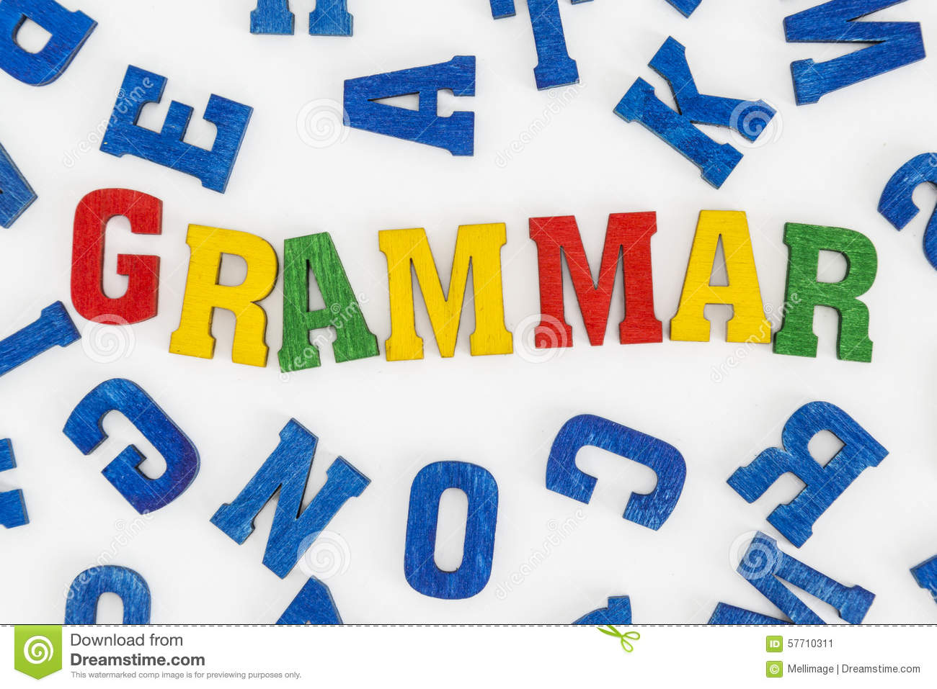
Навчння граматиці студентів 4 курсу

Slide 2
План
1. Comparisons
2. Else, more, another
3. Nouns as attributes
4. Other, another
5. So+adj.+a noun
6. either

Slide 3


Slide 4
Comparisons
 | Price | Processor Speed | Screen Size | Hard Disk | RAM
Evesham Axis 1.33 SK | £1,174 | 1.33 GHz | 17" | 40 GB | 256 MB
Armani R850 P4. | £2,467 | 1.7 GHz | 19" | 40 GB | 256 MB
Mesh Elite 1.7GT Pro | £1,938 | 1.7 GHz | 19" | 57 GB | 256 MB
Elonex WebRider Pro | £1,174 | 1.2 GHz | 17" | 38.1 GB | 128 MB

Slide 5
Three personal computers, the Evesham Axis 1.33 SK, the Armani R850 P4 and the Mesh Elite 1.7 GT Pro, were compared with respect to the following factors: price, processor speed and size of hard disk. The Evesham Axis, which costs £1,174, is by far the cheapest of the three, the Armani and the Mesh Elite costing £2,467 and £1,938 respectively. The Evesham Axis has the same hard disk size as the Armani, 40 MB, whereas the Mesh Elite is the largest at 57 GB. Regarding the processor speed, the Armani and the Mesh Elite are similar - the processor speed, at 1.7 GHz, being 0.37 GHz faster than the Evesham Axis.
The Evesham Axis is like the Elonex WebRider The Evesham Axis and the Elonex WebRider are similar The Evesham Axis is similar to the Elonex WebRider The Evesham Axis is the same as the Elonex WebRider The Evesham Axis resembles the Elonex WebRider | with respect to price. as regards price. as far as price is concerned. regarding price. in that the price is the same. in terms of price. in price.
Comparison

Slide 6
The Mesh Elite has a large screen. | Similarly, it has a high capacity hard disk. Likewise, it has a high capacity hard disk. Furthermore, it has a high cap[acity hard disk. Moreover, it has a high cap[acity hard disk. Correspondingly, it has a high capacity hard disk. It has a high capacity hard disk, too. It also has a high capacity hard disk.

Slide 7


Slide 8
Contrast
The Evesham Axis differs from the Armani The Evesham Axis is unlike the Armani The Evesham Axis and the Armani differ The Evesham Axis is different from the Armani The Evesham Axis contrasts with the Armani | with respect to price. as regards price. as far as price is concerned. regarding price. in terms of price. in price.

Slide 9
Contrast
The Evesham Axis costs £1,174, whereas the Armani costs £2,467. The Evesham Axis costs £1,174, while the Armani costs £2,467. The Evesham Axis costs £1,174, but the Armani costs £2,467. The Evesham Axis costs £1,174, in contrast to the Armani, which costs £2,467. The Armani is more expensive than the Evesham Axis. The Evesham Axis is not as expensive as the Armani. The Armani costs more than the Evesham Axis.

Slide 10
Contrast
The Armani is expensive to buy. | On the other hand, it is very fast and has a large screen. In contrast, it is very fast and has a large screen. Conversely, it is very fast and has a large screen. However, it is very fast and has a large screen. But, it is very fast and has a large screen.

Slide 11
Considerably, a lot/far/much, slightly
Translate into English using comparatives and expressions in the box where it is necessary.
considerably a lot/far/much slightly /a bit/a little
Подивитися фільм в кінотеатрі набагато цікавіше ніж подивитися по Інтернету.
Життя в джунглях значно небезпечніше ніж життя у великому місті.
Пошук інформації в Інтернеті набагато швидший за пошук в газеті.
Арабська мова трохи легша ніж китайська.
Сьогодні температура на вулиці трохи вище ніж вчора.
Картини Ван Гога набагато яскравіші ніж картини Моне.
Фільм «Хвиля» трохи цікавіший за фільм «Післязавтра».
Ціни на продукти у квітні значно вищі ніж у березні.
Чорне море трохи тепліше за Балтійське море.
Польща трохи більша за Словакію.

Slide 12
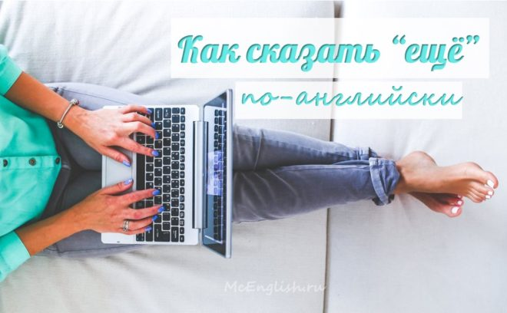

Slide 13
How to say «ще» in English
Let’s list the existing equivalents: still, yet, else, another, other, and more.
STILL
Used with verbs in statements and positive sentences:
Is the cat still hungry?
Are you still busy?
The children are still doing their homework.
It is still snowing .
This man still works at a factory.

Slide 14
Yet
Used in negative sentences at the end of the sentence or part of the sentence.
She doesn’t know yet how to boil an egg.
John isn’t a good programmer yet.

Slide 15
More, another
Mary needs (some) more time to find the solution to the problem.
Put (some) more sugar in my tea.
He asked for two more days to complete the course work.
Another means “ще один” or “one more”.
Give me another piece of cake. Or Give me (some) more cake.
Would you like another cup of coffee?
In informal English “another” can be used with numerals.
She has another three dresses to wear

Slide 16
else
Used without a noun or pronoun.
What else would you like?
What else do you know about the accident?
Let’s order something else.

Slide 17
other
Used with nouns in the meaning “інший”.
First, I tried some tea. Then I wanted to try other sorts of tea.
What other tea did you try?
Але «Про цю розробку було відомо ще у 80х роках» - This job was known even in the 80s.

Slide 18
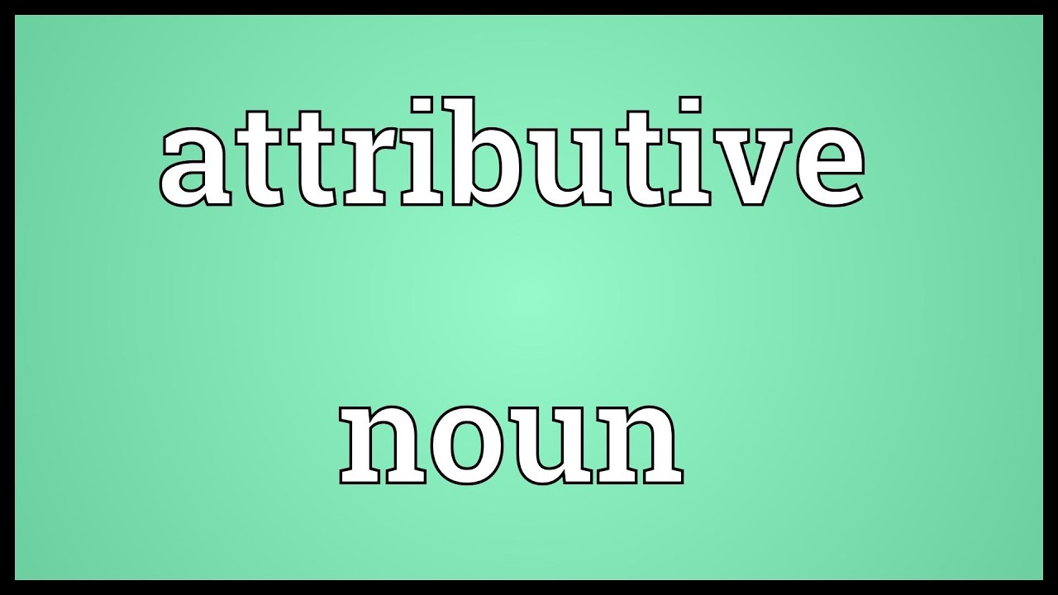

Slide 19
Nouns as Attributes
There are two ways of adding this information to a noun. One is with an attributive noun A bus ride. A pound note. This atttributive noun is always, singular. (The only exception I can think of is 'sports' - you have a sports car, or a sports bra). But the general rule is that the noun, if used attributively, is singular. eg a sweet shop. It sells lots of sweets, but because it is being used attributively, it is singular.

Slide 20
when you further modify that noun, you have to hyphenate it. A pound note A one-pound note. A five-pound note. Even if the number you add is plural, the attributive noun is still singular. A seven-year itch. It is hyphenated to show that 'seven' is linked to 'year' and not to 'itch'. If you didn't hyphenate, then all the words before the noun would describe that noun an old pound note

Slide 21
It is a five-minute walk. It is a country walk. (ie, it is an attributive noun acting as an adjective) note that because the noun is singular, it takes an article. It is a ____ walk.

Slide 22
If you don't go with the hyphenated route, you have to use the possessive to show that the number modifies the attributive noun. The walk takes five minutes. It is a walk of five minutes. It is five minutes' walk. It is his walk.

Slide 23
Note that because the noun is now the possessive "five minutes'", which is plural, there is no article. It is five minutes' walk. [A singular minute would have an article. It is a minute's walk.] It is just a habit that you could say "it is five minutes' walk" - you can equally say "a five-minute walk". But for the others, you would always use the hyphenated and never the possessive. A ten-dollar bill, an eight-year struggle. But The Hundred Years' War (which was in fact a one-hundred-and-sixteen-year war).

Slide 24
She is two years old.
She is a two-year-old girl.
She is a two-year-old.

Slide 25
Other, others, the other or another?
Other
Other means ‘additional or extra’, or ‘alternative’, or ‘different types of’.
Other as a determiner
We can use other with singular uncountable nouns and with plural nouns:
The embassy website has general information about visas. Other travel information can be obtained by calling the freephone number. (additional or extra information)
Some music calms people; other music has the opposite effect. (different types of music)

Slide 26
Other, another
What other books by Charles Dickens have you read, apart from ‘Oliver Twist’? (additional or extra books)
This one’s too big. Do you have it in other sizes? (alternative sizes)
If we use other before a singular countable noun, we must use another determiner before it:
I don’t like the red one. I prefer the other colour.
Not: I prefer other colour.
Jeremy is at university; our other son is still at school.
He got 100% in the final examination. No other student has ever achieved that.

Slide 27
Other, another
Warning:
Other as a determiner does not have a plural form:
Mandy and Charlotte stayed behind. The other girls went home.
Not: The others girls …
See also:
Determiners (the, my, some, this)

Slide 28
Other, another
Other as a pronoun
We can use other as a pronoun. As a pronoun, other has a plural form, others:
We have to solve this problem, more than any other, today.
I’ll attach two photos to this email and I’ll send others tomorrow.

Slide 29
The Other
The other
The other as a determiner
The other with a singular noun means the second of two things or people, or the opposite of a set of two:
This computer here is new. The other computer is about five years old.

Slide 30
The Other
Well, the gift shop is on the other side of the street, directly opposite. (the opposite side)
The other with a plural noun means the remaining people or things in a group or set:
Joel and Karen are here, but where are the other kids? (the remaining people in a group) but where are the others?
Where are the other two dinner plates? I can only find four. (the remaining things in a set – here six plates)

Slide 31
The Other
The other as a pronoun
We can use the other as a pronoun, especially to refer back to something which has been mentioned already in the sentence:
He had his hat in one hand and a bunch of flowers in the other.
She has two kittens, one is black and the other is all white.
On the one hand …, on the other hand ….
The other way round…

Slide 32
Another
When we use the indefinite article an before other, we write it as one word: another. Another means ‘one more’ or ‘an additional or extra’, or ‘an alternative or different’.
Another as a determiner
We use another with singular nouns:
Would you like another cup of coffee?
You’ve met Linda, but I have another sister who you haven’t met, called Margaret.
I don’t like this place. Is there another café around here we could go to? (alternative or different)

Slide 33
Another
Another as a pronoun
We can use another as a pronoun:
The applications are examined by one committee, then passed on to another.

Slide 34
Other, others, the others
When other is a determiner, it does not have a plural form:
These boxes are for books. The other boxes are for clothes.
Not: The others boxes …
When other as a pronoun refers to more than one person or thing, it takes the plural form, others:
Some scientists think we should reduce the number of flights to prevent global warming; others disagree.
Not: … other disagree.

Slide 35
Other, the other, others
Other must have a determiner before it when it comes in front of a singular countable noun. If the noun is indefinite (e.g. a book, a woman, an idea), we use another:
I’ve posted the first package. What shall I do with that other package?
Not: What shall I do with other package?
After a month in Bolivia, I was ready to move to another country.
Not: … to move to other country.
We write another as one word:
There is another car park a little further down the same street.
Not: There is an other car park …

Slide 36
Another is singular. We don’t use it with plural nouns:
Other interesting places to visit include the old harbour and the castle.
Not: Another interesting places to visit

Slide 37
So+Adj.+a noun
The fact of its being so rare a flower ought to have made it easier to trace the source of this particular specimen, but in practice, it was an impossible task.
The guy was so fascinating that I couldn’t help staring open-mouthed.
He was so fascinating a guy that I couldn’t help staring open-mouthed.

Slide 38
Too + adjective + a/an + noun:
The night was too cold to wander the streets.
It was too cold a night to wander the streets.
That+ adjective + a/an + noun:
The host family wasn’t that nice after all.
It wasn’t that nice of a host family after all.
how + adjective + a/an + noun:
How fun do you need a book to keep you up all night?
How fun of a book do you need to keep you up all night?

Slide 39
as + adjective + a/an + noun + as:
That day wasn’t as sunny as I thought it would be.
It wasn’t as sunny a day as I thought it would be.
Paraphrase:
It was such an easy task.
That subject wasn’t as difficult as I thought it would be.
The teacher wasn’t that tough after all.
I watched her closely while she asked how I was and touched my splinted leg and gave me her shoulder to lean on, as though one could lean with safety on so young a plant.

Slide 40
Either, neither
1. __________ my sister and I have blue eyes, but my brother's are brown. a) Either – You need a different word when there is an 'and' in the sentence. b) Neither – You need a different word when there is an 'and' in the sentence. c) Both – This is the correct answer. We use 'both…and…' for two things that are the same i.e. my sister has blue eyes and I have blue eyes. d) Either of – You can't use 'Either of' in this sentence.

