Slide 1

Teamwork
Created by Iryna Zhukevych
PhD in Pedagogical Sciences
Associate Professor
Це фото; автор: Невідомий автор; ліцензія: CC BY-SA

Slide 2

"Coming together is a beginning, staying together is progress, and working together is success.“
Henry Ford (1863 – 1947),
founder of the Ford Motor Company
Це фото; автор: Невідомий автор; ліцензія: CC BY-NC-ND

Slide 3
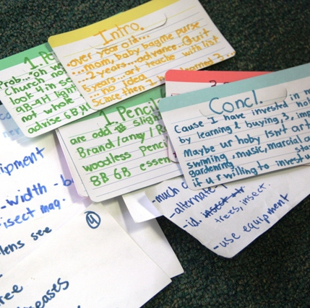
Speaking Cards
https://wordwall.net/resource/82471317/teamwork
Це фото; автор: Невідомий автор; ліцензія: CC BY-SA-NC

Slide 4

The Key to Good Teamwork https://www.youtube.com/watch?v=Zzo98wwGWMM
Decide if the statement is True or False.
The speaker believes that teamwork is essential for solving various challenges.
According to the speaker, the word "professional" has the same meaning for everyone.
TeamWords is a tool created to help improve communication within teams.
The speaker mentions that misunderstandings often arise from different interpretations of words.
The speaker suggests that teams should focus on their work before discussing team dynamics.
The speaker emphasizes the importance of agreeing on specific behaviors within a team.
The speaker thinks that better communication at work can lead to more beautiful outcomes.

Slide 5

Teamwork Conversation Questions
Think about a really good team you were a member of. Why was it a successful team? What did the people do to make it a success? What didn't they do?
Now think about a really bad team you were a member of. Why was it unsuccessful? What did the people do to make it a failure? What didn't they do?
How important is teamwork for helping you do your job?
Who are the people you depend on at work to do your job? Which people depend on you?
How important is socializing for teamwork?
Is having fun at work important for teambuilding, or does this negatively affect the team's performance?
When you have your evaluation at work, are you evaluated for your teamworking skills or just your individual performance? How is teamworking assessed?
In which jobs is it vital that people work as part of a team? Can you think of any jobs that don't require a high level of teamwork?

Slide 6

Practice
Scenario 1: Organizing a University Event
Context: Your university is planning a large event for the end of the year (e.g., a talent show, a sports day, or a charity fundraiser). Your team is in charge of organizing the event.
Task:
- Discuss the tasks that need to be completed, such as creating a schedule, managing volunteers, securing a venue, and promoting the event.
- Assign roles and responsibilities to each team member. Make sure that everyone agrees on their tasks and deadlines.
Share your ideas and explain why you assigned certain roles to different team members.
Objectives:
Collaboration and delegation of tasks
Clear communication of ideas
Time management and setting deadlines

Slide 7

Scenario 2: Starting a Business
Context: You and your team have decided to start a small business. The business could be anything from a food truck to an online store or a fitness app.
Task:
- Brainstorm the type of business you would like to create.
- Discuss what products or services you will offer and who your target market is.
- Decide on a business name, a marketing strategy, and a simple budget.
- Present your business idea, including the roles of each team member in the business.
Objectives:
Brainstorming and idea generation
Team decision-making
Presentation skills and creative thinking

Slide 8

Scenario 3: Planning a Group Trip
Context: Your team is planning a trip to a foreign country. You need to organize everything from the travel itinerary to accommodation and activities.
Task:
Research a destination and agree on the dates of the trip.
Discuss accommodation options, transportation, and activities to do while there (e.g., sightseeing, cultural experiences, or relaxation).
Set a budget for the trip and discuss how to divide the costs among the team members.
Present your travel plan, including the destination, activities, and costs.
Objectives:
Research and planning
Team decision-making and budgeting
Effective communication and presentation

Slide 9

Scenario 4: Charity Campaign
Context: Your team is organizing a charity campaign to raise funds for a cause you believe in (e.g., education, environmental protection, or animal welfare).
Task:
Decide on the cause you want to support and brainstorm ways to raise funds (e.g., a fundraiser event, crowdfunding, or selling items).
Plan the campaign strategy, including the goals, timeline, and promotional tactics (e.g., social media, posters, or community outreach).
Present your fundraising plan, including how much money you aim to raise and what it will be used for.
Objectives:
Goal setting and planning
Collaboration on fundraising activities
Persuasive communication and promoting a cause

Slide 10

Scenario 5: Creating a University App
Context: Your team is tasked with creating a mobile app for your university. The app should help students and staff in various ways (e.g., a homework tracker, event calendar, or communication tool).
Task:
Brainstorm the features that would make the app useful for students and staff.
Decide on the design and functionality of the app, and plan how it would be developed.
Discuss how to promote the app and get students and staff to use it regularly.
Present your app idea, including its main features, design, and how it will benefit the university community.
Objectives:
Idea generation and app design
Team collaboration and task delegation
Presentation and marketing strategies

