Slide 1

Introduction to
Management and Marketing: Marketing fundamentals
Created by Iryna Zhukevych
PhD in Pedagogical Sciences
Associate Professor

Slide 2
Read the information below.
Marketing is an essential aspect of business that involves promoting and selling products or services. The core concepts of marketing, often referred to as the "4 Ps," are Product, Price, Place, and Promotion. Understanding these elements helps businesses meet customer needs, achieve competitive advantage, and maximize profits.
Product: This refers to what a company offers to its customers, which could be a physical item, a service, or an idea. Product decisions involve product design, quality, features, branding, and services offered.
Price: This is the amount of money customers must pay to obtain the product. Pricing strategies can vary based on factors like competition, cost, demand, and perceived value.
Place: Also known as distribution, this involves making the product available to consumers at the right location and time. Decisions here include distribution channels, market coverage, and inventory management.
Promotion: This encompasses all the ways a company communicates with customers to inform and persuade them. It includes advertising, sales promotion, public relations, and personal selling.

Slide 3
Choose the correct answer from the choices for each question.
Which of the following is NOT one of the 4 Ps of marketing?
a) Product
b) Price
c) Performance
d) Promotion
What does the 'Place' aspect of marketing focus on?
a) The design and features of the product
b) The cost to consumers
c) The location and distribution channels
d) The advertising strategy
When a company sets the price of its product based on competitor prices, it is using which pricing strategy?
a) Cost-based pricing
b) Value-based pricing
c) Competitive pricing
d) Psychological pricing
Which element of the marketing mix involves branding and packaging?
a) Product
b) Price
c) Place
d) Promotion
Public relations is a part of which marketing mix element?
a) Product
b) Price
c) Place
d) Promotion

Slide 4
Discuss the following questions
Explain how the concept of 'Product' in marketing can influence consumer perception.
Describe a situation where a company might need to adjust its pricing strategy.
How can effective promotion strategies impact a company’s market share?

Slide 5

Marketing in the Age of AI
https://www.youtube.com/watch?v=3MwMII8n1qM&t=26s
Answer the questions below.
1. What are the main themes discussed in this video?
2. How does the speaker support their arguments throughout the presentation?
3. Identify any key statistics or data mentioned in the video. How do they contribute to the overall message?
4. What challenges or counterarguments does the speaker address regarding the topic?
5. Reflect on your personal perspective. How has the information presented in the video influenced your understanding of the topic?

Slide 6

The 4 Ps of Marketing: What They Are and How to Use Them
https://www.coursera.org/articles/4-ps-of-marketing?authType=google&completeMode=existingCourseraAccount
Watch the video for ideas on how the 4 Ps work in a specific industry, like sports.

Slide 7
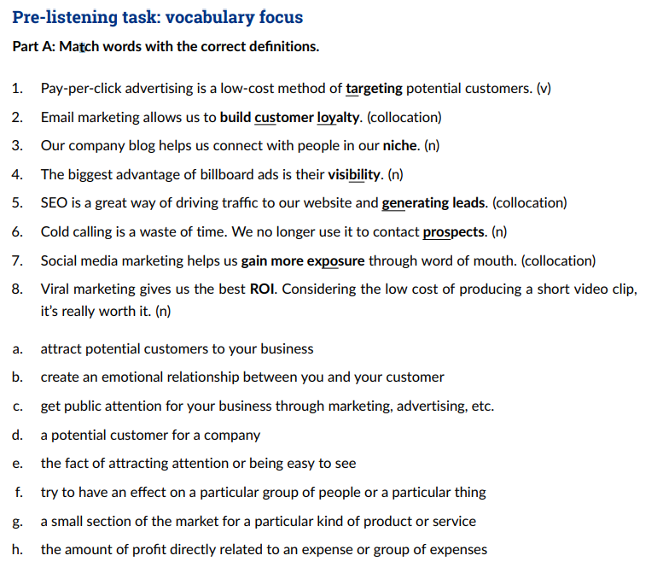

Slide 8
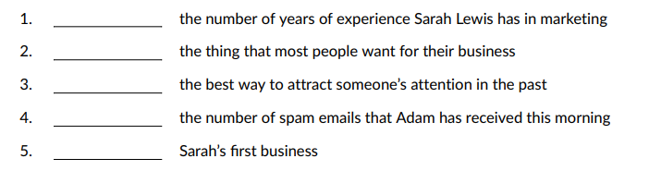
Listen to the report. Complete the gaps with the items mentioned in the recording next to the things they relate to. https://www.linguahouse.com/esl-lesson-plans/business-english/marketing-strategies/audioplayer/marketing-strategies-bemp3

Slide 9
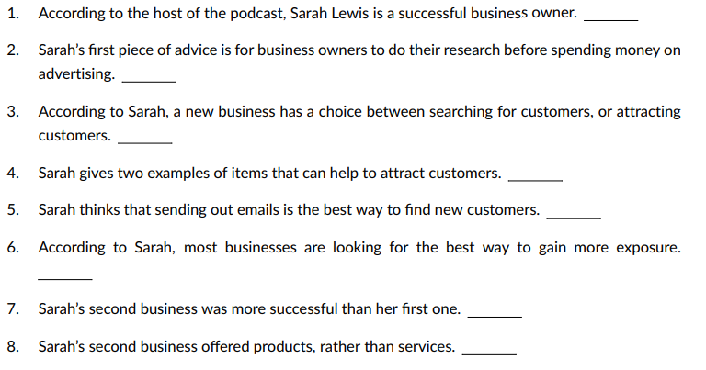
Listen to the report again. Answer the questions true, false or not given. https://www.linguahouse.com/esl-lesson-plans/business-english/marketing-strategies/audioplayer/marketing-strategies-bemp3

Slide 10

Speaking Cards
https://wordwall.net/resource/86153602/marketing-fundamentals

