Slide 1

Understanding Bullying and Addressing School Problems

Slide 2
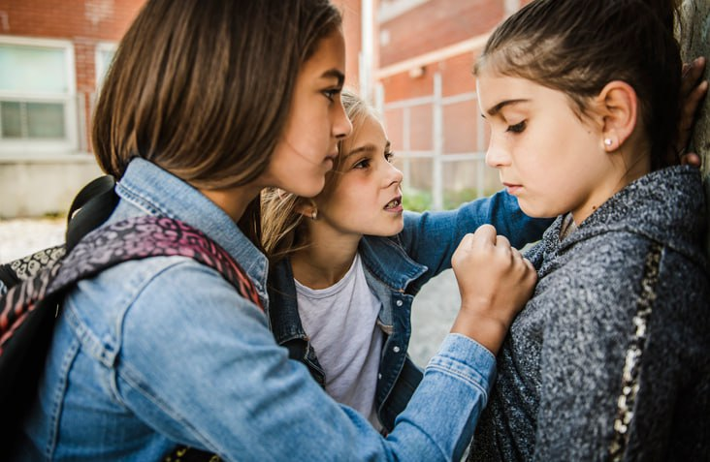
School is meant to be a safe and nurturing environment where pupils can learn, grow, and make friends. However, sometimes problems arise that can make school feel like a challenging place to be. One significant issue that many students face is bullying.

Slide 3
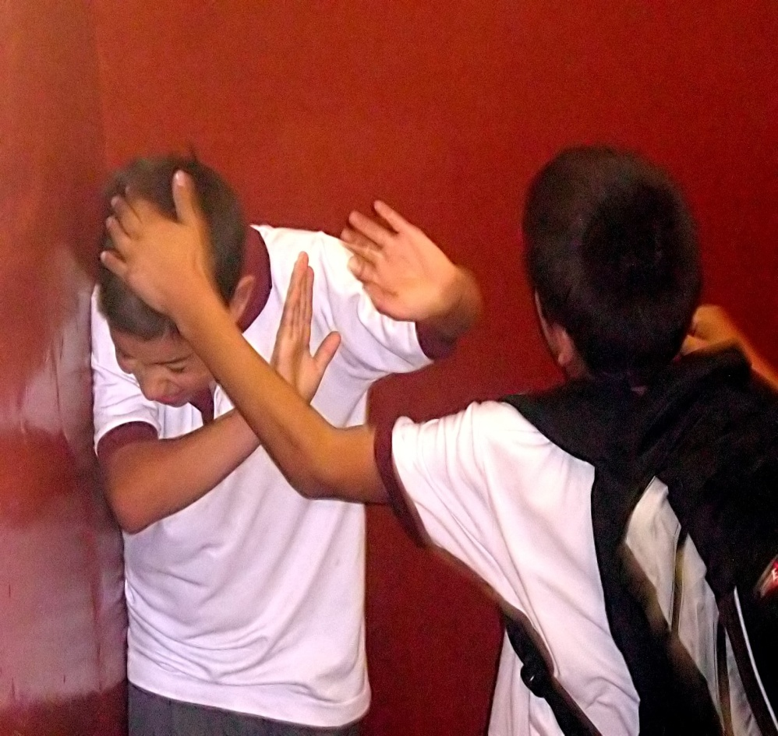
What is Bullying?
Bullying is when someone repeatedly hurts, threatens, or excludes another person on purpose. This behavior can happen in person or online, and it can take many forms, including physical, verbal, social, or cyberbullying. Bullying can have serious consequences for the victim, including emotional distress, low self-esteem, and even physical harm.

Slide 4
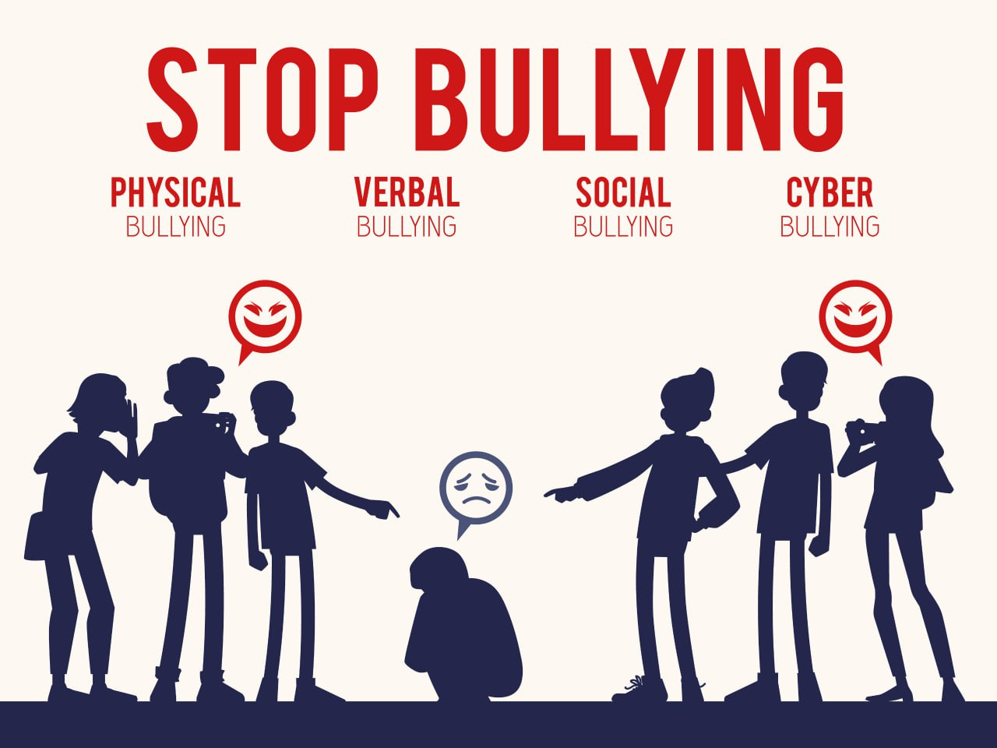
Types of Bullying:

Slide 5
Types of Bullying:
1. Physical Bullying: This involves hitting, pushing, or otherwise physically harming someone.
2. Verbal Bullying: Verbal bullying includes name-calling, insulting, or making hurtful comments.
3. Social Bullying: Social bullying involves excluding someone from a group, spreading rumors, or manipulating friendships.
4. Cyberbullying: Cyberbullying occurs through electronic means, such as social media, text messages, or emails, and can involve harassment, threats, or spreading rumors online.

Slide 6
Effects of Bullying:
Bullying can have an impact on both the victim and the bully. Victims of bullying may experience anxiety, depression, loneliness, and academic problems. Bullies themselves may also face long-term consequences, including difficulty forming healthy relationships and increased risk of engaging in criminal behavior later in life.

Slide 7
What Can You Do?
If you or someone you know is being bullied, it's essential to speak up and seek help. Here are some steps you can take:
1. Talk to a trusted adult, such as a teacher, school counselor, or parent, about what's happening.
2. Stand up for yourself. Let the bully know that their behavior is not acceptable.
3. Surround yourself with supportive friends who will stand by you and help you through difficult times.
4. Practice empathy and kindness towards others. Treat everyone with respect and inclusion.

Slide 8
In addition to bullying, there may be other problems that arise at school, such as conflicts with classmates, academic challenges, or feelings of stress and pressure. It's essential to address these issues in a constructive and supportive manner. Remember, you are not alone, and there are people who care about your well-being and are willing to help. By working together, we can create a school environment where everyone feels safe, respected, and valued. Let's stand up against bullying and support one another in overcoming challenges at school. Your well-being is important, and there are resources available to support you.
Remember, together, we can make a positive difference in our school community.

Slide 9
Thank you for attention!

