Slide 1
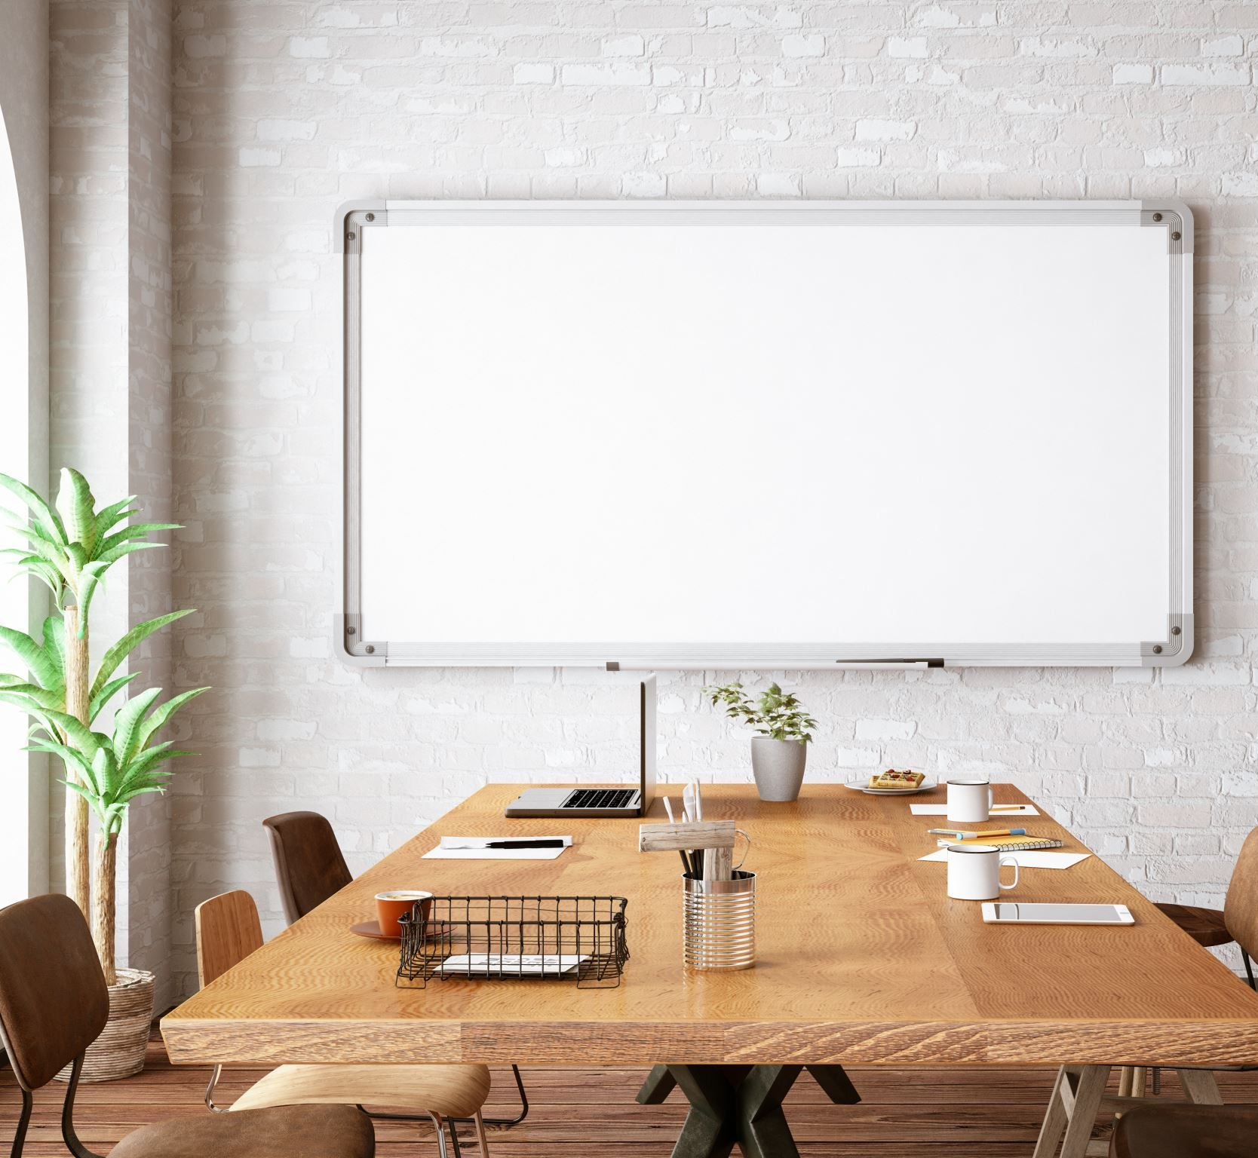
Presentation tools
Created by Iryna Zhukevych
PhD in Pedagogical Sciences
Associate Professor

Slide 2
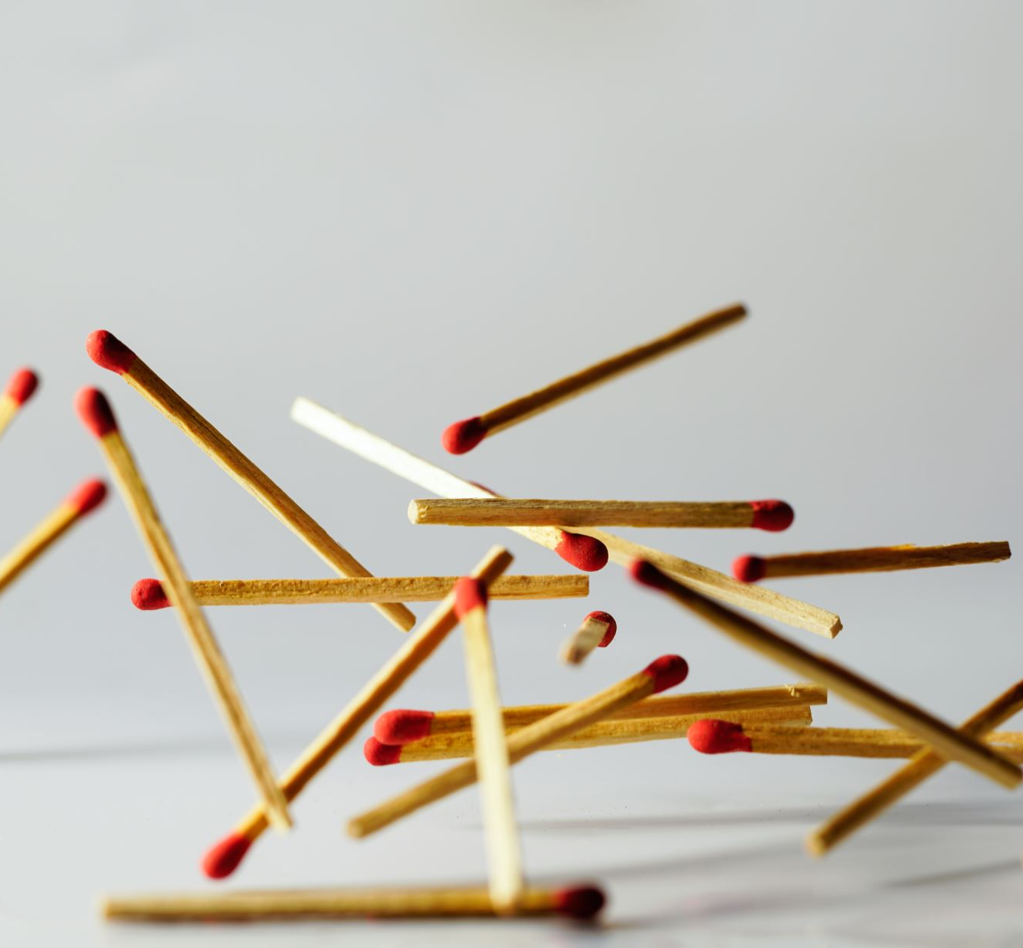
An effective presentation matches the message to the audience, matches the content and delivery to the purpose, and is delivered clearly and engagingly.

Slide 3

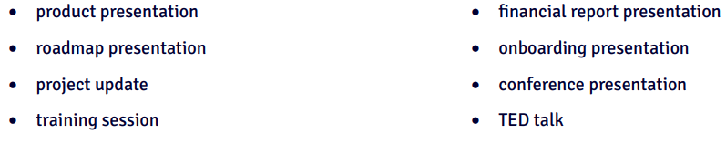
Look at the list of presentations and think about one you have seen recently. Name three things you remember from it.

Slide 4

Discuss the following questions
How often do you listen to other people’s presentations?
How often do you give presentations? How do you feel about presenting something? Have you ever done it in English?
How do you prepare for a presentation? Do you have any tips or tools for creating a great presentation?
What are the key elements of a successful presentation?

Slide 5
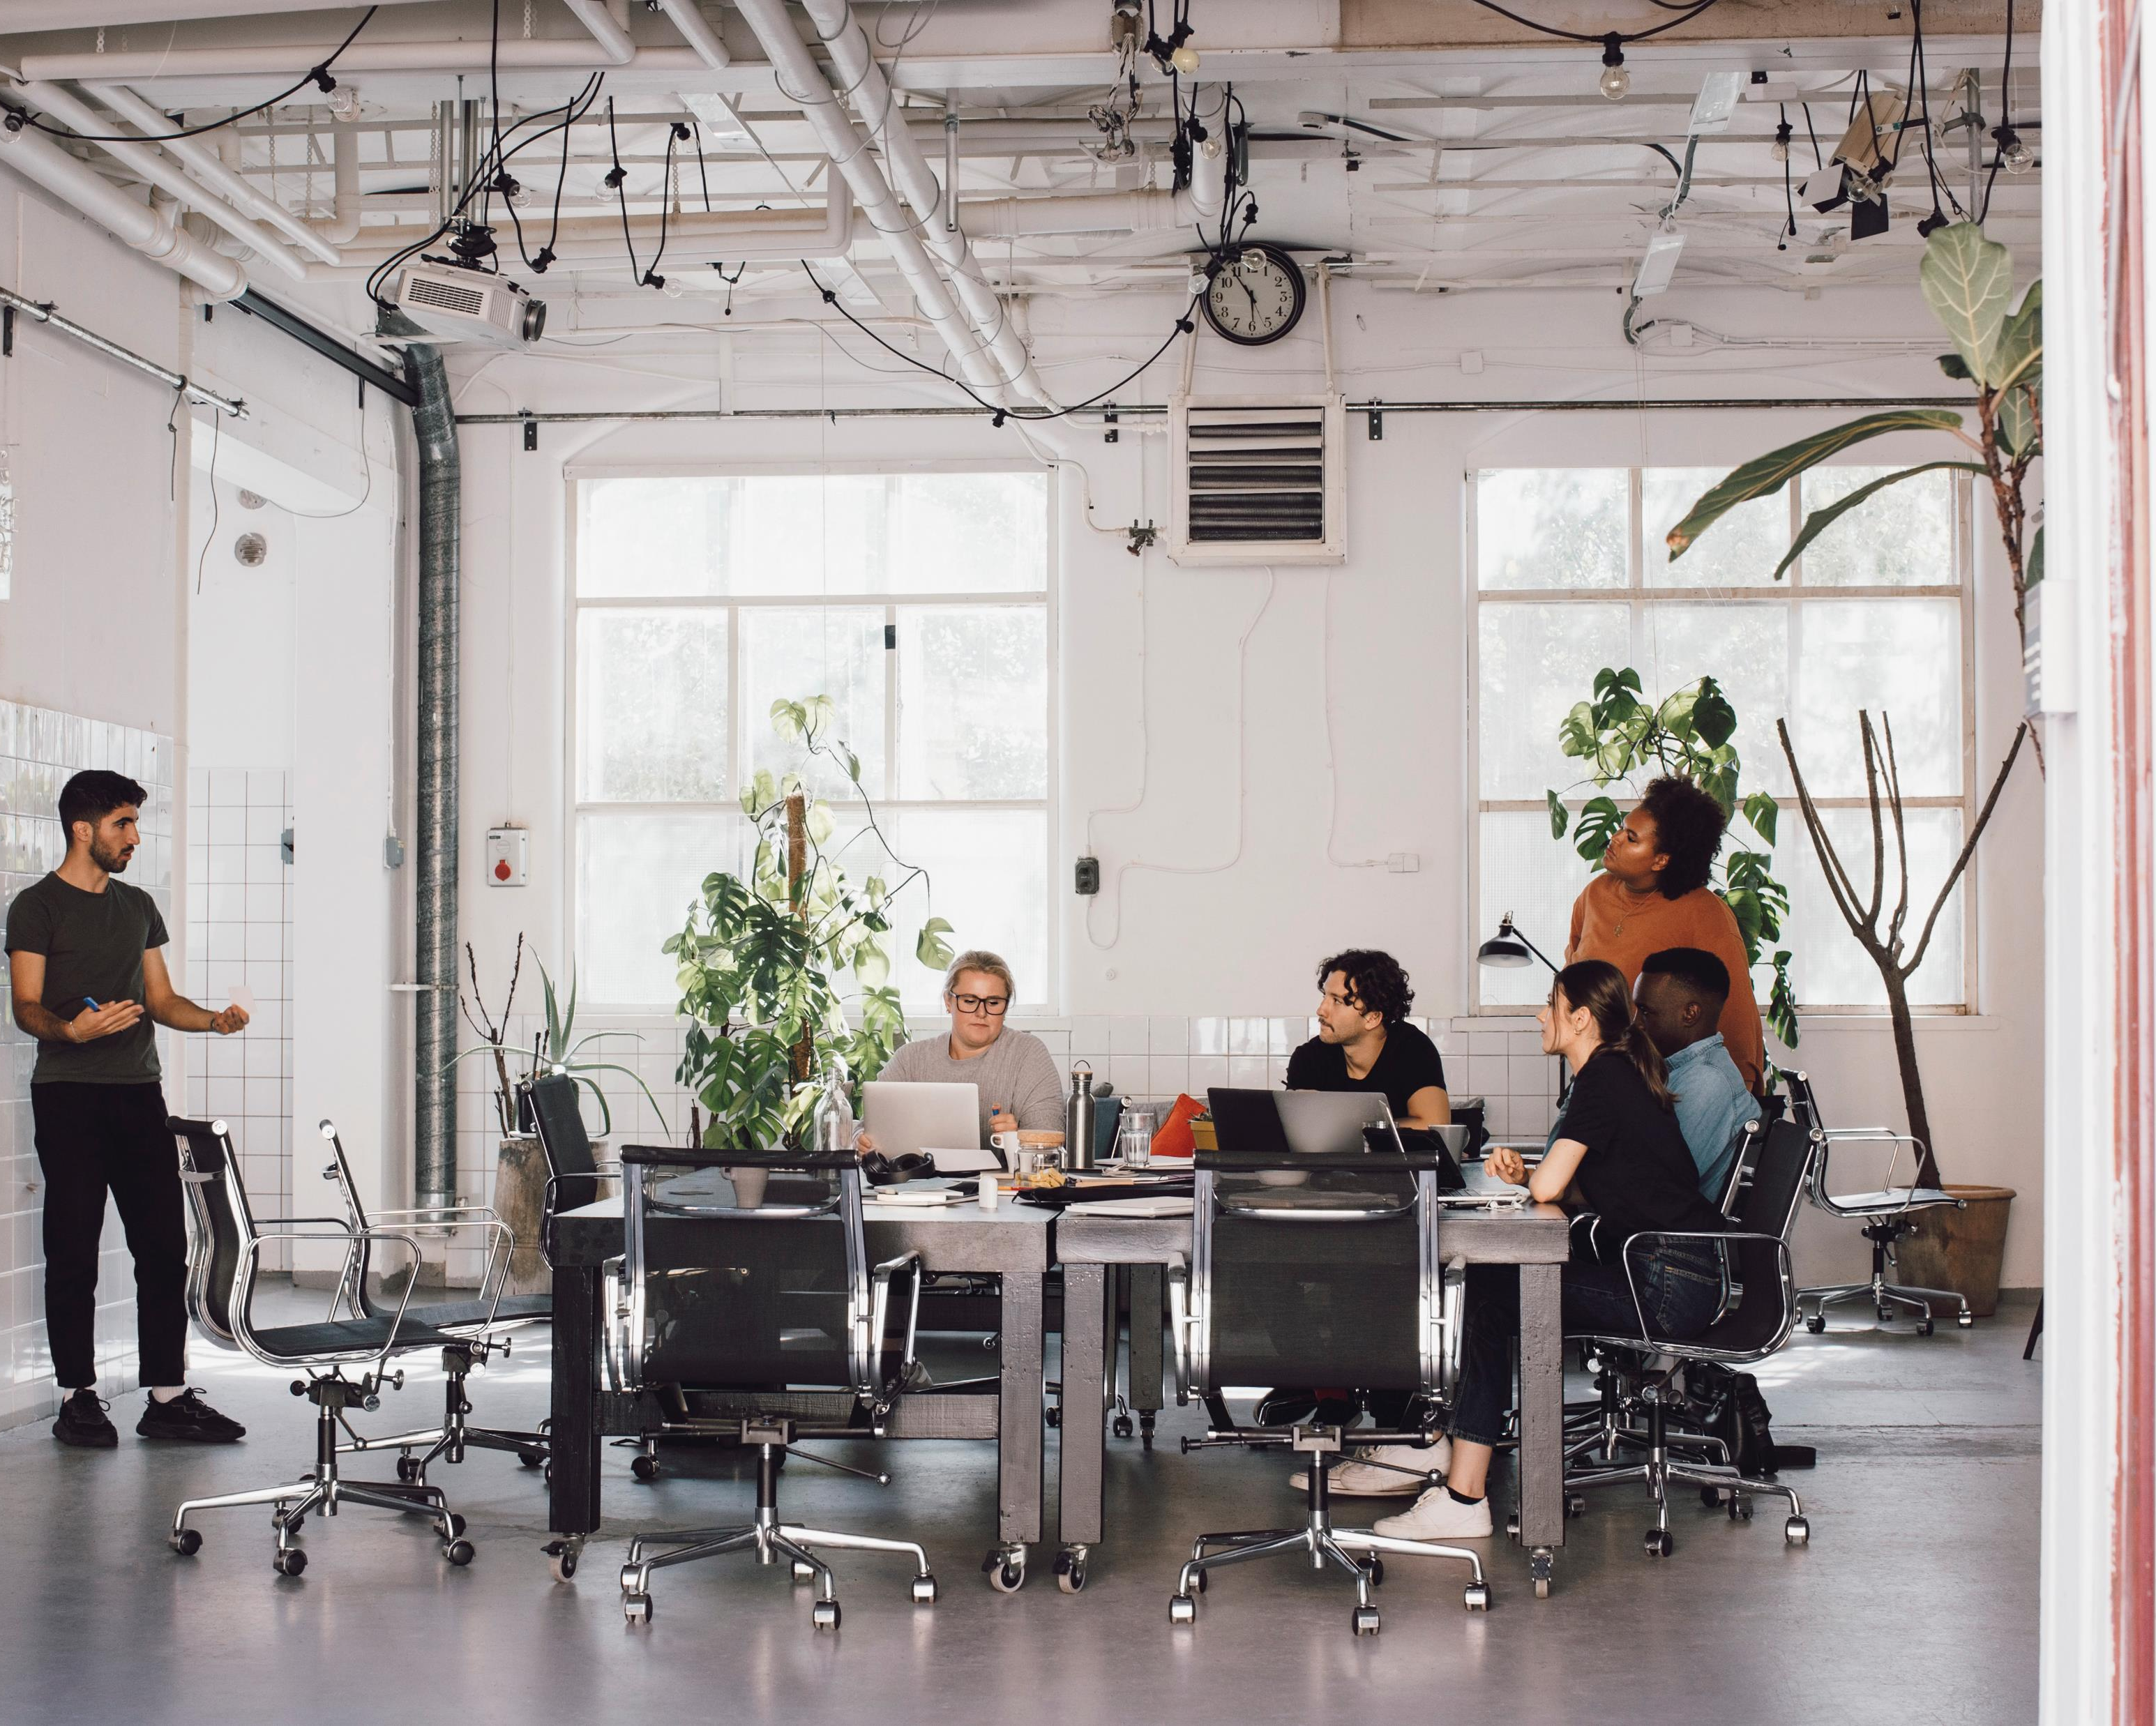
Exploring Presentation Tools
https://app.almanack.ai/resources/670d702d9d8c67824fde9a7c

Slide 6

10 best presentation tools of 2024
https://www.mentimeter.com/blog/meetings/best-free-presentation-tool

Slide 7
Watch the video “4 FREE Tools to Improve Your Next Presentation” and discuss the questions below
https://www.youtube.com/watch?v=5c9SapE_YNU

Slide 8
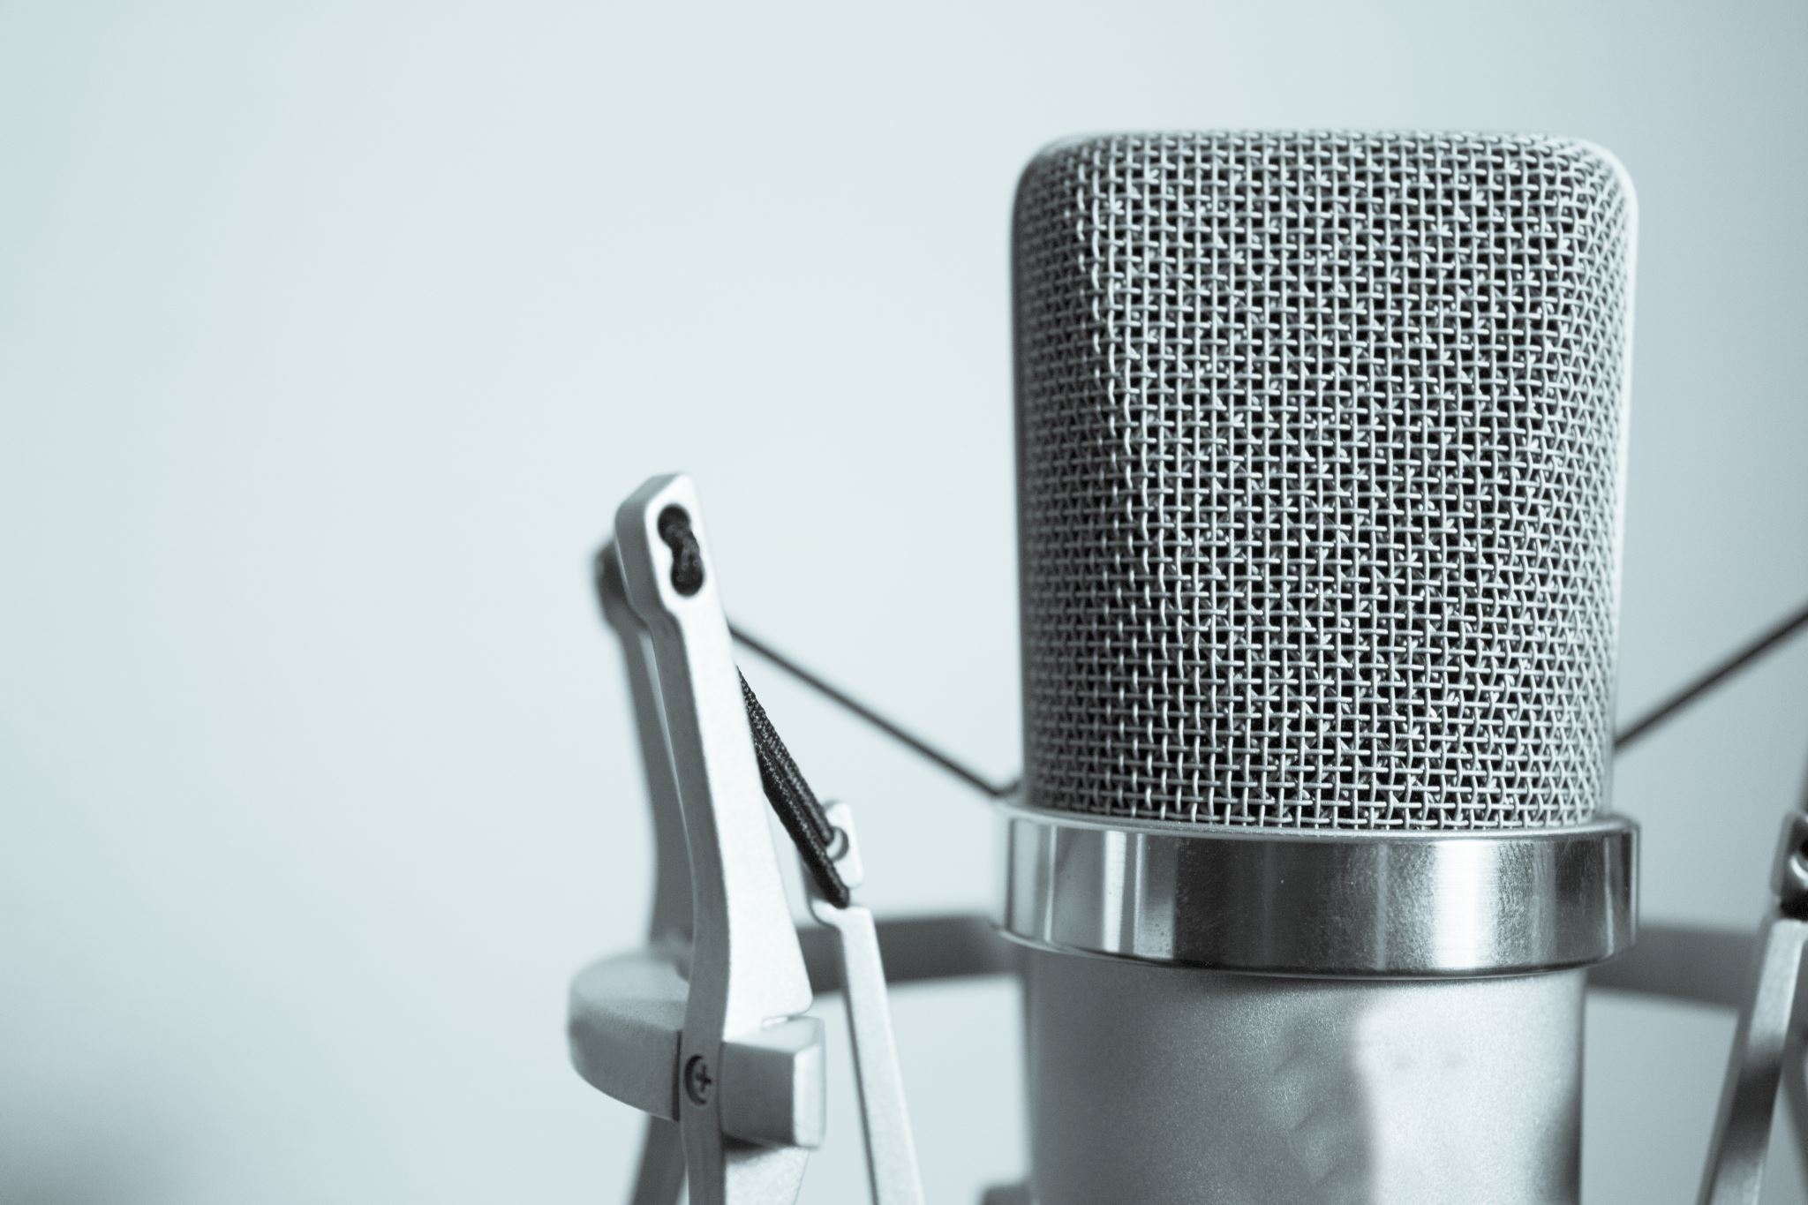
1. Describe the primary tools mentioned in the video for enhancing presentations.
2. Explain how the speaker transitioned from using Google Images to other resources. What impact did this have on their presentations?
3. What are the benefits of using templates from SlidesCarnival, as discussed in the video?
4. How does the speaker recommend customizing a chosen template for a presentation? Provide specific steps mentioned.
5. Discuss the importance of adhering to brand guidelines when creating presentations, as highlighted in the video.
6. What alternative websites does the speaker suggest for sourcing high-quality images and icons? List at least two.
7. What is the significance of using unique fonts in presentations, and how can viewers access new font ideas according to the speaker?

Slide 9
Quiz
https://app.almanack.ai/resources/670d706f11147e82b0d06897

Slide 10

Thanks for your attention and collaboration!

