Slide 1
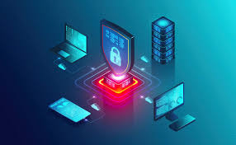
Introduction to Cybersecurity and Information Protection

Slide 2
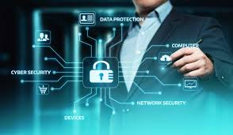
Activity: "How Safe Are You Online?"
Answer the question: "Have you ever faced a cyber threat (e.g., phishing, hacking)?"
Discuss real-world cybersecurity incidents (e.g., data breaches, ransomware attacks).
Discussion Prompt: "Why do companies and individuals need strong cybersecurity measures?"

Slide 3
Key Terms & Basic Definitions
Cybersecurity: The practice of protecting computer systems, networks, and data from cyber threats.
Information Security: Ensuring data confidentiality, integrity, and availability (CIA triad).
Phishing: A cyber attack that tricks users into providing sensitive information.
Ransomware: Malicious software that encrypts data and demands payment for its release.
Firewall: A security system that monitors and controls incoming/outgoing traffic.
Encryption: The process of converting data into a secure, unreadable format.
Ethical Hacking: The practice of legally testing security systems for vulnerabilities.
Zero-Day Attack: A cyber attack that exploits unknown vulnerabilities.
Multi-Factor Authentication (MFA): A security process requiring multiple forms of verification.
Social Engineering: Manipulating people to gain access to confidential information.
3. Discussion Questions (15 minutes)

Slide 4
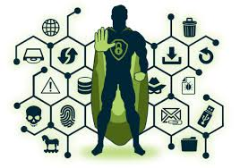
Discussion Questions
Why is cybersecurity more important today than ever before?
What are the biggest cyber threats faced by businesses and individuals?
How does encryption protect sensitive information?
Why do hackers target government and corporate systems?
What ethical dilemmas exist in ethical hacking and cybersecurity laws?

Slide 5
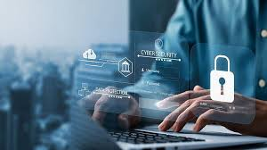
Speaking Topics
"The Most Dangerous Cyber Threats in the Digital Age"
"The Role of Ethical Hackers in Cybersecurity"
"How AI is Changing Cybersecurity and Cybercrime"
"The Importance of Personal Data Protection"
"Why Cybersecurity Laws and Regulations Matter"

Slide 6

Advantages & Disadvantages of Cybersecurity
Advantages | Disadvantages
Protects sensitive data from cyber threats | High costs of cybersecurity tools and professionals
Ensures business continuity and prevents downtime | Security updates can slow down systems
Builds trust in online transactions and communications | No system is 100% secure
Prevents financial and reputational damage | Increased complexity for users (e.g., MFA, strong passwords)

Slide 7
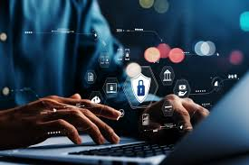
Task: "Cybersecurity Attack & Defense Simulation"
Form teams: one acts as cyber attackers, the other as defenders.
Steps:
Attackers create a cyber threat scenario (e.g., phishing, ransomware).
Defenders propose countermeasures (e.g., encryption, firewalls, MFA).
Present strategies and discuss which defense methods work best.

Slide 8
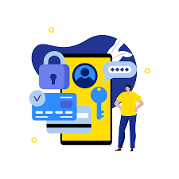
Conclusion & Reflection
Final Thought: "Cybersecurity is not just a technical issue but a critical part of protecting individuals, businesses, and nations."
Exit Ticket:
One new concept learned today.
One cybersecurity area they want to explore further.

