Slide 1

Future developments in international banking
Created by Iryna Zhukevych
PhD in Pedagogical Sciences
Associate Professor

Slide 2

Let's Answer the Following Questions!
How is technology transforming international banking transactions?
What role is artificial intelligence playing in the banking industry?
Why are more financial institutions incorporating ESG criteria into their investment strategies?
How are international banks expanding their mobile banking services?
What is the purpose of the evolving regulatory landscape in the banking industry?
What are some of the key factors driving the changes in the world of international banking?
What potential benefits can customers expect from the upcoming changes in international banking?

Slide 3
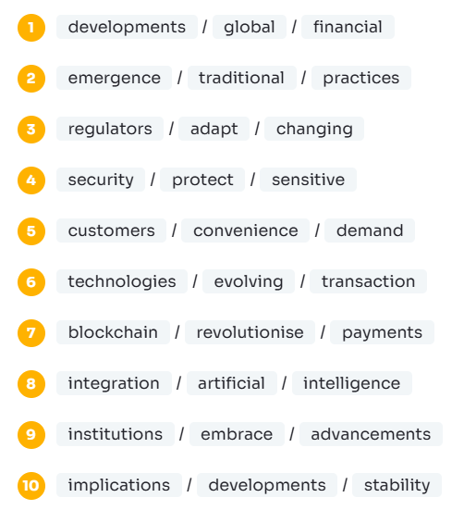
Make Sentences from These Words!

Slide 4
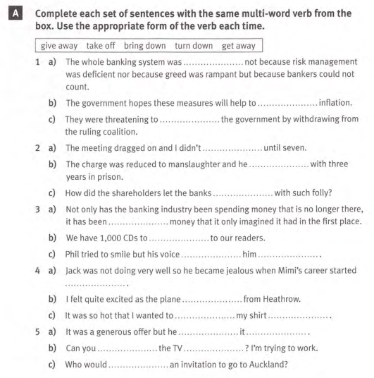

Slide 5
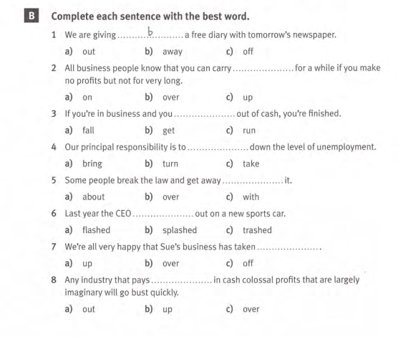

Slide 6
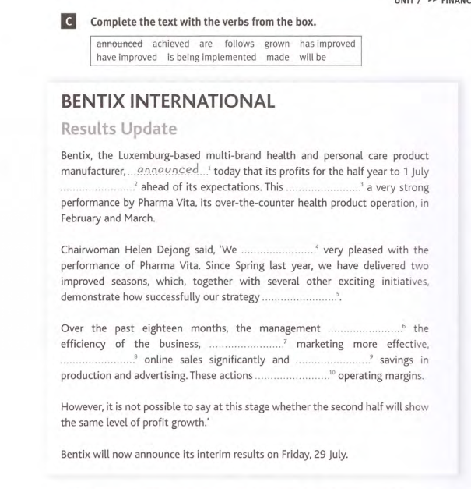

Slide 7

Speaking Cards
https://wordwall.net/resource/86689203

Slide 8
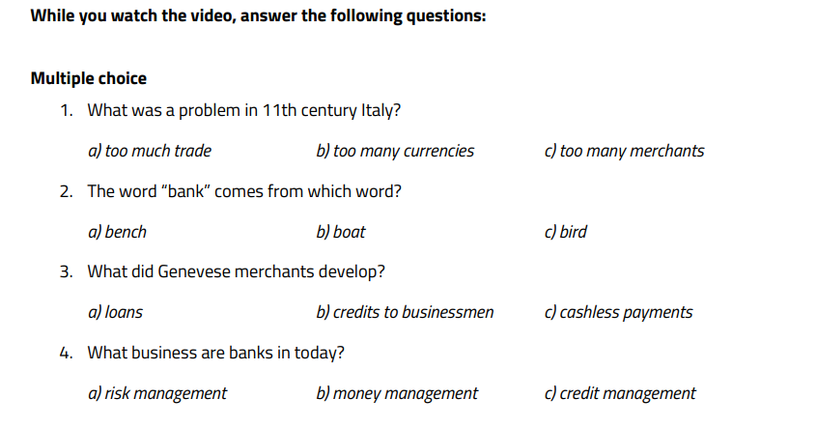
You are going to watch a video by Kurzgesagt – In a Nutshell called “Banking Explained – Money and Credit.” https://www.youtube.com/watch?v=fTTGALaRZoc

Slide 9
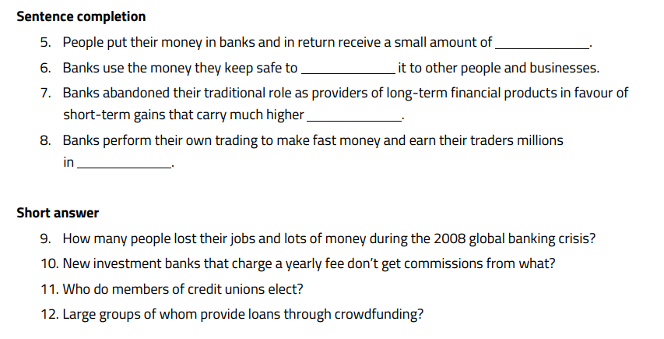

Slide 10
Discuss in small groups
The different services offered by banks.
Problems people can have when banking.
Whether banks can be trusted with our money.

