Slide 1

Innovation
Created by Iryna Zhukevych
PhD in Pedagogical Sciences
Associate Professor

Slide 2

“Creativity is thinking up new things. Innovation is doing new things.”
Theodore Levitt (1925 – 2006),
American economist and Harvard professor

Slide 3

Innovation Discussion
1.What is innovation?
2. Who is the most innovative person you can think of? What makes them so innovative? What qualities do they have?
3. Which are the most innovative companies? Why are they so innovative?
4. How innovative would you say you are?
5. How innovative is the company you work for?
6. What is the best idea you have ever had?
7. What innovative changes can you suggest for the place you work?
8. What innovations help you in your daily life? How would your life be different without these?

Slide 4

Watch a TED Talk by Adam Grant called “The surprising habits of original thinkers.”
https://www.youtube.com/watch?v=fxbCHn6gE3U

Slide 5
After watching activity.
Discuss the following questions:
1. When do you come up with your best ideas?
2. Do you tend to procrastinate, or do you prefer to complete your work well ahead of time? Where would you put yourself on the 'panic-monster to instant gratification monkey' scale?
3. When do you procrastinate the most? Why do you procrastinate? 4. Have you ever doubted an idea that you had? Was it self-doubt or idea-doubt?
5. What web browser do you use? Do you think this can determine your creativity? What else could be an indicator of someone’s creativity?
6. Do you agree that procrastination can help create better ideas?

Slide 6
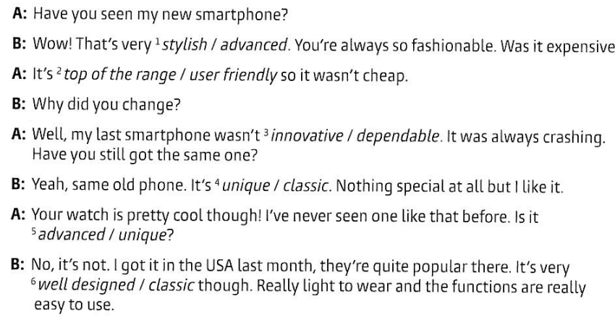
Describing innovative products.
Choose the correct opinion in italics.

Slide 7
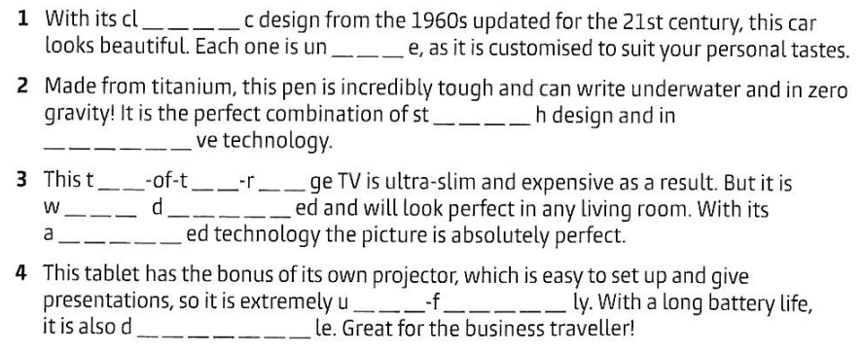
Complete the words in the text.

Slide 8

Speaking Cards
https://wordwall.net/resource/79182598

Slide 9

Watch the video and discuss the following questions
https://www.youtube.com/watch?v=nM8Yw8FX4Kw&t=40s
Why do we often accept pain and frustration in sports but not in learning?
What are the qualities of deep learning according to the speaker?
Why is deep learning effortful and intentional?
What kind of zone are you in during deep learning, and why is it uncertain?
How can experts and scaffolding help in deep learning?
Why does the speaker suggest that feeling frustration and negative emotions during learning can be beneficial?
What opportunities do educators design for students to help them develop resilience in learning?

Slide 10

Innovation in our everyday life
https://gamma.app/docs/Innovation-in-Our-Everyday-Life-8sorp00rcju2gll

