Slide 1
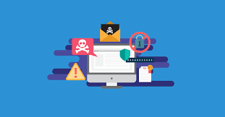
SECURITY AND PRIVACY

Slide 2

Warming-up Questions
Have you ever experienced a security breach or privacy issue (e.g., a hacked account)? How did it make you feel?
Why do you think security and privacy are important in today’s digital age?

Slide 3
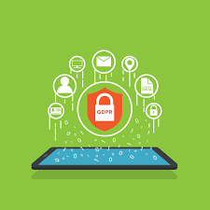
Key Terms
Security: Measures taken to protect systems and data from threats.
Privacy: The right to control how personal information is collected, used, and shared.
Encryption: Encoding data to prevent unauthorized access.
Data Breach: Unauthorized access to sensitive information.
Firewall: A security system that monitors and controls network traffic.

Slide 4
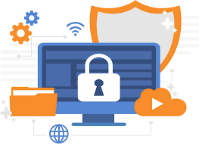
Speaking Questions
What steps do you take to protect your personal information online?
Can you think of examples where security and privacy might conflict?
How do businesses ensure customer privacy while maintaining robust security?

Slide 5

Discussion Questions
Should companies have access to user data to improve their services? Why or why not?
What are the ethical implications of monitoring employees' online activities?
How can individuals balance convenience and privacy when using technology?

Slide 6
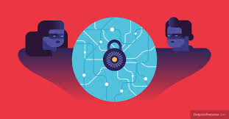
Advantages and Disadvantages
Advantages of Security and Privacy Measures:
Protects sensitive data from cyber threats.
Builds trust between organizations and users.
Reduces the risk of identity theft and fraud.
Disadvantages of Security and Privacy Measures:
May be costly to implement advanced security systems.
Overly strict measures can inconvenience users.
Balancing transparency with privacy can be challenging.

Slide 7
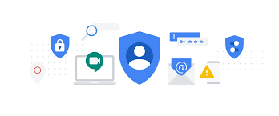
Task
Think of a privacy issue (e.g., phishing attack, data breach, or surveillance policy), discuss the problem and propose solutions.

Slide 8
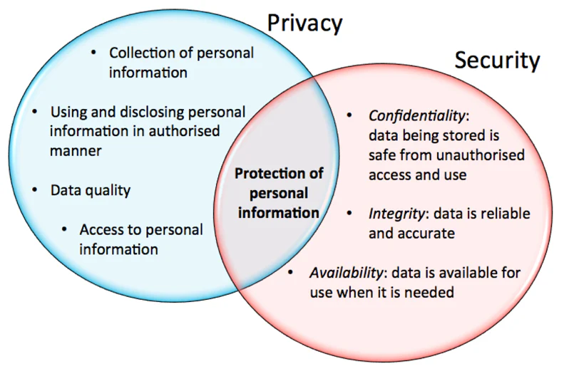
Conclusion
Recap: Security ensures protection from threats, while privacy safeguards personal rights. Both are critical in the digital age.
Takeaway: A balanced approach to security and privacy is necessary to build trust and maintain functionality.
Homework: Research a recent security breach or privacy issue and write a short report on what happened, its impact, and potential solutions.

