Slide 1

Emotions: that’s great news
Created by Iryna Zhukevych
PhD in Pedagogical Sciences
Associate Professor

Slide 2

Speaking cards
https://wordwall.net/resource/64968794/conversational-reactions-speaking-cards

Slide 3

Watch a short video showing a boss giving some news to his employees. Then discuss the questions below.
https://www.youtube.com/watch?v=vsLH70BrnnM
What news did the boss give his employees?
Why was his way of giving the bad news inappropriate? How could he have done it better?
When was the last time you had to give good or bad news? What happened?
Why can it be difficult to give good or bad news? What happened?
Why can it be difficult to give good or bad news to people?

Slide 4
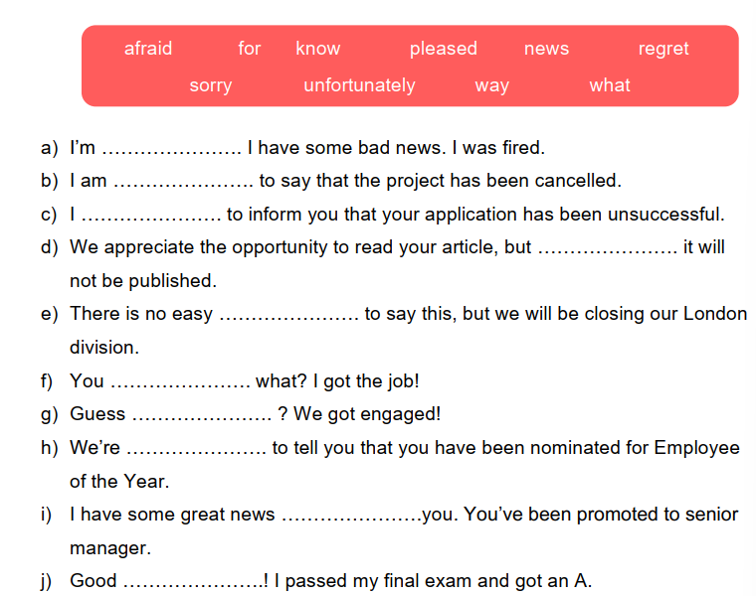
Complete the gaps with the words in the box.

Slide 5

Student A
You have got two tickets to a rock concert on Friday night. Invite Student B.
Student B
You have an important exam on Monday and would like to revise for it the whole weekend, but you are a great rock fan.

Slide 6
Student A
You are giving a birthday party at 6 pm on Saturday and invite Student B.
Student B
You must visit your grandma at the hospital, but you don’t want to miss the party. Promise to be at the party later.

Slide 7
Student A
You have bought a new house and want to invite Student B to see it.
Student B
You go on vacation for two weeks but promise to visit Student A when you get back.

Slide 8
Student A
You want to go clubbing at the weekend. Invite Student B.
Student B
You have just passed your exams, and you don’t want to stay at home. You don’t like clubbing.

Slide 9
Student A
You want to eat out. There is a new Thai restaurant in your town. Invite Student B for dinner.
Student B
You have never eaten Thai food but you like tasting new dishes. You are free on Monday evening.

Slide 10
Student A
You want to buy a new dress for a special party. Invite Student B to go shopping with you in the afternoon and help you choose the best.
Student B
You are crazy about shopping, but you have an appointment at your dentist.

