Slide 1
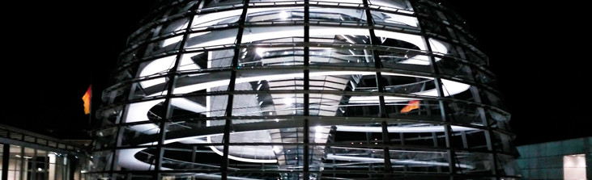
Introduction to Design Fields:
Overview of various design disciplines
Created by Iryna Zhukevych
PhD in Pedagogical Sciences
Associate Professor
Це фото; автор: Невідомий автор; ліцензія: CC BY-SA

Slide 2
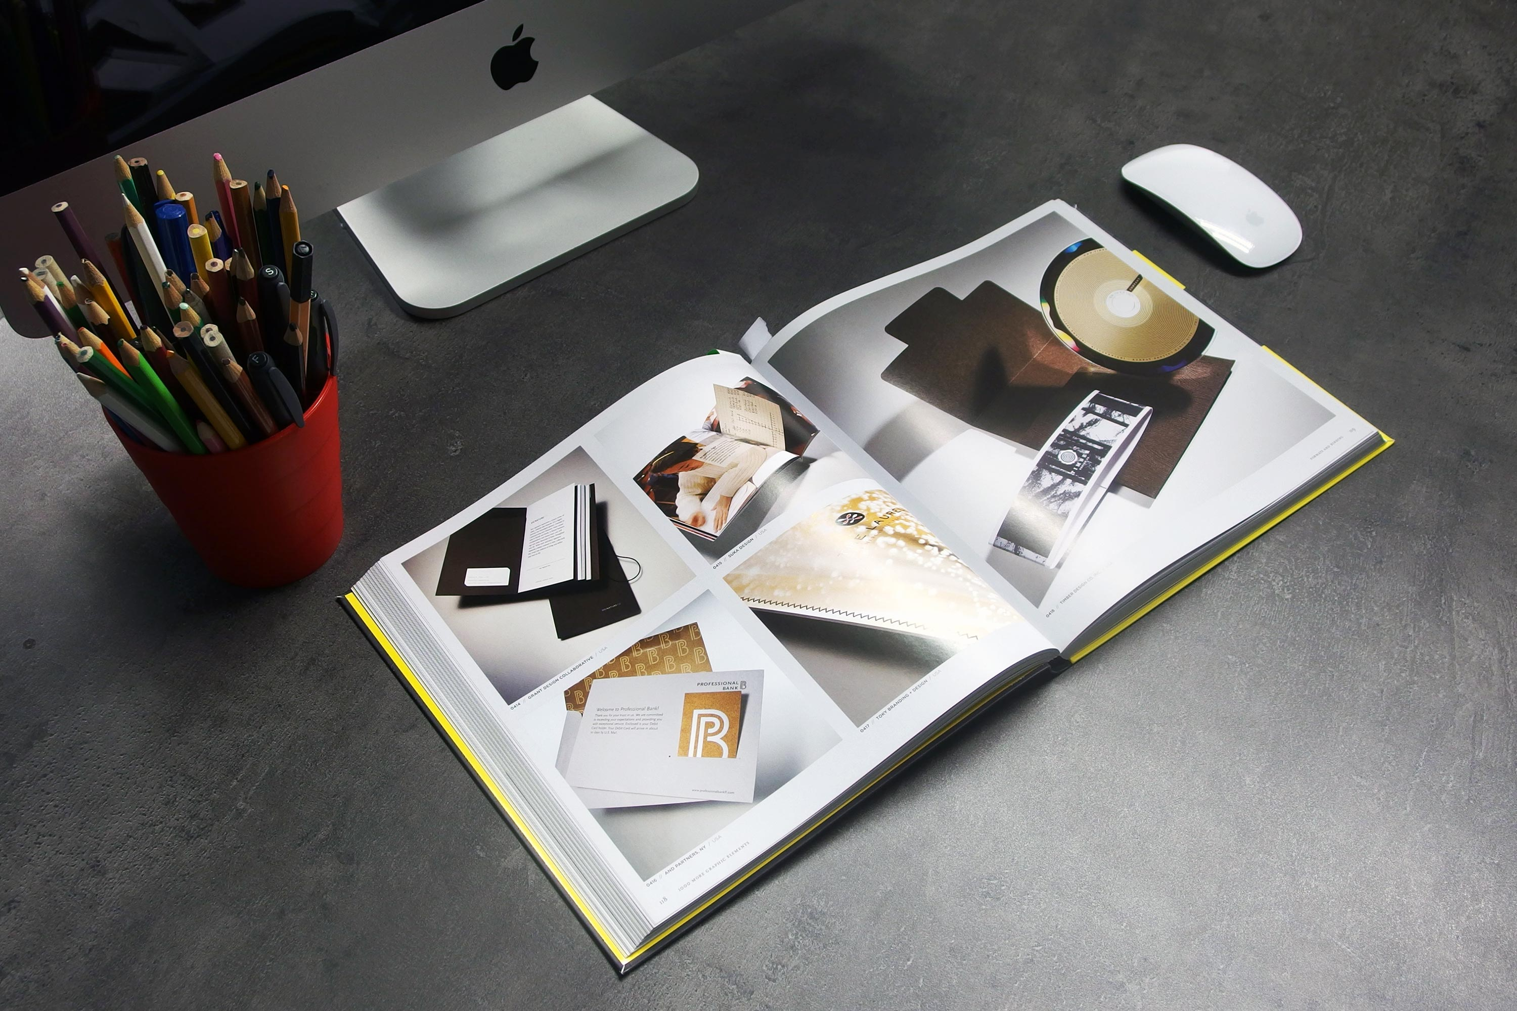
Reading. Design Disciplines
https://app.uxcel.com/courses/design-lingo/design-disciplines-terms-647

Slide 3
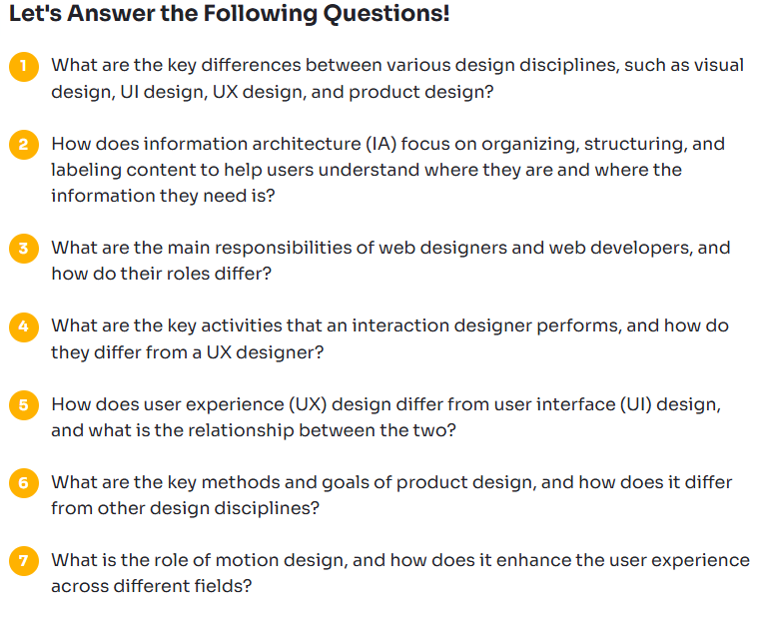

Slide 4
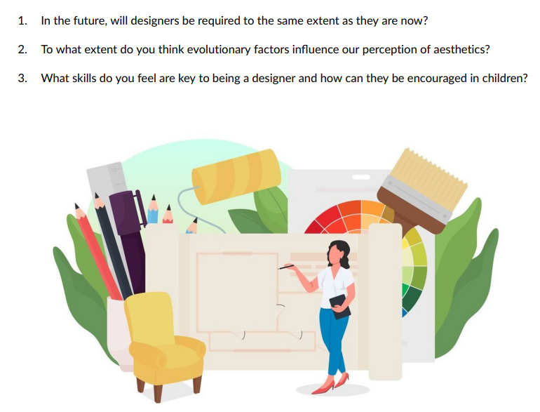
Discuss the following questions.

Slide 5
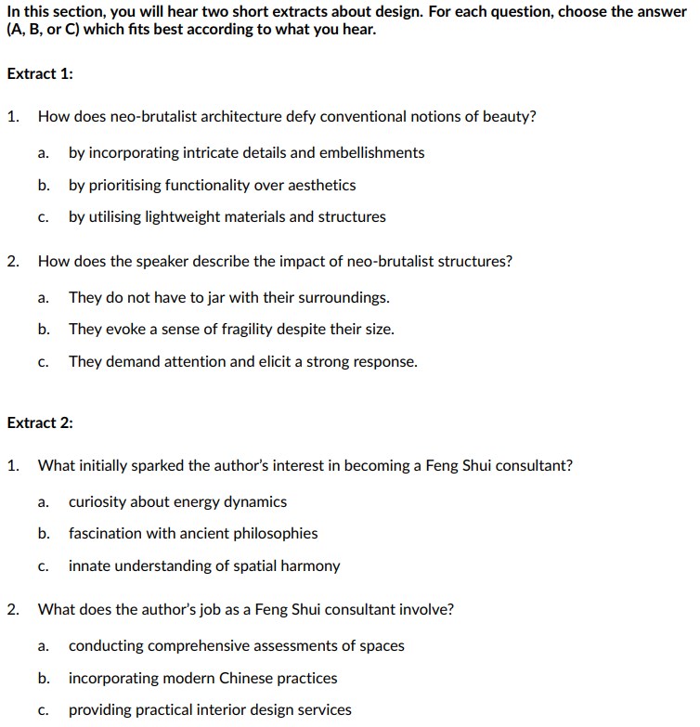
https://www.linguahouse.com/esl-lesson-plans/general-english/design/british/multimedia

Slide 6
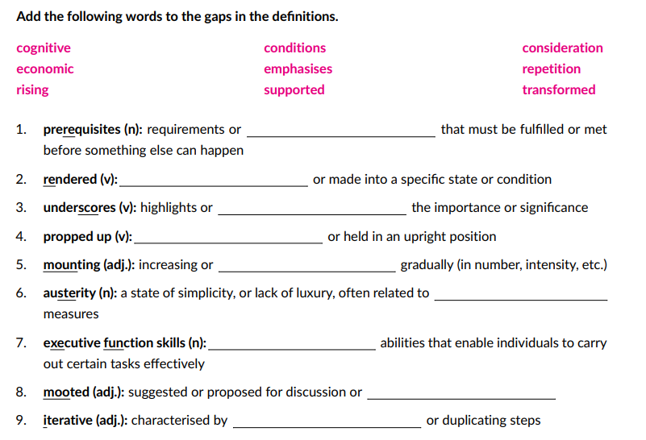

Slide 7

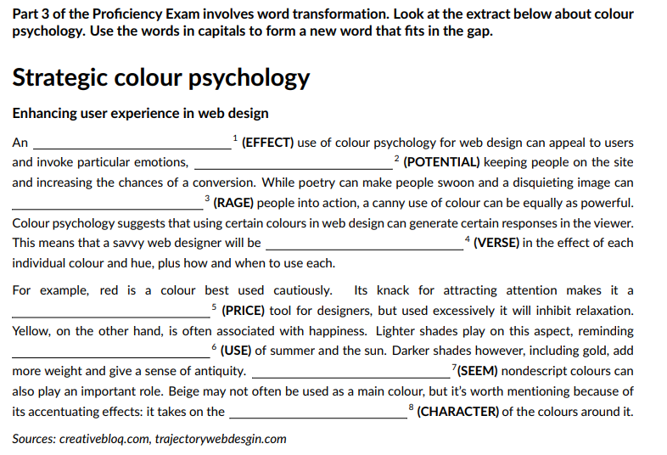
Це фото; автор: Невідомий автор; ліцензія: CC BY-SA-NC

Slide 8

Industrial Design Trends 2025
https://www.youtube.com/watch?v=kfU23zS_qVk
Watch the video and answer the questions below.
What are the key characteristics of the xenomorph trend in industrial design?
What is the significance of flowing surface breaks in product design?
How does perimeter text contribute to the overall design of a product?
What role do heavy line textures play in modern industrial design?
What impact do color trends like evil teenage engineering and retro combinations have on product design?

Slide 9
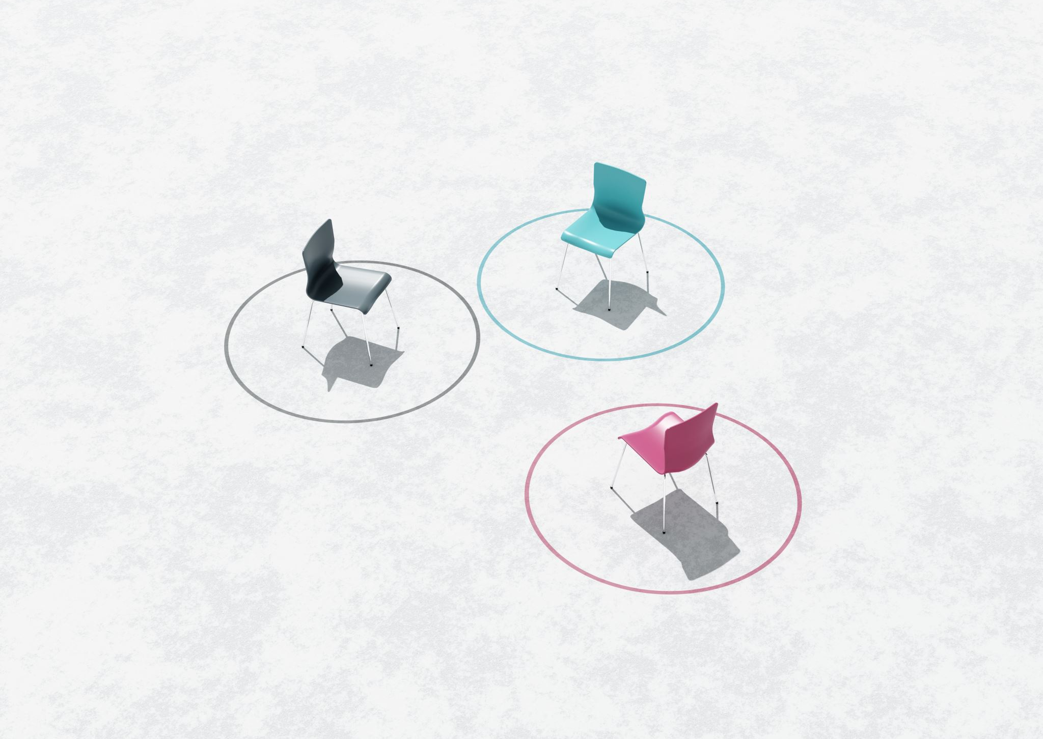
Match each tool/software to the correct design discipline.
https://wordwall.net/resource/90217386

Slide 10
SCENARIO 1.
If you are the Designer:
Choose your design discipline (e.g., fashion design, UX design, interior design, industrial design, graphic design, game design, etc.):
Discipline: ___________________________
Create a character:
Name: ___________________________________
Age: _______
Country/City: __________________________
Years of experience: _______
Famous projects: _______________________
Think about:
  Why did you choose this discipline?
  What’s your design process?
  What tools or software do you use?
  What inspires your work?
  What challenges do you face in your field?
If you are the Journalist:
Prepare 5–7 interview questions. Here are some examples to help you:
What inspired you to become a designer?
Can you describe your typical workday?
What’s your favorite project and why?
What advice would you give to future designers?
How do you stay creative or find inspiration?
What are the biggest trends in your field right now?
How does your work impact people’s lives?
Write your own questions.

Slide 11

Scenario 2.
In pairs, one student is a client, the other is a designer. The client needs a design for something (e.g., logo, room, website, outfit), and the designer must ask questions, suggest ideas, and explain their process.
Це фото; автор: Невідомий автор; ліцензія: CC BY

Slide 12

Scenario 3.
You are attending a design awards event.
Create a fictional designer who is nominated for an award in a specific field (e.g., Best Sustainable Fashion, Best App Design).
Nominee’s name, field, project name, and bio
Description of the winning project (tools used, inspiration, challenge)
Acceptance speech writing section
Optional: Dress code and roleplay awards show!

