Slide 1

Автор: Гаєва Поліна Олександрівна
Рік: 2024

Slide 2
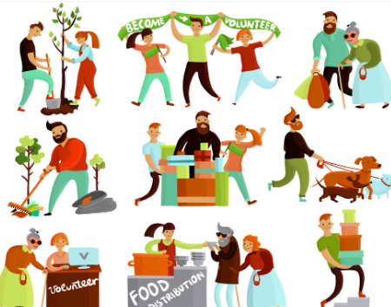
The other
The others
Other
Others
Another

Slide 3
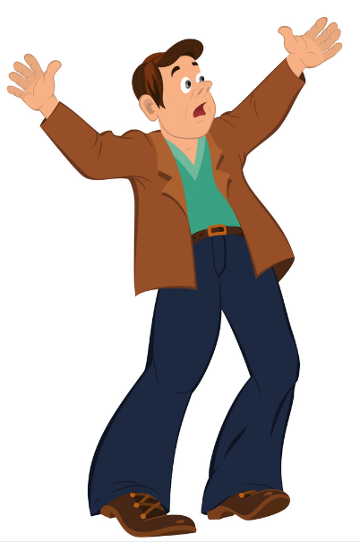


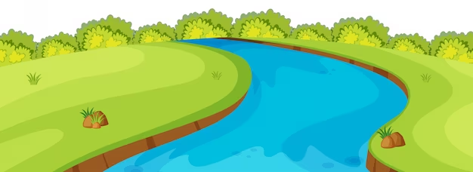
Use the other + singular noun to mean ‘the second of two things or people, or the opposite of a set of two
ON THE OTHER HAND
ON THE ONE HAND
THE OTHER BANK OF THE RIVER
ONE BANK
This computer here is new. The other computer is about five years old.
We could also say the other one instead of the other computer.

Slide 4
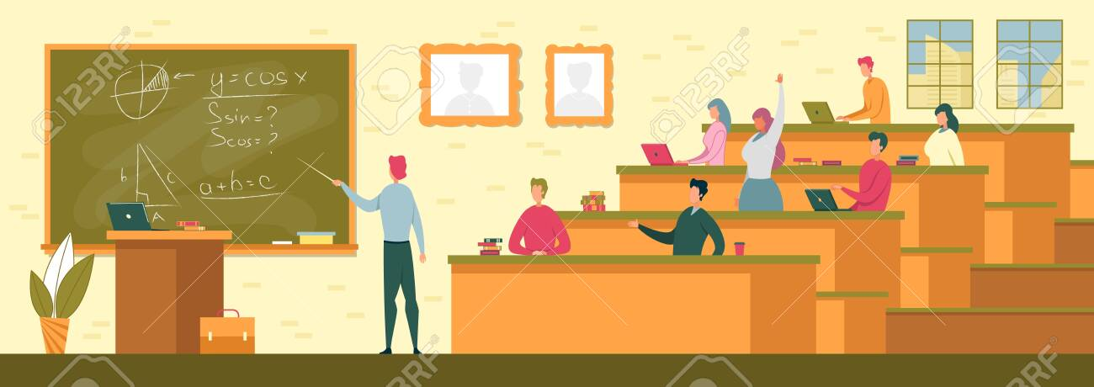
Use the other + plural noun to mean ‘the remaining people or things in a group or set’.
THERE ARE 10 STUDENTS IN MY CLASS.
7 STUDENTS ARE HERE.
WHERE ARE THE OTHER STUDENTS?
WHERE ARE THE OTHERS?

Slide 5
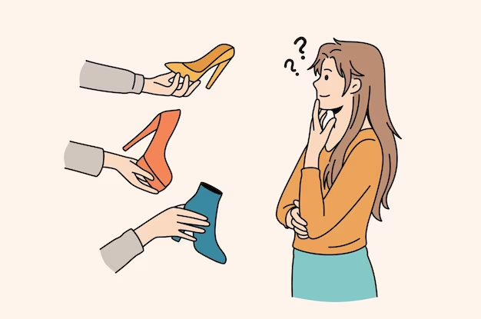
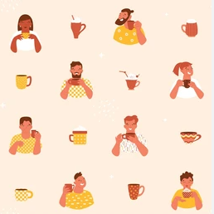
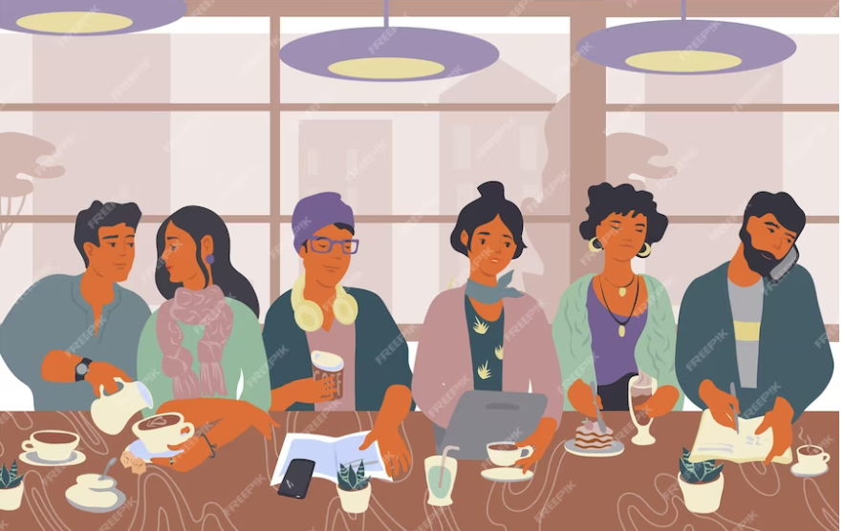
Other meaning:
- different/alternative;
- in addition to the ones already mentioned
THESE SHOES ARE TOO SMALL.
DO YOU HAVE ANY OTHER SHOES?
DO YOU HAVE ANY OTHERS?
SOME PEOPLE LIKE COFFEE, OTHER PEOPLE LIKE TEA.
OTHERS LIKE TEA.

Slide 6


When we use ‘an’ before ‘other’, we write it as one word: another. It means 'additional' or 'one more’. We use another with singular nouns
CAN I HAVE ANOTHER CUP OF COFFEE?
I’D LIKE TO HAVE ANOTHER 3 CUPS
ONE CUP
ANOTHER CUP

Slide 7
1. I have been to New Zealand, Australia and many ____________ countries.
a) other
b) another
c) others
2. I'd like _________beer, please.
a) other
b) others
c) another
3. Where is ___________ shoe? There is only this one in the shoe rack.
a) other
b) the other
c) another
4. I think you should see _________ people.
another
others
other
5. I've talked to Josh and Sarah, but I haven't talked to __________ students yet.
other
others
the other

Slide 8
6. He has two brothers. One is tall and handsome and ___________ is short and unattractive.
another
other
the other
7. Ask me ____________ question if you want. I know all the answers.
another
other
others
8. Forget about this now. We have _____________ problems.
others
other
another
9. Only two computers work, all the _____________ don’t.
another
other
others
10. Some people voted 'yes', some people voted 'no', and _____________ didn't vote.
others
other
another

Slide 9
11. I need ______ pen, this one doesn't work.
a. another
b. other
c. others
12. I like this bed; ______ is cheap but uncomfortable. Choose TWO correct options
a. other
b. the other bed
c. the other one
13. Thanks, these are some of the books I lent you, but where are ______ ones?
a. the other
b. the others
c. another
14. I don't like this jacket. Let me see ______.
a. other
b. the other one
c. anothers
15. The police caught two of the four prisoners who escaped and they are looking for ______.
a. other
b. others
c. the others

