Slide 1
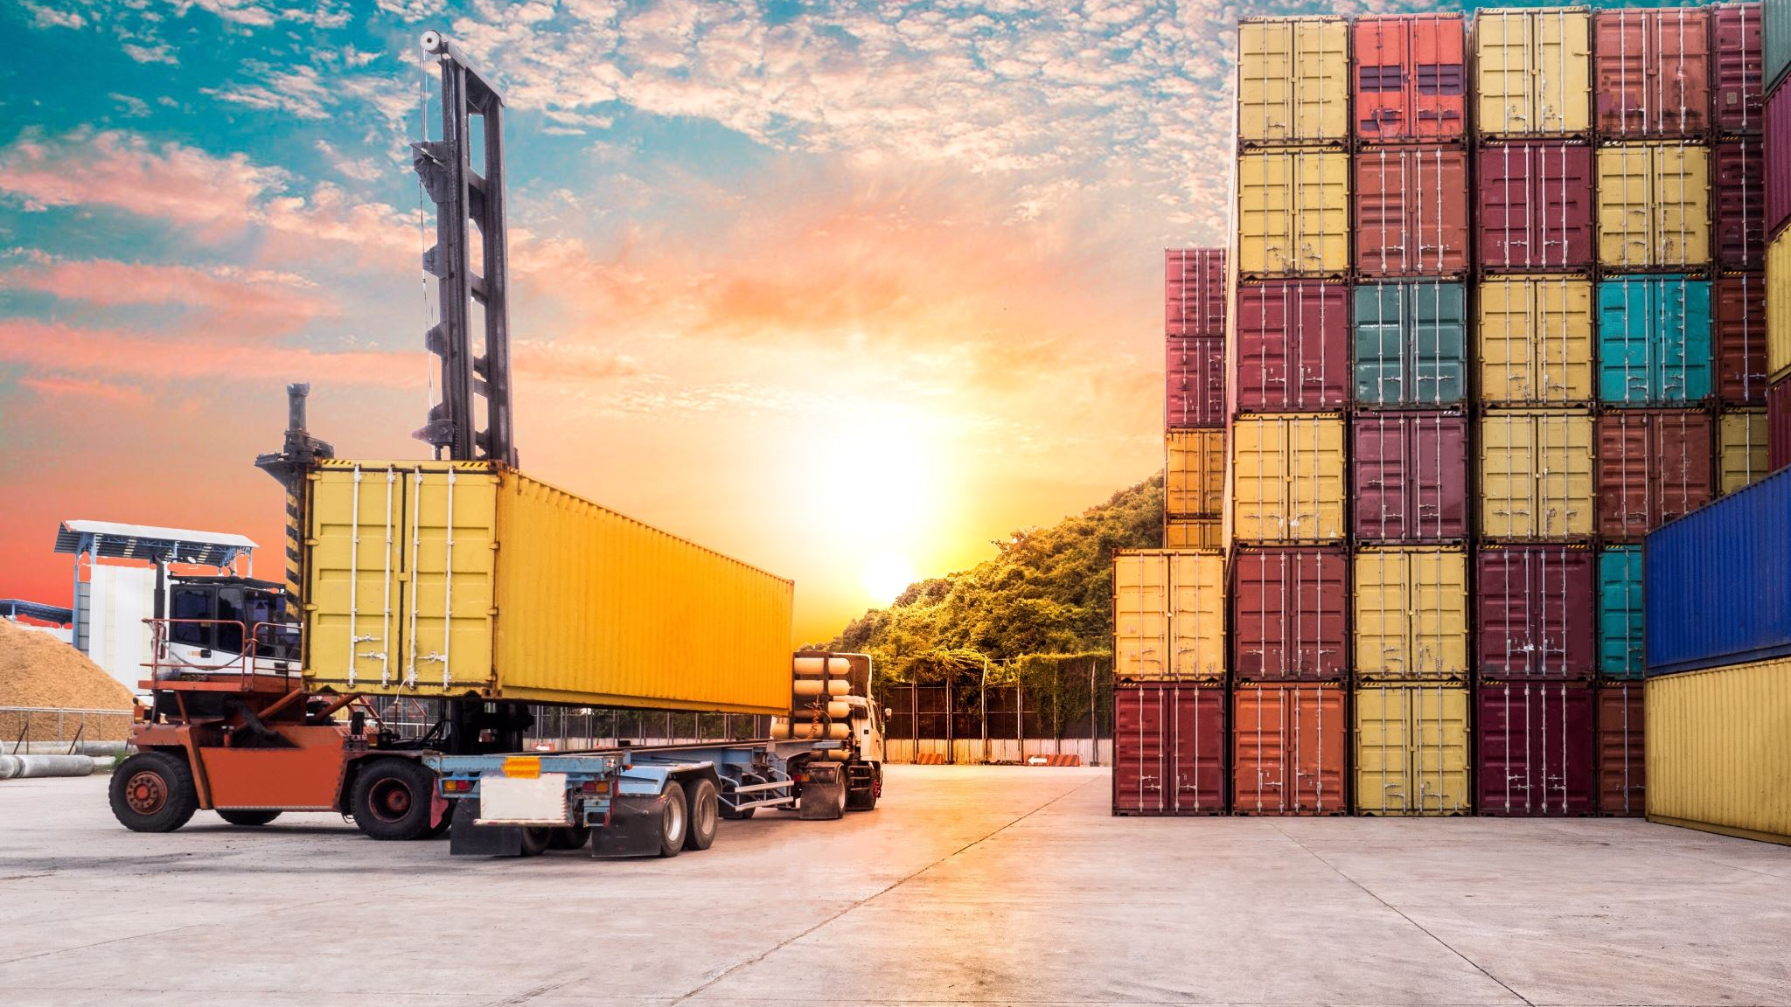
Logistics. Demand and supply
Created by Iryna Zhukevych
PhD in Pedagogical Sciences
Associate Professor

Slide 2
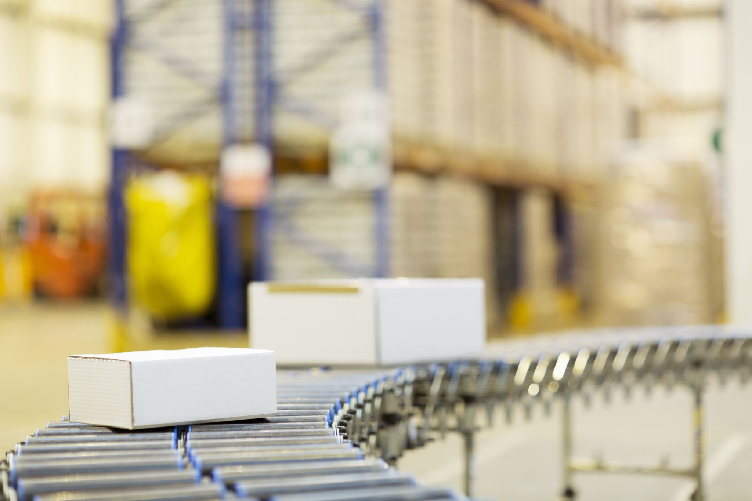
Logistics is planning and executing the efficient transportation and storage of goods from the point of origin to the point of consumption.
Logistics aims to meet customer requirements in a timely, cost-effective manner.

Slide 3

Discuss the statements
• I don’t think it’s fair to increase the price of taxi services when there’s a surge in demand.
• There is rarely a shortage of goods these days because companies do a good job predicting demand.
• I only buy things that are in stock. I don’t like to wait for my order for a long time.
• Automation in warehouses is not a good thing as it makes many people unemployed.
• There’s a high demand for IT professionals in my country.
• Excess of some goods is no better for the economy than shortage.

Slide 4
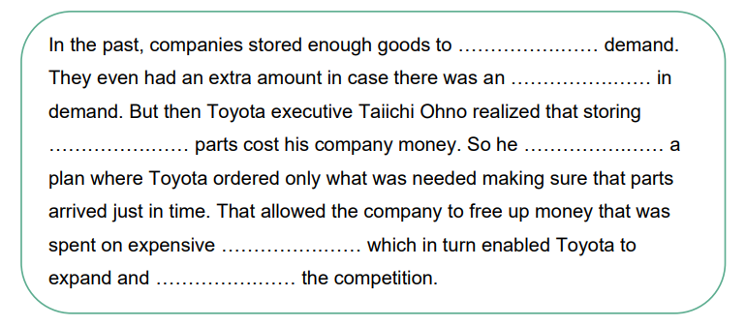
Read a story about Toyota and complete the gaps. Watch the first part of the video (to 01:21) and check your answers
https://www.youtube.com/watch?v=-PQEP3wdVo0

Slide 5
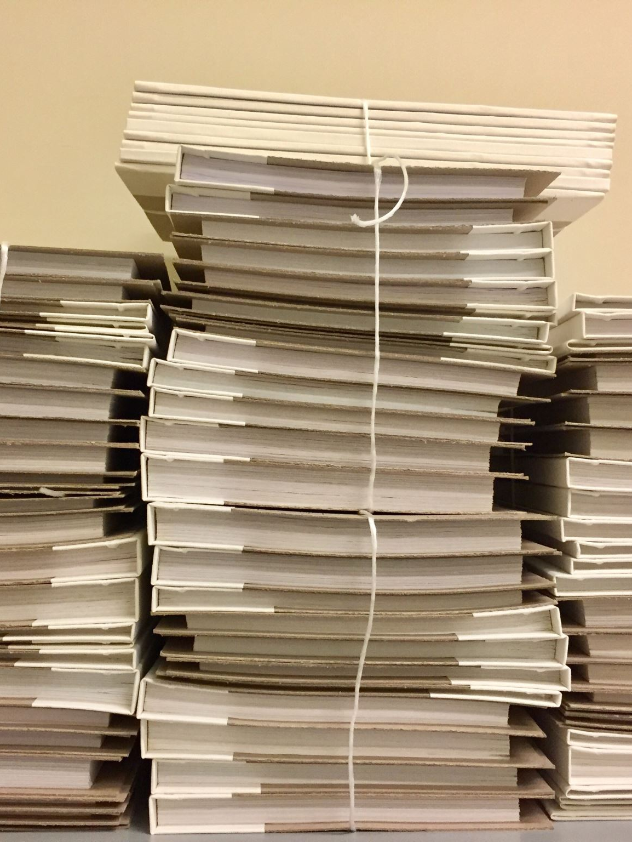
Watch the second part of the video (from 01:22 to 03:56) and answer the questions.
What are the two main things that make a just-in-time system fragile?
b) Why do shops run out of toilet paper quickly whenever there is a spike in demand?
c) Why are spending sprees problematic on a global scale?
d) What is an example of a just-in-time supply chain?
e) What are the two real examples of problems that occur in a supply chain?

Slide 6

Think about other areas of life where just-in-time systems might be problematic. Watch the third part of the video (from 03:57) and check your answers.

Slide 7

Discuss the questions
Have you heard about just-in-case and just-in-time systems before? Do you think changing from a just-in-case system to a just-in-time system is always a good idea?
Will companies ever return to just-in-case? Will the climate crisis be the main reason for it? Who should be responsible for the transition – manufacturers/businesses or governments?
Do you think a just-in-time system can be applied to areas of life other than manufacturing?
What has always been in demand in the place you live? Are manufacturers able to meet the demand? Have you ever experienced a shortage of some goods?
Think about a recent crisis in your country or anywhere else in the world (the pandemic, the economic crisis, etc.). Which goods had a surge in demand? Did they have excess supplies?

Slide 8
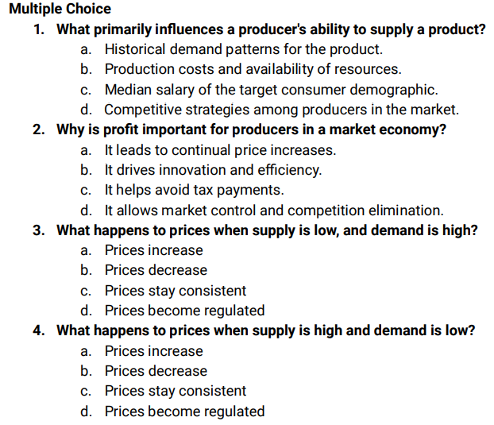
Watch the video and do the following exercise https://www.prageru.com/video/supply-and-demand

Slide 9

Think of a product that was extremely high in demand a few years ago. How have the demand and prices for that product changed to one another over the years?
Optional extension: research the price trends of the product you selected and document price changes over the years.

Slide 10

Game
https://wordwall.net/resource/78848499/logistics
https://quizlet.com/950608034/test?answerTermSides=2&promptTermSides=6&questionCount=20&questionTypes=4&showImages=true

