Slide 1
Warming-up activities Ph.D., Associate Professor, Department of English language for Humanities, FL, Igor Sikorsky Kyiv Polytechnic Institute

Slide 2
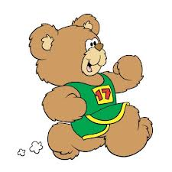
What is warming-up activity?
A warm-up activity is a short, fun game which a teacher can use with students. The purpose of a warm-up is to:
• encourage the students
• wake them up
• prepare them to learn by stimulating their minds
Warm-ups should last about 5 minutes.
Warm-ups are particularly useful:
• to help new students to get to know each other
• to mark the shift when students have finished learning about one topic before starting on a new topic

Slide 3

Tell me about me
● Bring in some things to class that have information about you (e.g. a book you like, pictures of you friends or relatives etc.).
● Give students different things of yours and tell them to build an idea of what you are like as a person.
● Then they do the same activity with each other (they can use the contents of their wallet or purse).

Slide 4
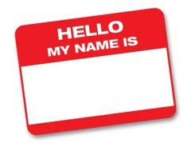
Who am I?
● The teacher prepares cards with famous people’s names on them.
● The teacher tapes one card on the back of each member.
● Student with the card asks other student questions with the answers ‘Yes’ or ‘No’.
● After the correct answer the next student starts asking questions.

Slide 5
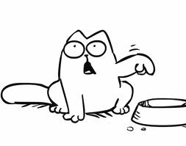
Guess who?
● You will need a hat (or some kind of a container) for this one.
● The students write one fact about themselves on a piece of paper; e.g. “I have a cat called Tom”, fold the pieces of paper up and put them into the hat.
● Students take turns to draw a piece of paper out of the hat and read it out.
● The group then has to guess who wrote it.

Slide 6

Clap!
● The teacher starts telling the story.
● After a few sentences teacher claps hands and asks a student to continue the story.
● After a few more sentences, the teacher claps hands again and asks another student to continue.
● For example, the students can make up a story about what kind of business they would like to start.

Slide 7

True or false
● On the board write three things about yourself. Two statements should be true and one false.
● For example: 1)I’m from Ukraine. 2)I have a cat. 3)I hate chocolate.
● Ask students to guess which is the false one.
● Students now do the same, writing three statements. Students read the statements aloud and the whole class guesses.
● It could be also the team game.

Slide 8

Funny holidays
● Use the cards.
● Students take a card in turn. If it says truth then they must tell a true story about a past holiday.
● If they choose card with a destination or holiday already on it, they must talk about an imaginary holiday they took there.
● Encourage them to make it as fanciful and detailed as possible.
● The group must guess which is true and which is false.

Slide 9
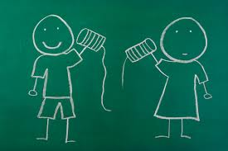
Broken telephone
● This is a listening and pronunciation activity that always gets people laughing.
● One student whisper a sentence or phrase to the person behind him/her (it is better to use tongue-twisters or idioms).
● The person then whispers what she heard to the next person.
● At the end of the chain last person must speak out loud the phrase.
● In a big group you can send the message two ways and find out which team comes closest to the real message.

Slide 10

Hot seat
● The group is split up into two teams.
● One member from each team sits facing the group.
● The teacher writes the word on the board for all of the team members to see except for the two players in the hot seats.
● The teams must try to get the person in the hot seat to guess the word or phrase.
● The first person to guess correctly gets to stand up and a new member from their team takes the hot seat.
● Warning! This is a loud game because people tend to get excited and yell!

Slide 11

Thank you for attention!

