Slide 1

Presentation. Describing Graphs and Charts
Created by Iryna Zhukevych
PhD in Pedagogical Sciences
Associate Professor

Slide 2
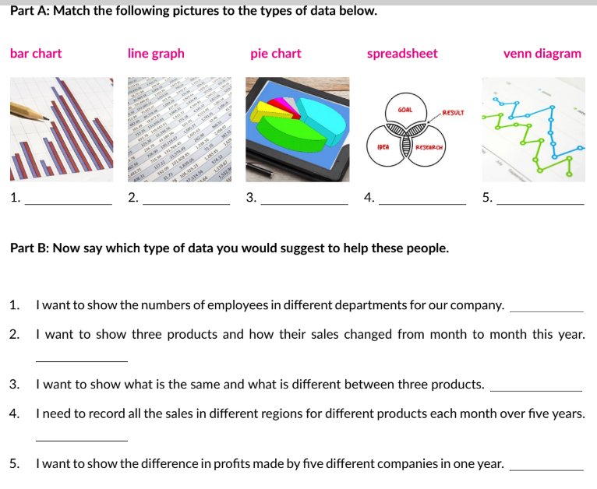

Slide 3

Describing charts
https://learnenglish.britishcouncil.org/skills/writing/b1-writing/describing-charts

Slide 4

Theory and Examples
https://www.slideserve.com/jerrig/describing-tables-charts-and-graphs-powerpoint-ppt-presentation

Slide 5
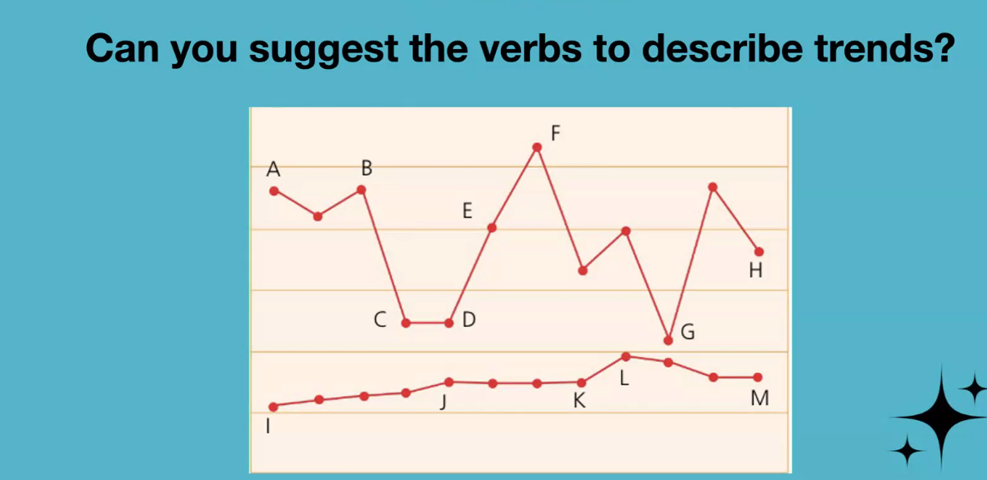

Slide 6
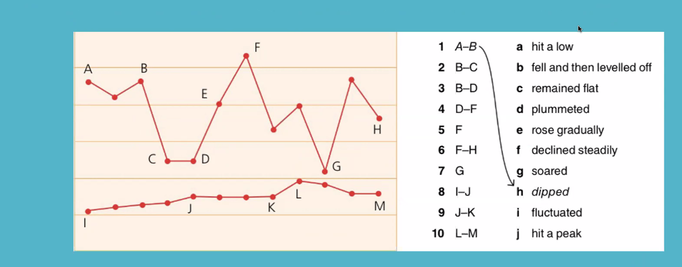

Slide 7
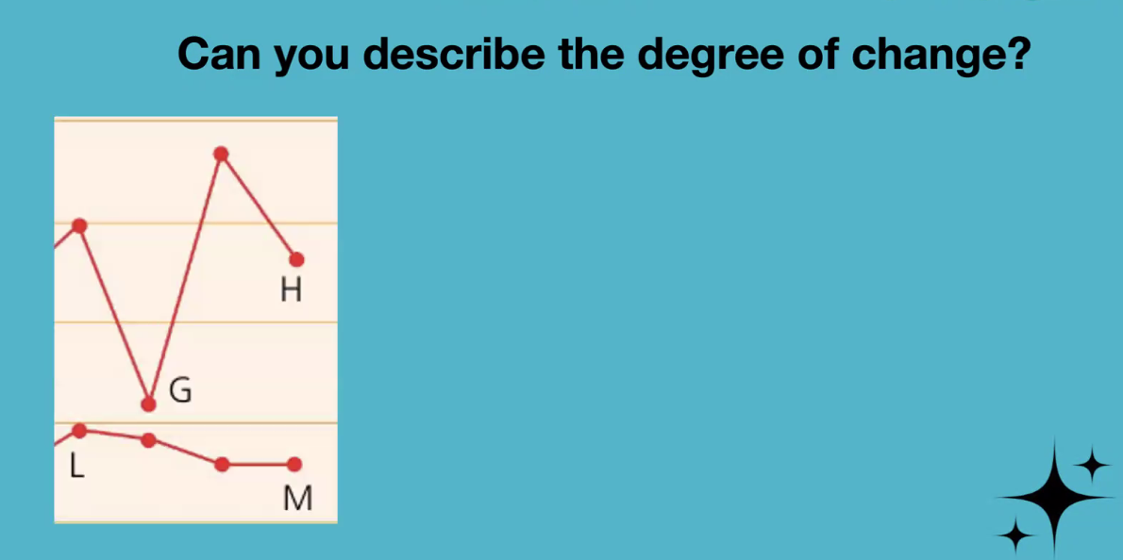

Slide 8
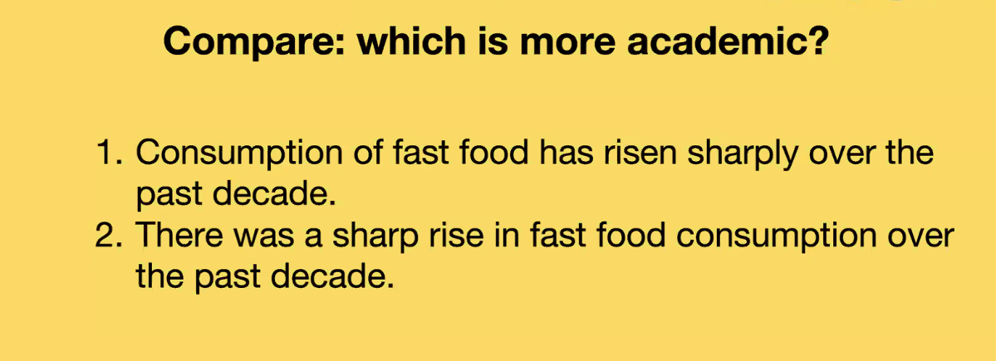

Slide 9
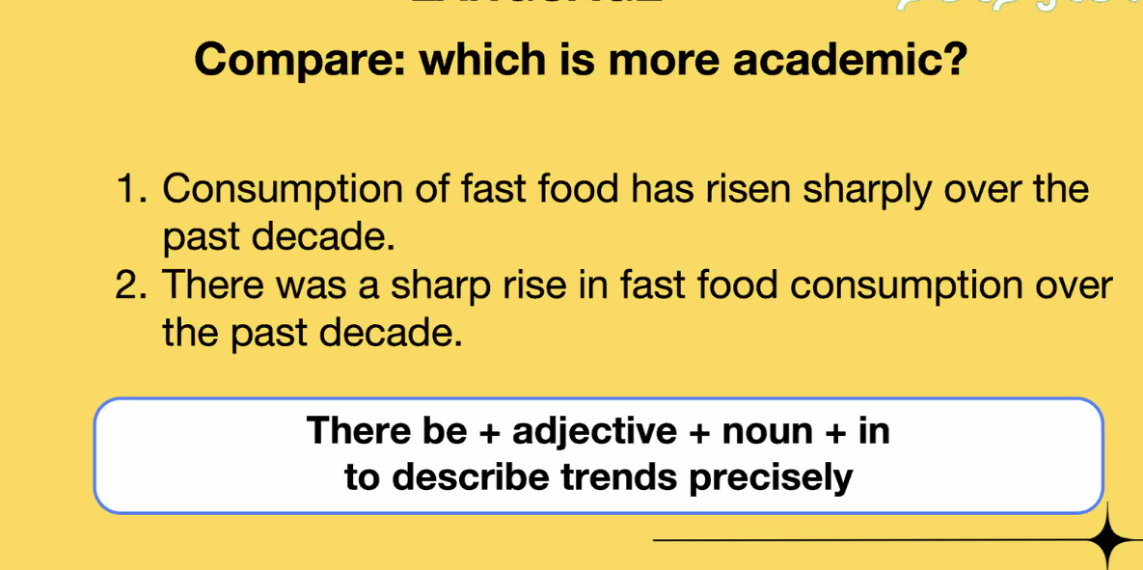

Slide 10
