Slide 1

Applications of Sociology and Psychology in Society
Created by Iryna Zhukevych
PhD in Pedagogical Sciences
Associate Professor

Slide 2
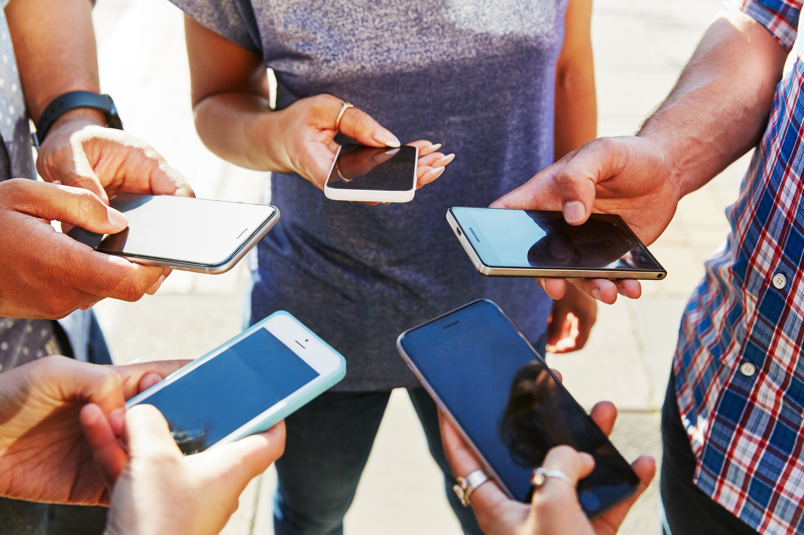
CAN SOCIAL MEDIA IMPACT OUR MENTAL HEALTH? DISCUSS.

Slide 3

Watch the video and discuss the questions below
https://www.youtube.com/watch?v=soHn6t_jjIw
Have you ever felt these stressors connected with your social media use?
How many hours per day, on average, would you say you spend on social media?
How many hours per day, on average, would you say you THINK about social media?
Do you feel like this time impacts your mental health/wellness?

Slide 4
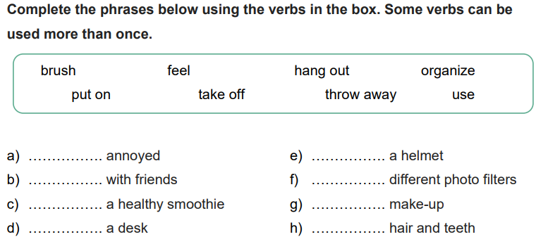

Slide 5

Discuss the questions
What do you think the message of this video is? Do you agree with it?
What negative results can the actions of the people in the video have?
Do any of these stories make you feel annoyed? If yes, which ones and why?

Slide 6

Read the statements about truth and lies on social media, choose one you agree with the most and explain your choice.
• Social media show our real lives, so people who lie in real life also lie on Instagram.
• It is boring to scroll through your Instagram feed and see people only showing their real lives and not using filters.
• There are enough great people on social media who show their lives the way they are, you just need to be careful about choosing who to follow.
• The only way to be honest about your life is to quit social media and share everything with people you trust.

Slide 7

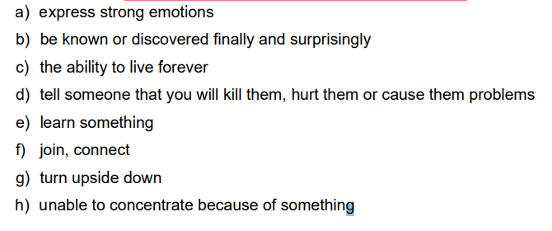
Match the words with the definitions.

Slide 8

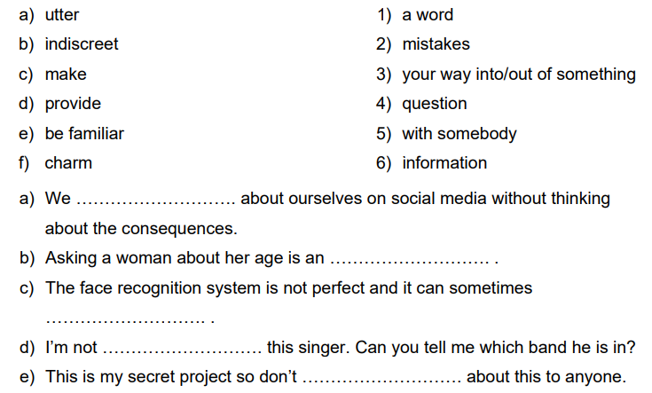
Match the words from the two columns to create collocations. Then, put them into the sentences below

Slide 9

Watch a video and answer the questions. https://www.youtube.com/watch?v=Fu1C-oBdsMM
What examples of electronic tattoos did the speaker mention?
b) What does the Facedeals camera do?
c) How does the speaker change Andy Warhol’s theory?
d) Which characters from Greek mythology did the speaker mention?
e) Who was Jorge Luis Borges?

Slide 10
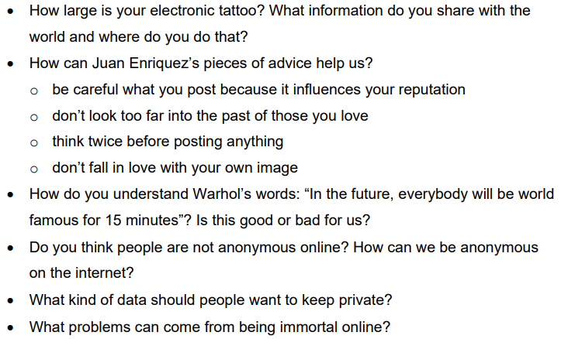
Discuss the questions

