Slide 1

Setting goals
Created by Iryna Zhukevych
PhD in Pedagogical Sciences
Associate Professor
Це фото; автор: Невідомий автор; ліцензія: CC BY-NC-ND

Slide 2

How to Talk About Your Goals and Dreams in English
https://www.youtube.com/watch?v=JS9KpbF_804&t=1s
Create three sentences based on phrases from native speakers in the video.
Це фото; автор: Невідомий автор; ліцензія: CC BY

Slide 3

Watch the video and do online exercises
https://en.islcollective.com/english-esl-video-lessons/listening-comprehension/deep-listening-focus-on-meaning/how-to-set-smart-goals-goal-setting-for-students/370503
Це фото; автор: Невідомий автор; ліцензія: CC BY-NC

Slide 4

Unlocking Your Potential Through Effective Goal Setting
https://app.almanack.ai/resources/673a56076bb0e7609a0c8c9d#gsc.tab=0&gsc.q=set%20goals

Slide 5
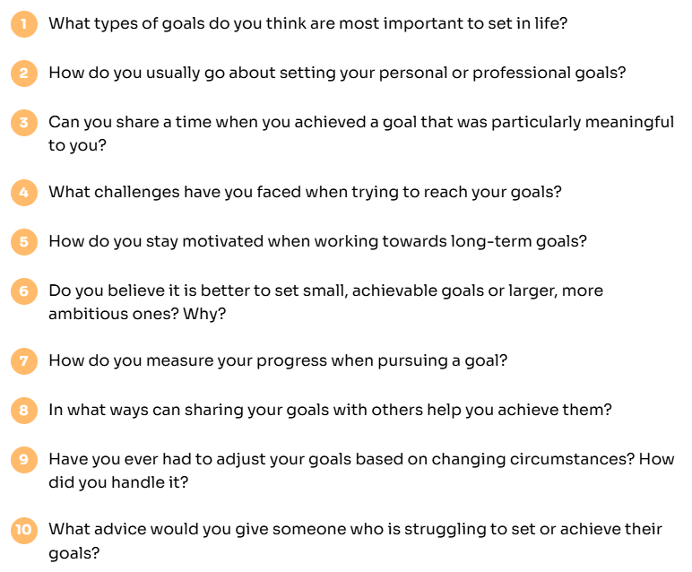

Discuss the following questions
Це фото; автор: Невідомий автор; ліцензія: CC BY

Slide 6
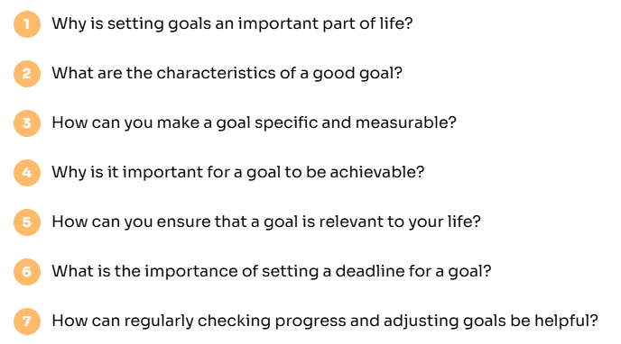

Let's Answer the Following Questions!
Це фото; автор: Невідомий автор; ліцензія: CC BY-NC

Slide 7

Watch the video and do online exercises
https://en.islcollective.com/english-esl-video-lessons/listening-comprehension/deep-listening-focus-on-meaning/a-student-changed-her-study-habits-by-setting-goals/242471

Slide 8

Some of the reasons for setting goals:
You take control of your life A goal is like a GPS in life. It gives you direction and helps you choose where to go in life. It makes you envision your ideal future and helps you turn it into reality. When you have achieved the goal, you improve your life and become a better version of yourself.
You focus on the important things Goals help us to sort out what is important and what isn’t. You will only focus on the things that you want to achieve and spend precious time on them.
You will make good decisions Goals help you identify and establish your priorities and make the right choices based on the long-term view of what is most important to you.
You can finish the task efficiently You will focus and concentrate your time and energy on the task. This will keep away all the distractions which will make you more efficient.
You will be self-confident and enthusiastic When you set a goal and measure the achievement, you are able to see what you have done and what you are capable of. This process of achieving goals gives you confidence, enthusiasm, and a belief in yourself.
You will make progress After you have achieved one goal, you will try to achieve higher goals. When you look back you will see all of the progress you have made.
You are closer to success Goals are the starting point of success. A good start makes for half the success.

Slide 9

The Goal-Setting Framework
Anyone Can Use
https://www.youtube.com/watch?v=859p85cbJAU
How important is self-care to you when pursuing your personal or professional goals?
Can you share a time when you had to adjust your plans or goals? What did you learn from that experience?

Slide 10

Motivational video
How To Master The Art Of GOALS SETTING
Millionaire Mindset of Brian Tracy
https://www.youtube.com/watch?v=UR2Evsj7OwE
Це фото; автор: Невідомий автор; ліцензія: CC BY-SA

