Slide 1
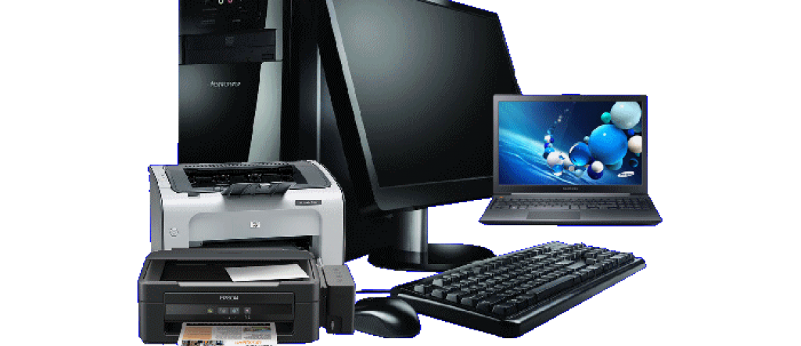
Це фото; автор: Невідомий автор; ліцензія: CC BY-NC
Understanding Computer Peripherals
Enhancing Computer Functionality

Slide 2
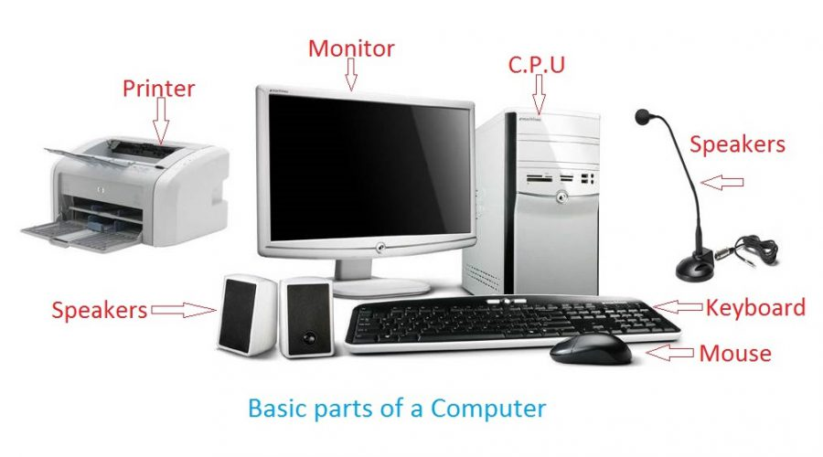
Watch the video “Computer parts vocabulary in English” and make up 3 sentences using vocabulary in it.
https://www.youtube.com/watch?app=desktop&v=8rW8FtecT1Q
Це фото; автор: Невідомий автор; ліцензія: CC BY

Slide 3

Types of Input Devices
Keyboard: Primary input device for text and commands.
Mouse: Facilitates navigation and interaction with graphical interfaces.
Scanner: Converts physical documents into digital format.

Slide 4

Types of Output Devices
Monitor: Displays visual output from the computer.
Printer: Produces hard copies of digital documents.
Speakers: Output audio signals for sound reproduction.

Slide 5

Types of Storage Devices
USB Drives: Portable storage for data transfer.
External Hard Drives: Provides additional storage capacity.
Cloud Storage: Online storage solutions for data accessibility.

Slide 6

Wired vs. Wireless Peripherals
Wired Peripherals: Reliable connection, no battery needed.
Wireless Peripherals: Greater mobility, less clutter.
Considerations: Latency, interference, and battery life.

Slide 7
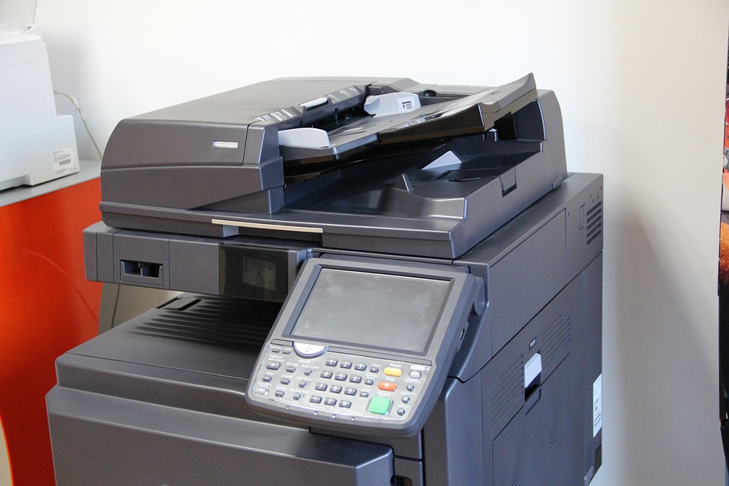
Watch the video and answer the questions below.
https://www.youtube.com/watch?v=f8pPbEk4OZ8
1
Who introduced the first printer in 1953?
2
How does a laser printer transfer text or images onto paper?
3
What is the working principle of Matrix printers?
4
Who conceived the idea of a scanner in 1957?
5
What are the different types of scanners mentioned in the video transcript?
6
How were data initially input into computers before keyboards were invented?
7
What are the three main keyboard layouts mentioned in the video transcript?

Slide 8

Peripheral Presentation
Choose a peripheral and prepare a short presentation on its uses and benefits. Include function, importance, and personal experience.

Slide 9
Questions and Discussion
https://wordwall.net/resource/80366618/peripherals

Slide 10
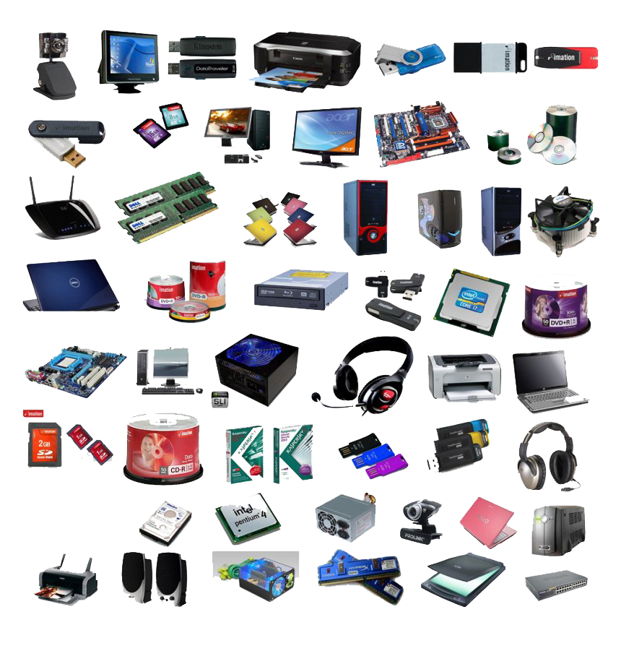
Imagine you are designing a new computer peripheral. Describe its function, target users, and how it would improve user experience. Consider both hardware and software aspects in your response.

