Slide 1
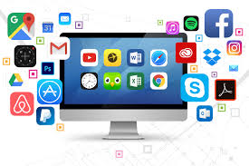
APPLICATION PROGRAMS

Slide 2
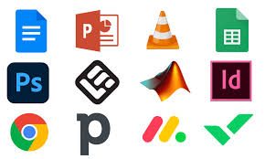
Warm-Up Activity
List 5 application programs you use daily.
Discuss their purpose and category (e.g., productivity, multimedia, security).
Discussion Prompt: "What makes an application useful or successful?"

Slide 3
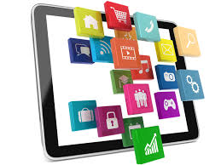
Key Terms & Basic Definitions
Application Program (Software): A program designed for a specific task, such as word processing, browsing, or gaming.
System Software: Software that manages hardware (e.g., OS, drivers).
Productivity Software: Applications that help with tasks (e.g., Microsoft Office, Google Docs).
Multimedia Software: Apps used for creating and viewing media (e.g., Photoshop, VLC Media Player).
Web Applications: Apps that run in a web browser (e.g., Gmail, Google Drive).
Mobile Applications: Apps specifically designed for smartphones/tablets.
Cloud-Based Applications: Software hosted on remote servers (e.g., Google Workspace, Dropbox).
Open-Source Software: Free software that users can modify (e.g., Linux, LibreOffice).
Proprietary Software: Software owned by companies with restrictions (e.g., Adobe Photoshop).
Software as a Service (SaaS): Apps accessed via the cloud on a subscription basis (e.g., Netflix, Microsoft 365).

Slide 4
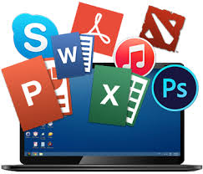
Discussion Questions
What are the main differences between application programs and system software?
How has cloud computing changed the way applications are developed and used?
What are some advantages of open-source software over proprietary software?
Why do companies prefer web applications instead of traditional desktop applications?
What security risks do users face when installing or using applications?

Slide 5
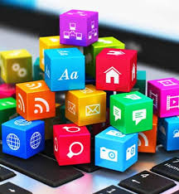
Speaking Topics
"The Importance of Cloud-Based Applications in Business"
"Web vs. Desktop Applications: Which is Better?"
"How Mobile Apps Are Changing Daily Life"
"The Role of AI in Modern Application Programs"
"Why Cybersecurity is Critical for Application Development"

Slide 6
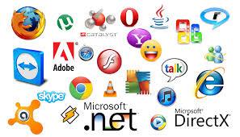
Advantages & Disadvantages of Application Programs
Advantages
Automates tasks for businesses and individuals
Can be customized based on user needs
Accessible via desktop, mobile, and cloud
Provides entertainment and multimedia capabilities
Increases efficiency and productivity
Disadvantages
Some apps require high system resources
Software updates may cause compatibility issues
Subscription-based services can be costly
Learning curves for complex applications
Privacy and data security risks

Slide 7

Creative Task: "Design an Application Program"
Imagine you are a software developer creating a new application.
Steps:
Define your app’s purpose and target users.
Decide whether it will be desktop, web, mobile, or cloud-based.
Sketch the user interface (UI) and describe key features.
Share your idea with the class.

Slide 8
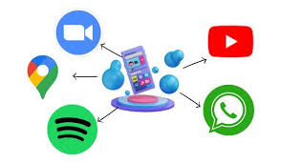
Conclusion & Reflection
Final Thought: "Application programs power the digital world, from entertainment to business solutions."

