Slide 1
Business meetings for esp students
Hanna Kolosova
Ph.D., Associate Professor, Department of English language for Humanities,
FL, Igor Sikorsky Kyiv Polytechnic Institute

Slide 2
What do you know about the business meetings?
1. All types of meetings, whether individual or group, are the modes of____.
A) external communication
B) internal communication
C) no communication
2. Effective ways to create new ideas are_________.
A) regular letters and presentations
B) individual or team meetings
C) constant email and text messaging
3. At the end of a meeting, everyone must clearly understand_________.
A) who said the least
B) who said the most
C) who is responsible for carrying out decisions made
4. Meetings can_________ by clarifying the corporate aims.
A) increase productivity
B) increase confusion
D) decrease morale
5. There may appear some limitations of meetings such as high cost and______.
A) low attention
B) availability
C) low technology
6. If meeting is properly conducted, it can improve_________.
A) the written word
B) selective perception
C) morale and productivity
7. The_________ is the tool that helps control the process of the meeting.
A) minutes
B) meeting agenda
C) feedback
8. Using graphs, charts, and other forms of visualization can help_________.
A) decrease the perception
B) the audience better understand you
C) control the meeting
9. During the preparation for meetings, you should consider_________.
A) the significance of non-verbal communication
B) the significance of verbal and non-verbal communication
C) the significance of verbal communication
10. If there is no exact _____to the meeting, there is no necessity to call for one.
A) leader
B) location
C) objective

Slide 3

What do you know about the business meetings?
Self-check
1. B
2. B
3. C
4. A
5. A
6. C
7. B
8. B
9. B
10. C

Slide 4
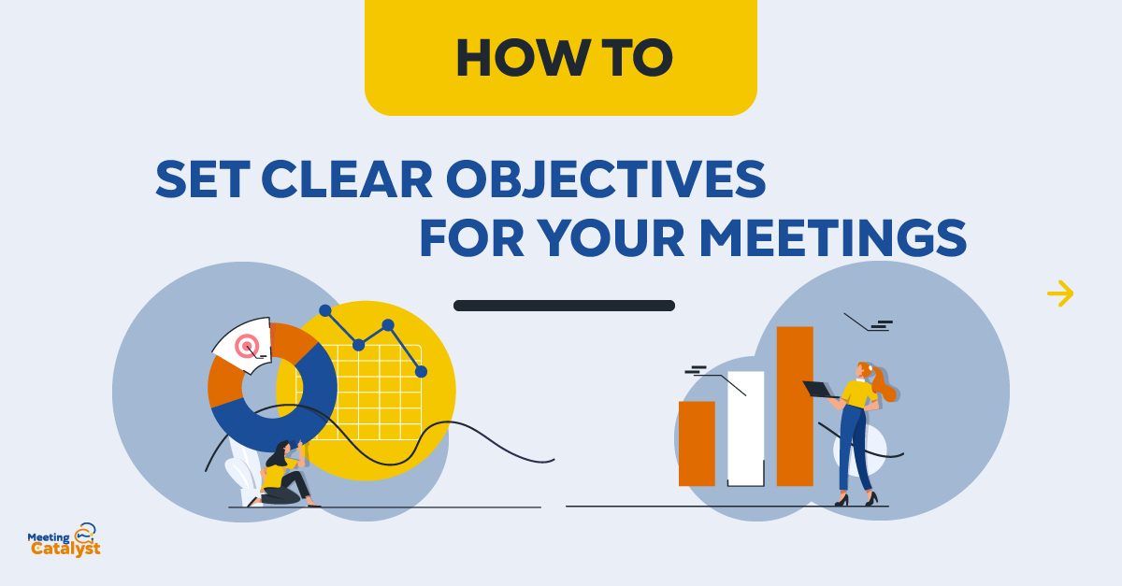
Tips for Effective Meeting Management
1. Set a Clear Objective
Is the meeting needed to generate new ideas, gather information, or make decisions? If you’re unsure what you’re trying to accomplish, you can be sure it won’t happen. The number one factor for a successful meeting is having a clear goal and a concrete agenda.
Entrepreneur Neil Patel says he refuses to have a meeting simply for the sake of having a meeting. He starts every meeting by stating the ultimate goal for that meeting. “Meetings aren’t social gatherings. Instead, they are goal-oriented business events,” he says. Start with the goal, and you’ll finish with success.

Slide 5

Tips for Effective Meeting Management
2. Be Prepared
The key to successful meeting management is in preparation. Before the meeting starts, provide all participants with an agenda. It should include:
●a list of topics to be covered
●a brief description of the meeting’s objectives
●a list of people attending the meeting
●who will address each topic
●the time and location of the meeting
●any background information participants need to know about the subject
A Tesla employee was quoted on Quora, saying “When we met with Elon Musk, we were prepared. Because if you weren’t, he’d let you know it. If he asked a reasonable follow-up question and you weren’t prepared with an answer, well, good luck.”

Slide 6

Tips for Effective Meeting Management
3. Invite Fewer People
Most of the time, a brief summary by email will work just as well. If you can reduce a half-hour meeting’s attendee list by just two people whose presence isn’t essential, that’s an hour of productive time returned to the company.
Amazon’s Jeff Bezos follows the Two Pizza Rule: No meeting should have more people than can be fed with a pair of pepperoni pies. This not only allows for quicker decisions but also lets teams test their ideas without the interference of groupthink.
4. Leave Room for Creativity
A successful meeting should result in creativity and energy. This happens when people are actively participating, not just passively attending.
Every Thursday, senior managers of food manufacturer Plum Organics get out coloring books and hold a creative-thinking meeting where staff members color, talk, and decompress. “It’s proven that coloring during a meeting helps promote active listening, and is more beneficial than multitasking on something like email,” is mentioned by Plum Organics.

Slide 7

Tips for Effective Meeting Management
5. Stop Multitasking
A study shows that multitasking makes us less effective, increases stress, and costs the global economy an estimated $450 billion every year. Harvard Business Review reports that multitasking leads to a 40% drop in productivity and a loss of 10 IQ points.
Nowhere is the problem more apparent than in the meeting rooms where email, texts, and web browsing can have a significant impact on an organization’s bottom line. How to prevent multitasking:
●Assign roles for the meeting.
●Provide a timed agenda.
●Have a phone/computer parking lot. Unless the computer is absolutely necessary for the meeting, turn it off.

Slide 8

Tips for Effective Meeting Management
6. Keep Your Meetings Short
It’s very likely that 30 minutes into the meeting, your team’s attention is not a sharp as at the beginning. The longer the meeting, the more effort it will take to keep up the energy and discussion. Do not schedule any meetings to last longer than an hour. People appreciate it when you understand that their time is valuable.
At O3 World, a digital agency, the conference room is hooked up to a technology the company created called Roombot. The app reads everyone’s Google Calendar and warns meeting participants when it’s time to wrap up. “Roombot creates more urgency and structure to the team’s calendars,” says O3 World’s CEO Keith Scandone.

Slide 9

Tips for Effective Meeting Management
7. Follow Up
The art of follow-up is a vital professional habit, and it also matters in the context of meetings. It’s quite common for people to come away from the same meeting with very different interpretations of what went on. Document the responsibilities that are given, tasks delegated, and any assigned deadlines, and send out the meeting notes on the day of the meeting. For very important matters, make a note on a shared team calendar or task management software, to continue following up until you reach a resolution.
The key to successful meetings lies in communication. Especially if you’re experimenting with new formats. Ask your employees for feedback, be open to suggestions, and base your conclusions on what they think, not how you personally feel. If your team feels engaged and effective, you’re surely on the right track.
The text is borrowed and modified from https://www.scoro.com/blog/tips-for-effective-meeting-management/ as of 27th October 2020

Slide 10
Tips for Effective Meeting Management
True or false?
1) The average manager spends less than 12 hours a week for meetings.
2) It is very important to set clear objectives and create definite agenda to make the meeting more productive.
3) The agenda of the meeting should include a brief description of every employee’s working duties.
4) Elon Musk demands from his employees to be strictly prepared for the meetings.
5) If it is possible to invite fewer people to the meeting, it might result in the growth of productivity.
6) Creativity and active participation of employees during meetings can lead to a decrease in productivity and wastage of time.
7) In order to prevent multitasking, it is better to refuse the usage of phones and computers during meetings if it is possible.
8) The productive meeting should last longer than an hour.
9) It is widely spread for employees to leave the same meeting with different interpretations of what was discussed.

Slide 11

Business Meeting. discussion
Read about the three situations below. Decide what action you would recommend in each situation. Make short notes about your ideas.
1) Your company has been criticized for the low percentage of female employees. What to do to change the situation?
2) Your company does not take a very active part in social work. How to improve the situation?
3) The staff loyalty to your company is low at the moment. How to motivate people?

Slide 12
references
Tips for Effective Meeting Management (2017). – Retrieved from: https://www.scoro.com/blog/tips-for-effective-meeting-management/

Slide 13

Thank you for attention!

