Slide 1

INTRODUCTION TO DESIGN FIELDS:
PRINCIPLES OF DESIGN THINKING AND INNOVATION.
Created by Iryna Zhukevych
PhD in Pedagogical Sciences
Associate Professor
Це фото; автор: Невідомий автор; ліцензія: CC BY-SA-NC

Slide 2

Vocabulary
https://quizlet.com/ua/1035754825/design-thinking-flash-cards/?new

Slide 3

Reading and Watching
Design Thinking (DT)
https://www.interaction-design.org/literature/topics/design-thinking?srsltid=AfmBOoppfcrSgg0jv1p7W1myuIrQcz_jhm8sIn6nZSeKS9qIrqM6f_Li
Це фото; автор: Невідомий автор; ліцензія: CC BY-SA

Slide 4
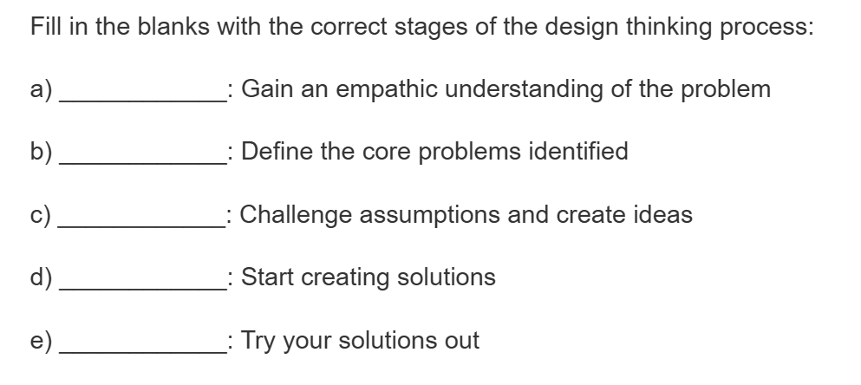

Slide 5
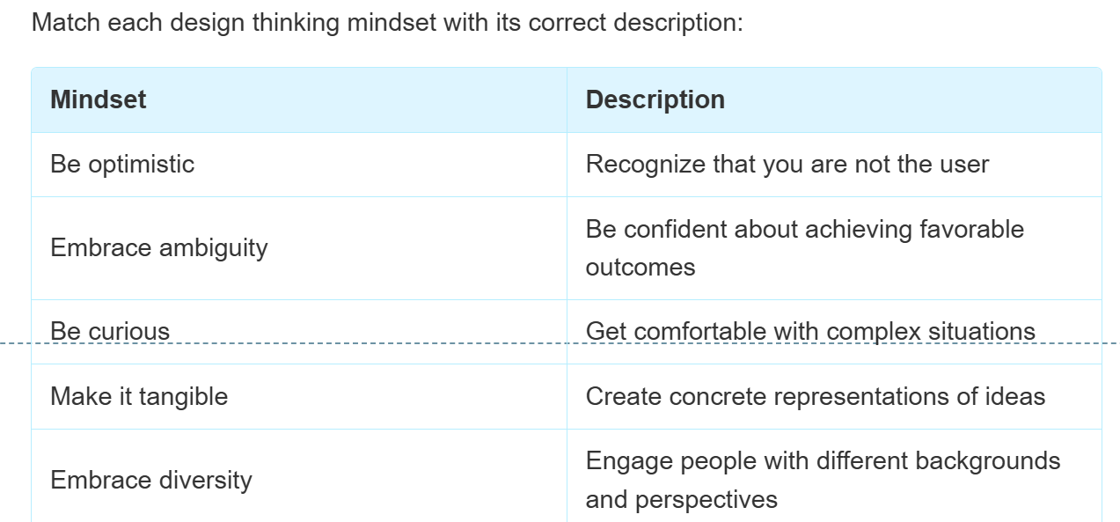

Slide 6

Think about a problem you've encountered recently. How might you apply design thinking principles to approach this problem differently?

Slide 7
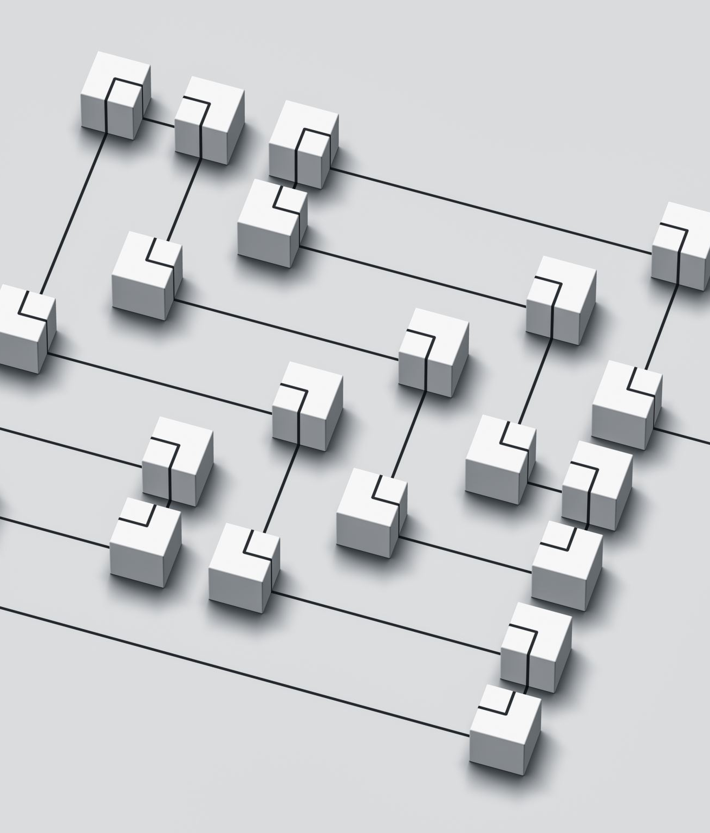
What Design Thinking is? Interview with Stanford Professor Barry Katz
https://www.youtube.com/watch?v=PAZY3iR431Y
Answer the questions below.
1. In the context of design thinking, how does collaboration enhance the problem-solving process, particularly when addressing complex social issues in different industries? Additionally, what challenges might team face in maintaining effective collaboration during this process?
2. Based on the discussion about design thinking and its relevance in various industries, critically evaluate the role of creativity in problem-solving. How does the approach of design thinking enhance or challenge traditional methods of addressing problems, particularly in unique contexts like Ukraine's current situation?
3. In the context of design thinking, how does the process of prototyping and testing ideas contribute to solving complex problems, such as those faced by organizations in Ukraine? Additionally, in what ways can the iterative nature of this approach enhance creativity and innovation in various fields?

Slide 8
Scenario 1: Designing a More Engaging Orientation Program for New Students
The current orientation program for new university students is perceived by many as overwhelming, information-heavy, and not very engaging. Students often feel lost and struggle to connect with their peers and the university community.
What are the experiences and emotions of new students arriving at the university?
What are their hopes and anxieties?
What are the key pieces of information new students need to know?
How do they prefer to receive this information?
What aspects of the current orientation program do students find most and least helpful?
What opportunities are there for new students to build connections and a sense of belonging?
What are the perspectives of current students who have gone through the orientation program?

Slide 9
Scenario 2: Designing a Better Way to Navigate University Resources
Students, especially new and international students, often struggle to find and understand the various resources and support services available at the university (e.g., academic advising, career services, mental health support, financial aid).
What are the common pain points students experience when trying to access university resources?
Which resources are students most frequently unaware of or struggle to find information about?
What are students' preferred methods of seeking information?
How do different student groups (e.g., first-year, transfer, international) experience these challenges differently?
Are there any existing platforms or systems that are particularly confusing or ineffective?

