Slide 1

TYPES OF LIES
Автор: Гаєва Поліна Олександрівна
Рік: 2024

Slide 2
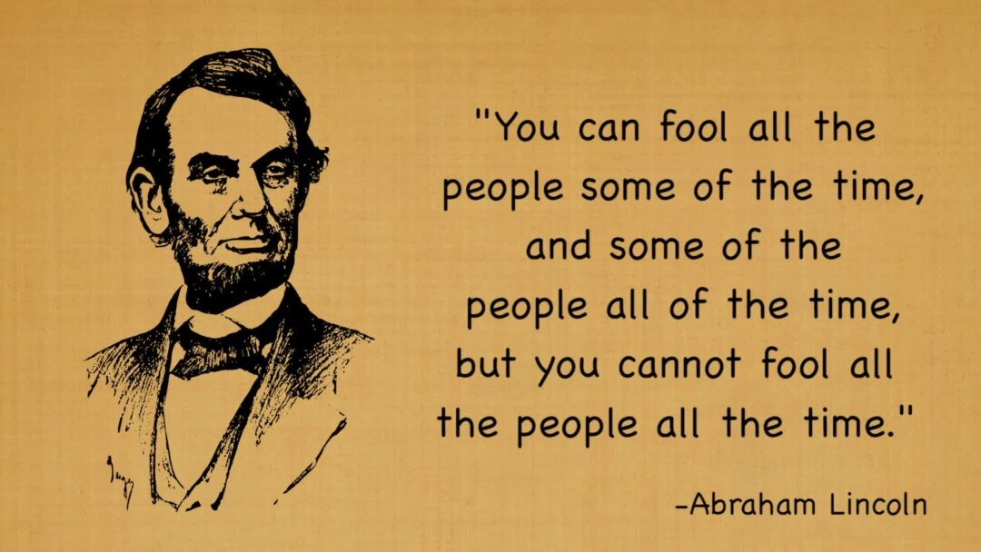

Slide 3
3 Types of Lies
Lies of Commission
Lies of Omission
Lies of Influence

Slide 4

A – Q: Did you do it?
A: I would never do something like that!
2. B – Q: Do I look fat in this dress? A: No, honey.
3. C – Q: Where were you yesterday? A: I went to the office (neglecting to tell you he also visited his mistress)
4. D – Q: Is this a good neighborhood to live in? A: Yes, we’re good friends with the people next door (not telling you the people across the street are really very nasty people).

Slide 5
#1: Identify Your Prolific Liars
#2: Watch The Nose
#3: Watch The Neck
#4: Watch for Mismatched Hand Gestures
#5: Pay Attention to The Ears
#6: Look for Facial Microexpressions
#7: Watch for Eyeblinking Changes

Slide 6
#8: Decode The Feet Fidget
#9: Vocal Pitch Changes
#10: Listen to The Lyrics
#11: Use of Complicated Words
#12: Watch for Redirection
#13: Being Too Defensive

Slide 7
Words and Phrases Commonly Used by Deceivers
“To be honest,” “Honestly,” “Truthfully”: People who are being honest don’t usually need to label their statements as such.
Excessive Details: Over-explanation can be a ruse to make the lie seem more believable.
Vagueness: On the flip side, being too vague can also be a sign. “I was out,” “It’s complicated,” or “I don’t remember exactly” might be dodging the truth.
Third Person Pronouns: Liars often distance themselves from their lies, opting for third-person pronouns like “he,” “she,” or “they” rather than “I.”
Passive Voice: “The document was misplaced” rather than “I misplaced the document.” Using passive voice takes the focus off the doer of the action.

