Slide 1

Created by Iryna Zhukevych
PhD in Pedagogical Sciences
Associate Professor

Slide 2

What
is
Networking?

Slide 3

Describe an occasion when you or a friend of yours made a useful contact in a business or social setting.

Slide 4

Discuss the following questions
How useful is networking in your business or career?
What is the most effective way to get a good job in Ukraine?
Have you ever used a connection when looking for a job? What effect has your network had on your career?
How could you use technology to help build a network?
Why do people need to make connections and build networks?

Slide 5

Video: Networking https://www.youtube.com/watch?v=xFrqZjIDE44
After watching the video, discuss the following questions:
Why would networking make us feel dirty?
Does networking make you feel awkward? Why or why not?
Do you know the network that is already around you? Who are they?
Is it better to build a network around new people or people you used to know (dormant ties)? What are the advantages and disadvantages of both?
Who are the most successful people you went to school with?
How much influence do you think your friends have had on your life?

Slide 6

https://www.youtube.com/watch?v=7XJAcsQiEfo
Review the Networking Strategy Video and discuss why planning and thinking ahead with networking may be important.

Slide 7
How to Network Effectively
Be prepared: Do your research on the people you are going to meet and the organization they work for. This will help you make a good first impression.
Be yourself: Don't try to be someone you're not. People can spot a fake a mile away.
Be a good listener: Show genuine interest in the other person and their work.
Ask thoughtful questions: Don't just ask generic questions. Ask questions that show you are interested in learning more about the other person and their work.
Be clear about your goals: What are you hoping to achieve by networking? Once you know your goals, you can tailor your conversations accordingly.
Follow up: After you meet someone, be sure to follow up with them afterwards to stay connected.

Slide 8

Watch the video and discuss networking tips
https://www.youtube.com/watch?v=OVf5c7NthSw&t=16s

Slide 9
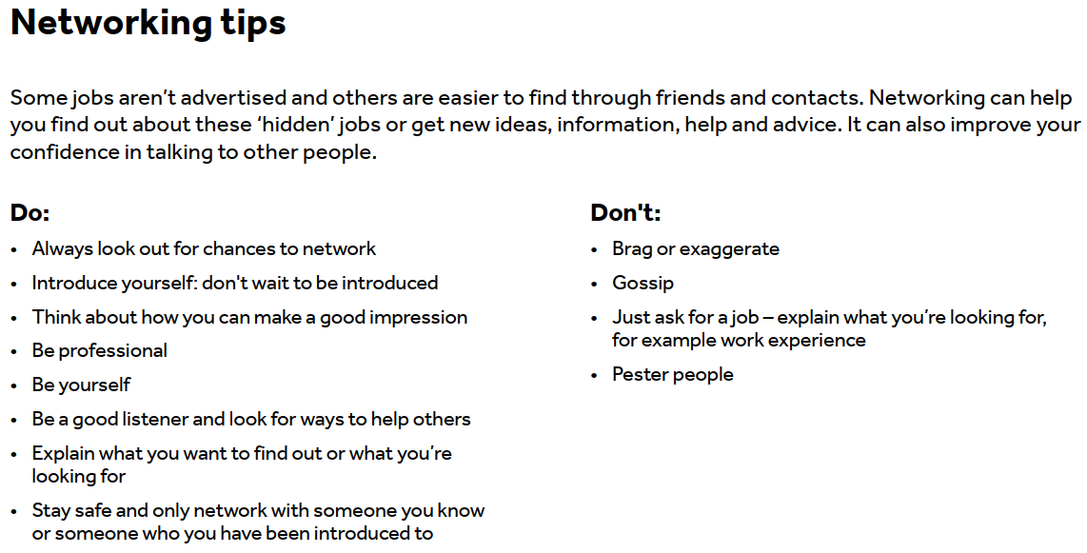

Slide 10

Game. Speaking Cards
https://wordwall.net/resource/78392971/networking

