Slide 1
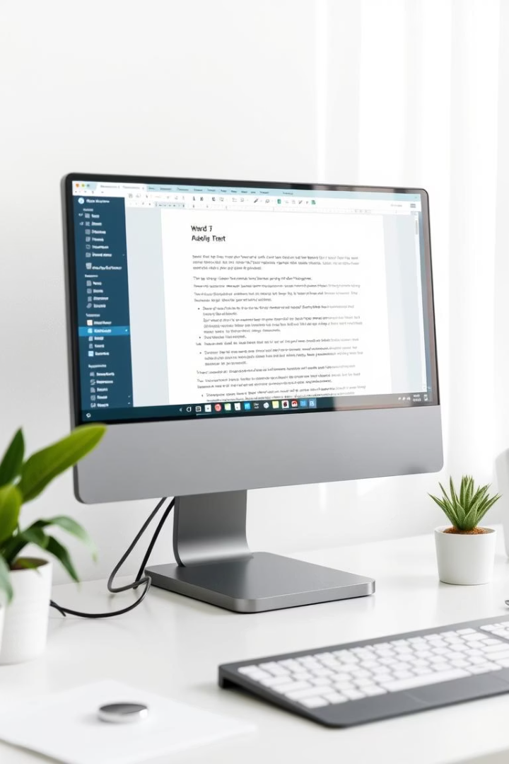
Word Processing
Understanding digital document creation powers daily communication and productivity. Word processing is essential across all industries.
Автор: Поліна Гаєва
Рік: 2025

Slide 2

What is Word Processing?
Word processing is software for creating and managing text documents.
It includes writing, editing, formatting, and printing documents.

Slide 3
Main Features of Word Processors
Text Editing & Formatting
Spell & Grammar Check
Insert Images, Tables, Charts
Templates for Fast Creation
Page Layout Options

Slide 4
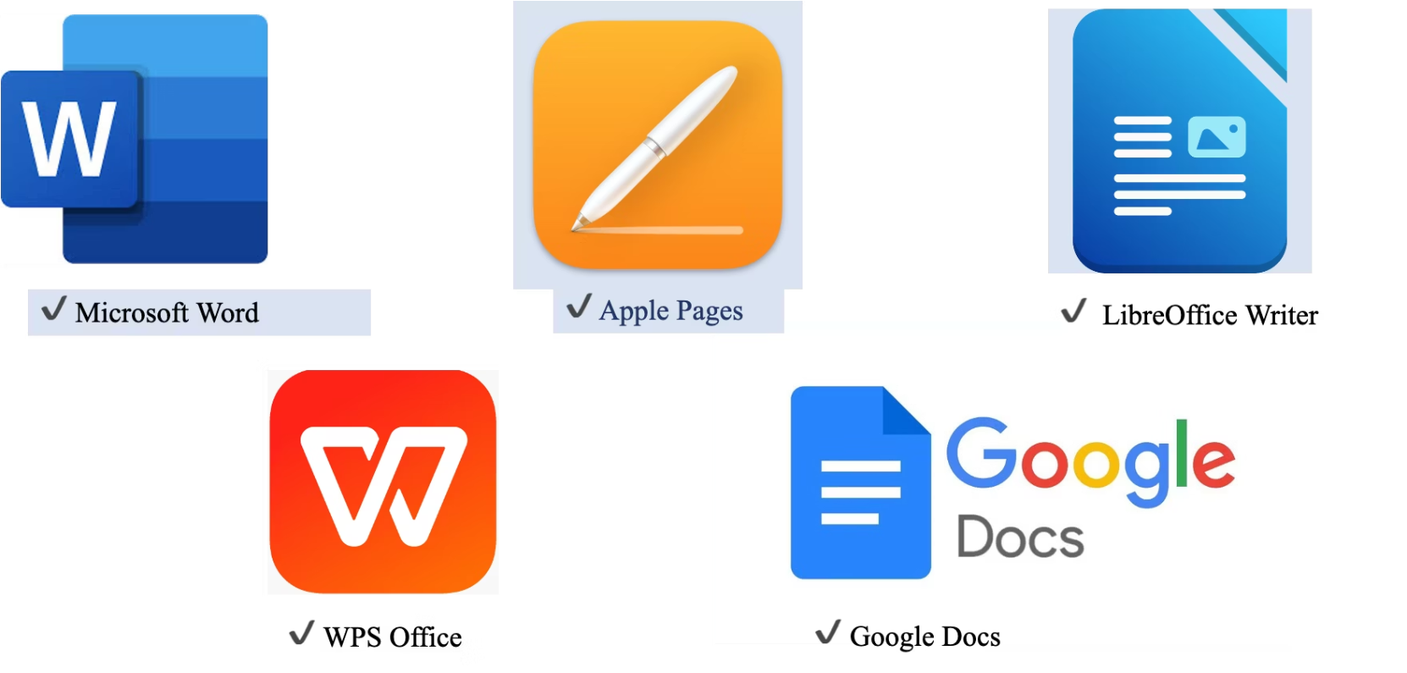
Examples of Word Processing Software

Slide 5

Advantages of Using Word Processors
Saves Time & Effort
Easy to Edit & Update
Creates Professional Documents
Avoids Spelling & Grammar Mistakes
Supports Collaboration

Slide 6
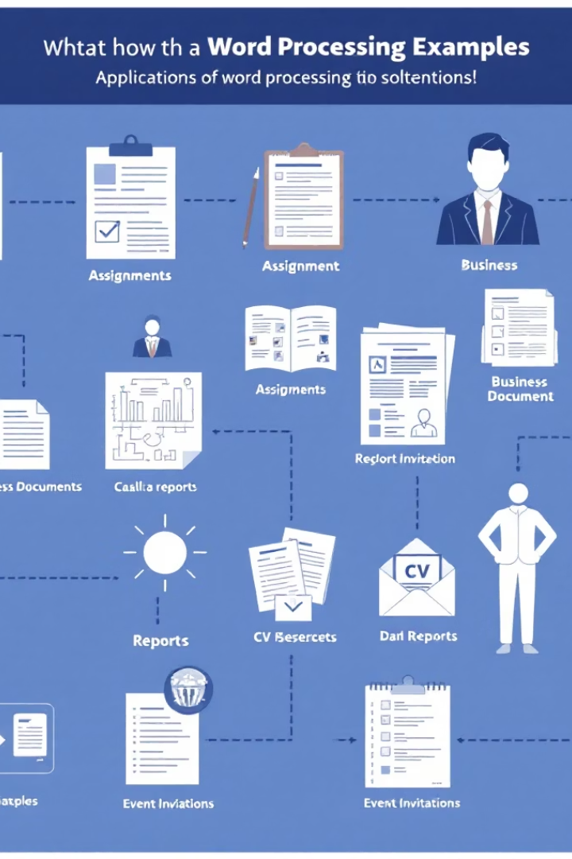
Real-Life Applications of Word Processing
School Assignments
CVs and Cover Letters
Business Documents
Event Invitations and Flyers
Reports and Articles

Slide 7

Group Discussion Questions
In what situations do you personally use word processors the most?
How does word processing software make your academic or professional life easier?
What features of word processors do you find most helpful, and why?
Can you think of a time when using a word processor saved you from a big mistake?
What are some ways word processors support teamwork or collaboration?
Imagine word processors didn’t exist — how would that affect your daily tasks?

Slide 8
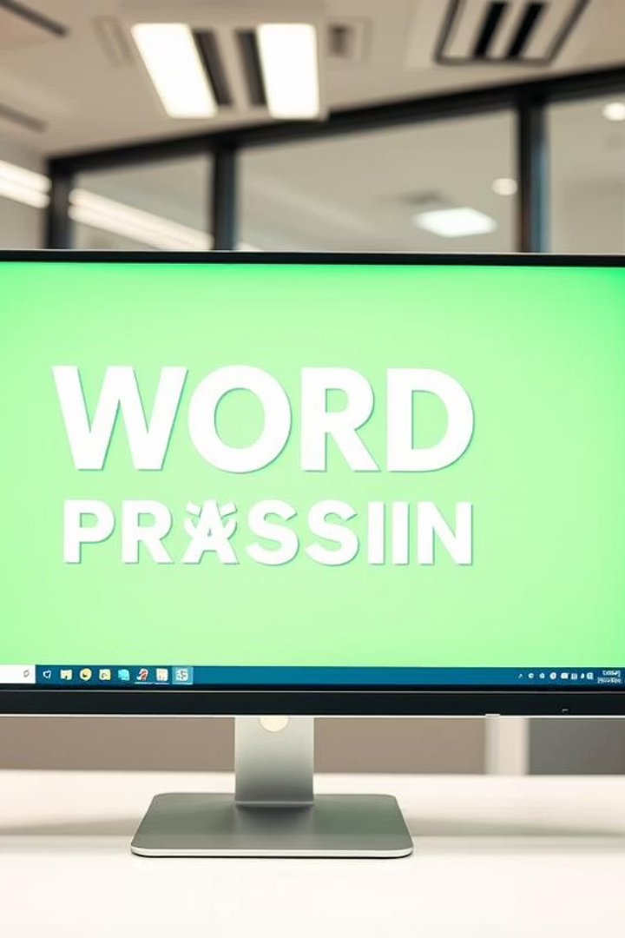
Conclusion
Word Processing is a vital skill in education, business, and daily life. Mastery boosts communication and productivity.

