Slide 1
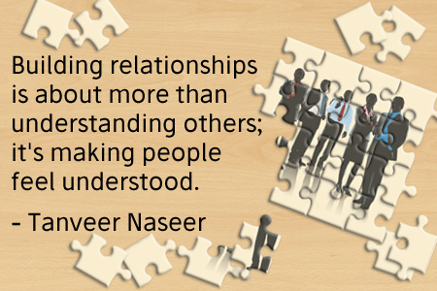
Це фото; автор: Невідомий автор; ліцензія: CC BY-SA-NC
Created by Iryna Zhukevych
PhD in Pedagogical Sciences
Associate Professor

Slide 2

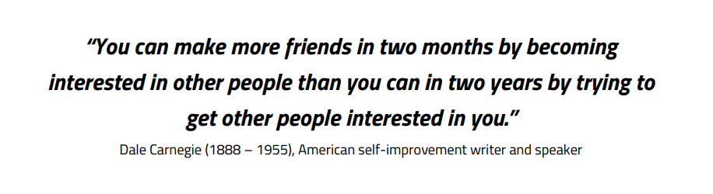

Slide 3
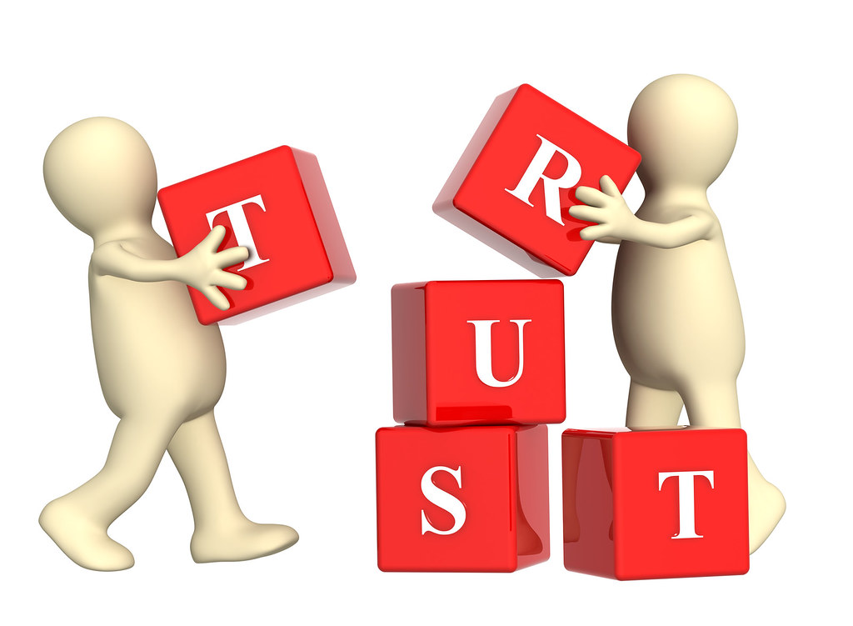
Video: Why is trust important in building business relationships?
https://www.youtube.com/watch?v=T6VAHcA1YIE
Це фото; автор: Невідомий автор; ліцензія: CC BY

Slide 4
After-watching activity. Discuss the following questions:
What makes you trust someone? What makes you distrust someone?
Have you ever thought somebody was not paying attention to you at work?
Have you ever been distracted when somebody is telling you about themselves?
Do you sometimes have trouble understanding other peoples' logic? Do you have difficulties explaining your own logic?
When have you thought someone, or an organization, was not being authentic?
Do you ever find yourself not being yourself at work?

Slide 5
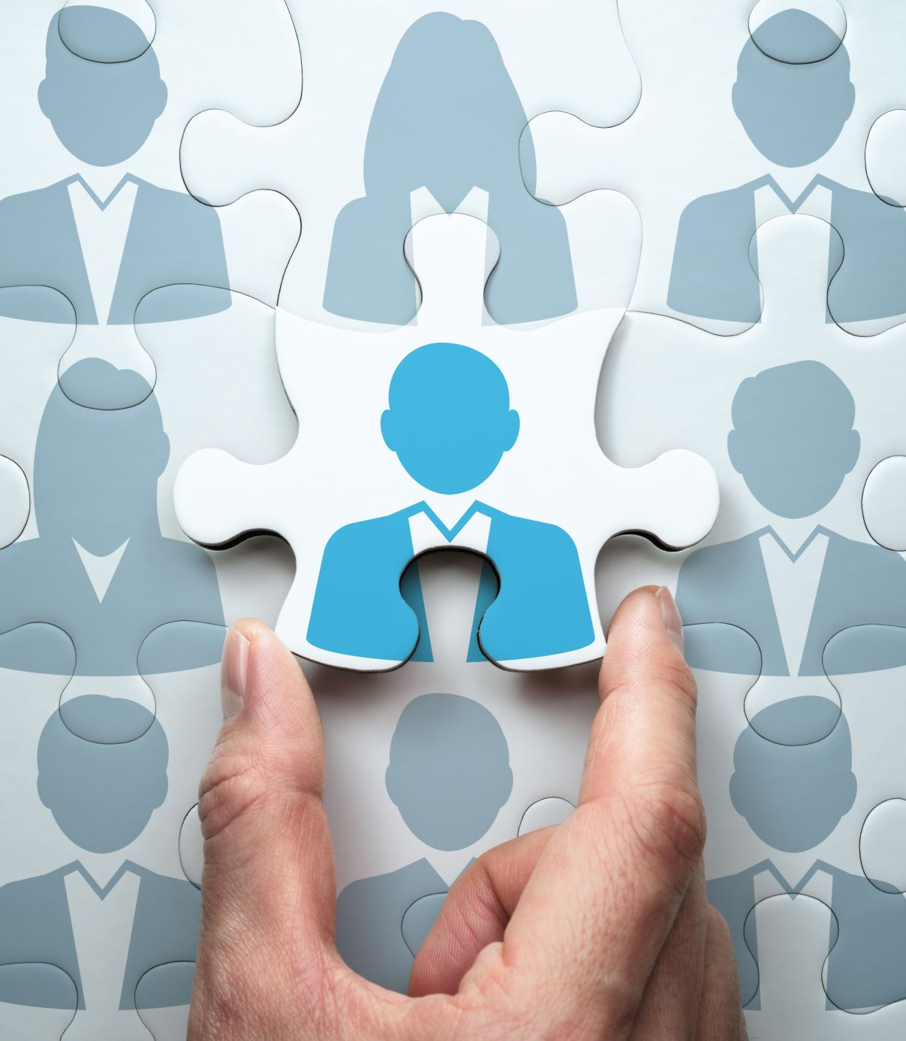
Watch the video and discuss the questions below
https://www.youtube.com/watch?v=D6RqLramoq4
1. What are some key motivations for individuals to establish business relationships?
2. Describe the importance of effective communication in maintaining business relationships.
3. How can emotional intelligence play a role in navigating disagreements within professional networks?
4. Explain the concept of trust in business relationships and how it can be developed over time.
5. In what ways can a recent graduate leverage their network to advance their career?

Slide 6
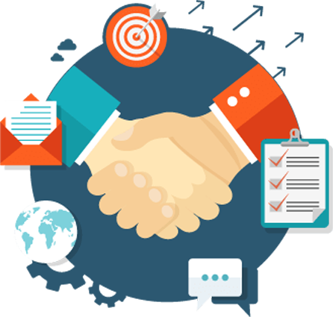
Business Relationships Conversation Questions
How are business-to-business (B2B) relationships different to business-to-consumer (B2C) relationships?
Do you think the way we build relationships is the same across different cultures, or is it different?
If you are meeting a potential business contact, would you prefer to talk about the business you could do together or unrelated topics of conversation?
What is more important in your culture when building trust: socializing with a potential partner or by being punctual with deadlines?
What kind of ethical issues can put a strain on business relationships?
Why do relationships break down between colleagues or business partners?
Has the internet changed the way we make relationships at work?
Це фото; автор: Невідомий автор; ліцензія: CC BY-NC

Slide 7
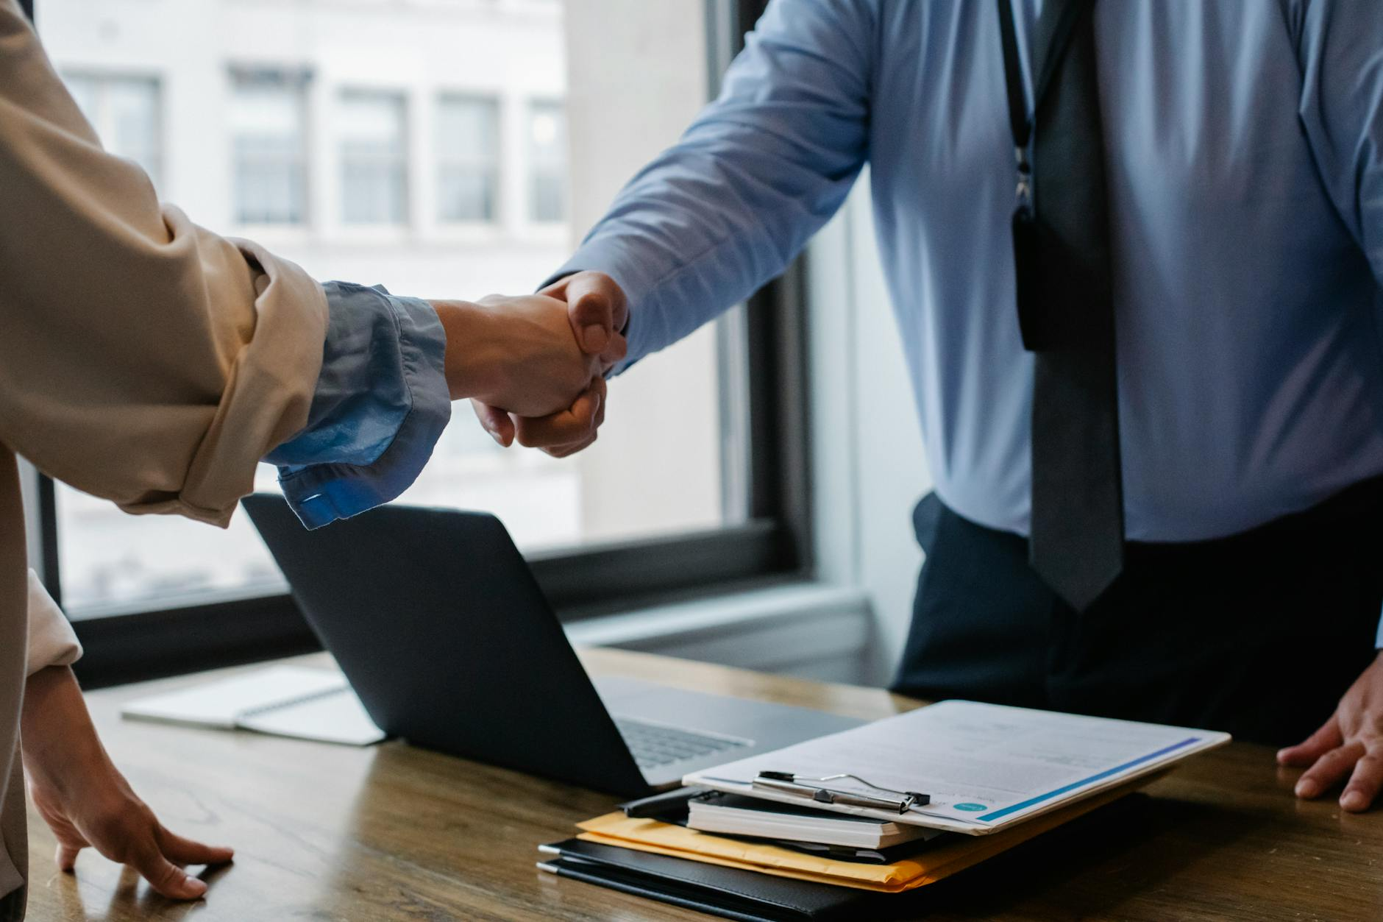
New Colleague
You've just started a new job and want to make a good impression on your new team.
How do you initiate conversations and build rapport with your colleagues?

Slide 8
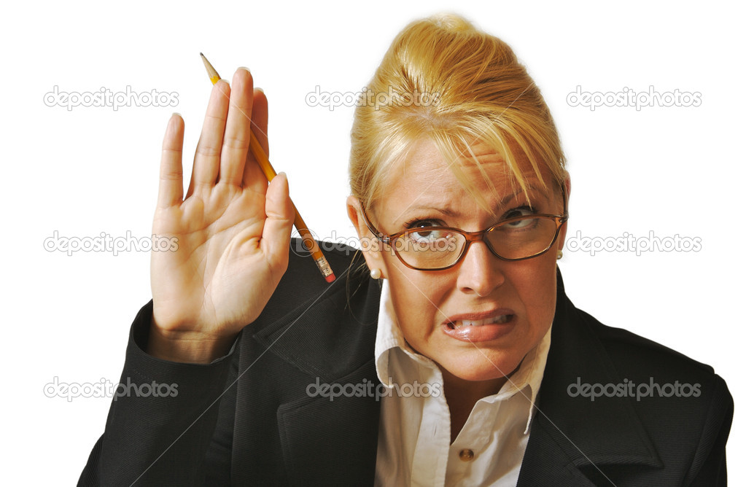
Apologizing and Repairing a Relationship
You’ve made a mistake or miscommunication that has affected a business relationship.
You need to apologize sincerely, repair the relationship, and offer a solution.
Це фото; автор: Невідомий автор; ліцензія: CC BY-SA

Slide 9
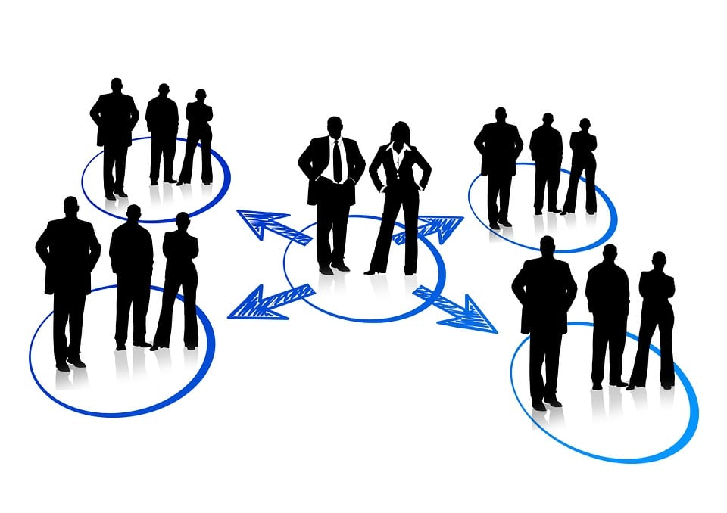
Watch the video “Mastering Business Relationships”
https://www.youtube.com/watch?v=zDRTXasa4To

Slide 10

Discuss the following questions
https://wordwall.net/resource/81273082/business-relationships-discussion
Це фото; автор: Невідомий автор; ліцензія: CC BY-SA-NC

