Slide 1
Negotiation skills for ESP students
Hanna Kolosova
Ph.D., Associate Professor, Department of English language for Humanities,
FL, Igor Sikorsky Kyiv Polytechnic Institute

Slide 2

How good you are as a negotiator?
Complete the questionnaire with 1 to 10 points (1 – totally disagree, 10 – totally agree). Then calculate your points and read about the results. Discuss the results with a partner
1. I am the master of myself in the middle of a conflict.
2. I realize that other people have feelings.
3. I am ready to compromise if it is necessary.
4. I can say, that I am a very good listener.
5. I easily cope with stressful situations.
6. I am really patient person.
7. I am ready to work on a situation where all sides can win.
8. I am able to determine the most urgent issues very quickly.
9. I am ready to research and analyze all the tasks very carefully.
10. I can stay cool when I am personally threatened.

Slide 3

How good you are as a negotiator?
Self-check
Your score is 80 or higher. You know the most important issues about negotiations. You are aware of everything that is important in this process. So, it is possible to say, that you are a good negotiator.
Your score is between 60 and 79. Of course, you are not bad in negotiations, but there are some areas that you need to work on. Nevertheless, for sure, nobody is perfect!
Your score is below 60. You need to develop your negotiating skills a little bit more. Maybe some additional training on this topic may help you.

Slide 4
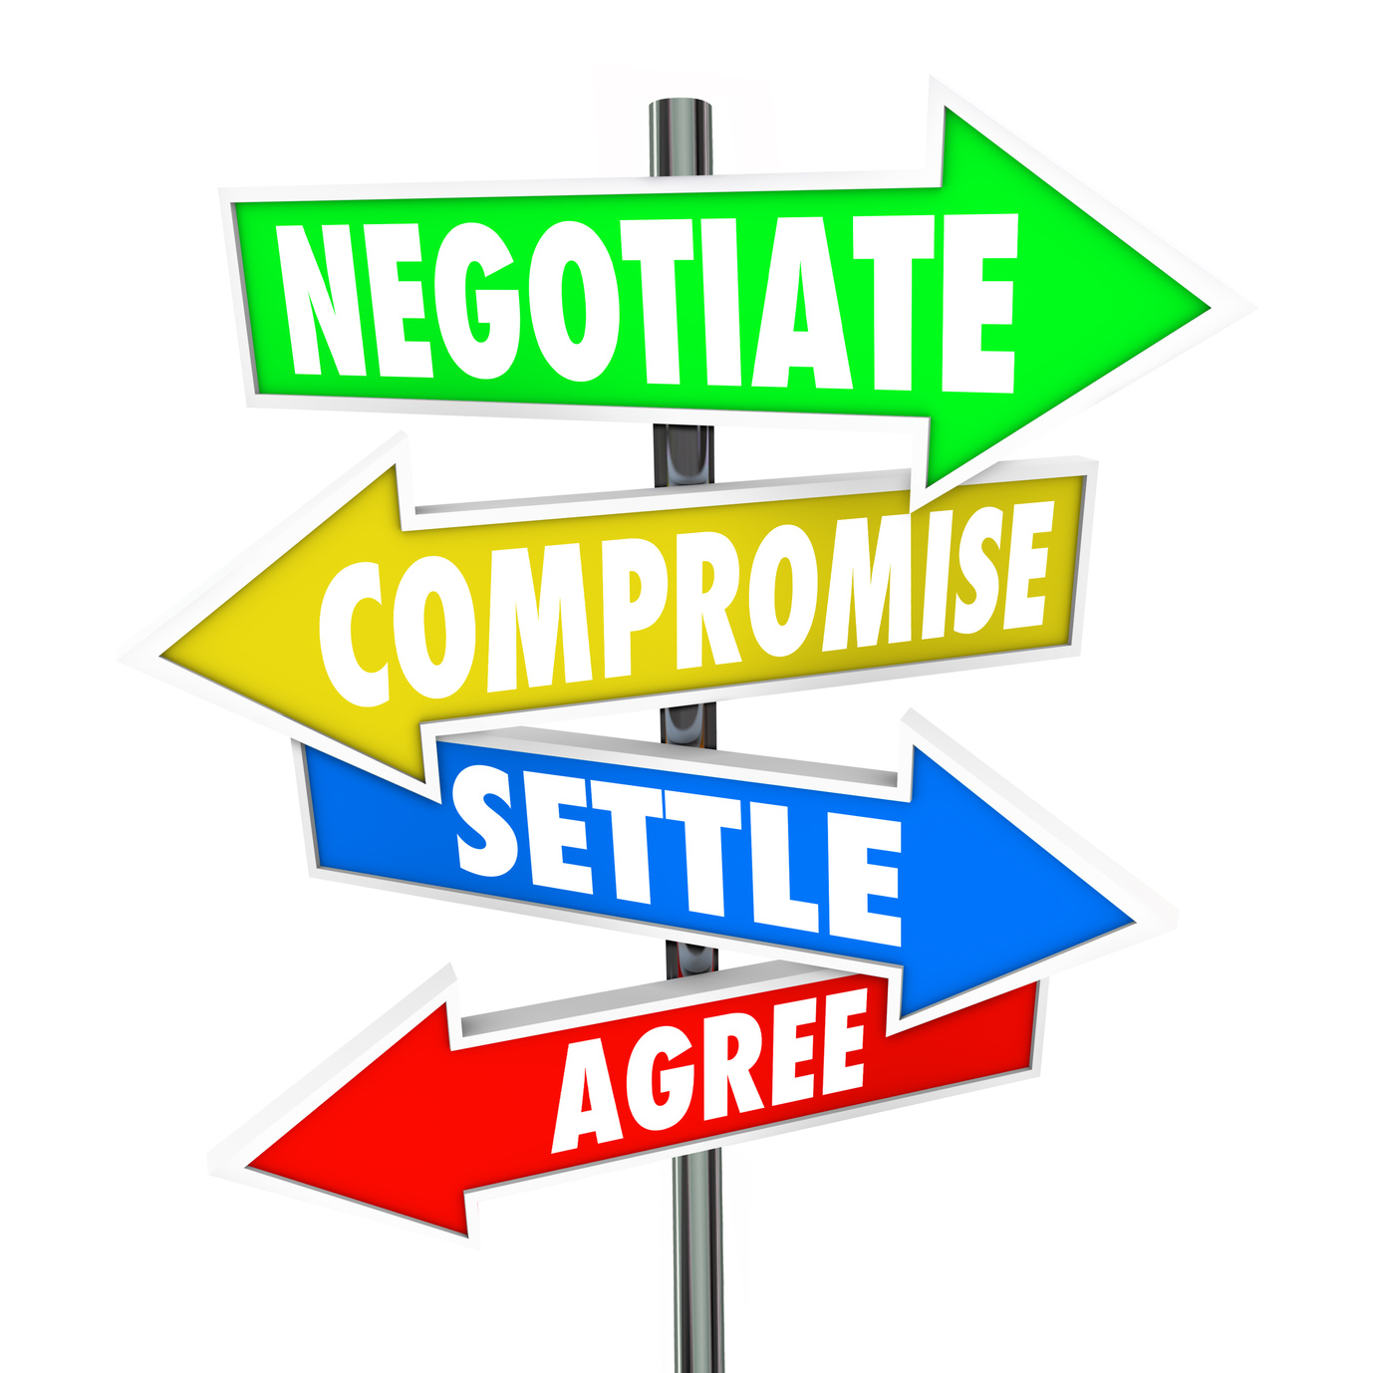
Tips for negotiating agreements
Watch the video about the tips for negotiating agreement (link to the video https://www.youtube.com/watch?v=QCT1BWZByko) and answer the following questions:
1. What was the reason to organize the Halloween party at French school?
2. What does BATNA mean?
3. Why was the price for pumpkins accepted without negotiations?
4. What strategic options came into the mind of the negotiator to convince Madame Petite to sell all of her Pumpkins, but they were refused?
5. What was the last option that worked and why did it work?
6. Why is it difficult to win in negotiations if you want the other party to lose?

Slide 5
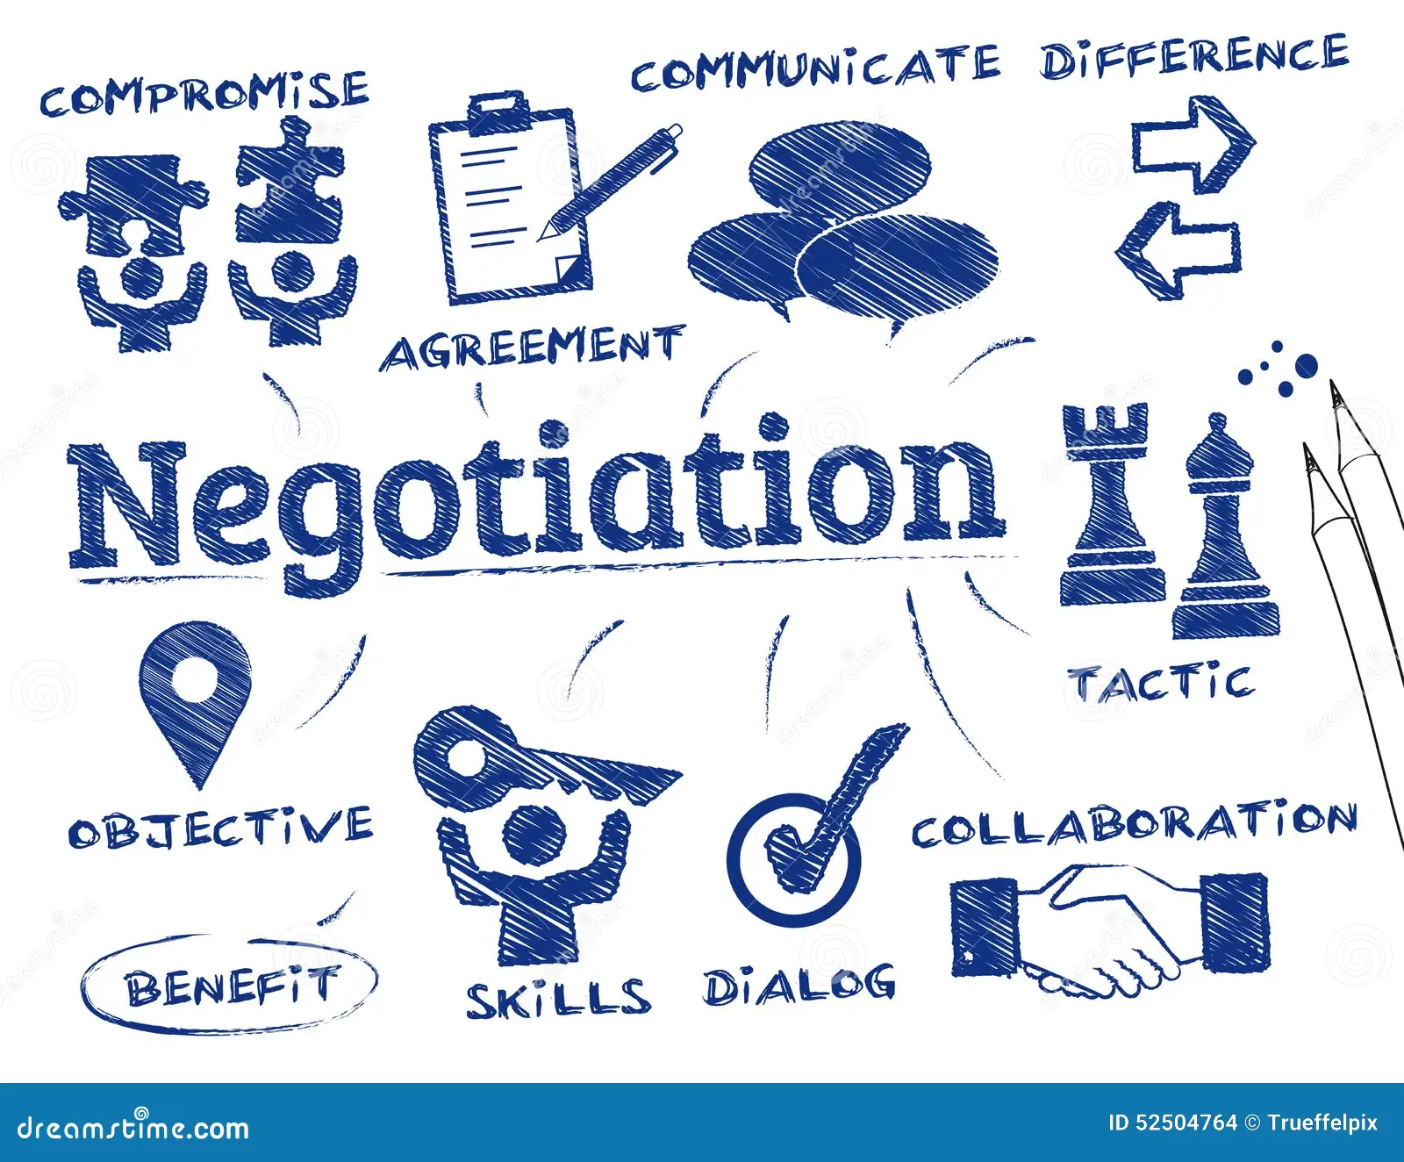
Tips for negotiating agreements self-check
1. The teachers there saw a couple of American parents as an opportunity to organize the Halloween party for their children.
2. BATNA – best alternative to a negotiated agreement.
3. Because the BATNA to the pumpkins was terrible.
4. To offer more money, but it was not the interest underlying her no. To ask how many pumpkins Madame Petite may sell, but it did not meet the interests of a negotiator. To ask why would not Madame Petite sell all her pumpkins, but she might not share with her plans.
5. So, the negotiator decided to ask directly why she would not like to sell all of the pumpkins. Madame Petite answered that she would not have any seeds to plant next year. So, the negotiator offered to bring all the seeds back in November.
6. Most of the negotiators often think that the only way to win in negotiation is when the other party loses. But it is more important to understand your interests and to learn about the interests of the other party. You can often reach an agreement in which both parties win.

Slide 6
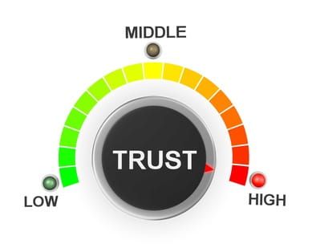
Cultural differences of negotiations
Read the text about how culture can affect the negotiation
1. Negotiating goal: Contract or relationship?
Negotiators from different cultures may tend to view the purpose of a negotiation differently. For deal makers from some cultures, the goal of business negotiation, first and foremost, is a signed contract between the parties. Other cultures tend to consider that the goal of a negotiation is rather the creation of a relationship between the two sides. Although the written contact expresses the relationship, the essence of the deal is the relationship itself. For example, a survey of over 400 persons from twelve nationalities founded that whereas 74 percent of the Spanish respondents claimed their goal in negotiation was a contract, only 33 percent of the Indian executives had a similar view. The difference in approach may explain why certain Asian negotiators, whose negotiating goal is often the creation of a relationship, tend to give more time and effort to negotiation preliminaries, while North Americans often want to rush through this first phase of deal-making. The preliminaries of negotiation, in which the parties seek to get to know one another thoroughly, are a crucial foundation for a good business relationship.

Slide 7
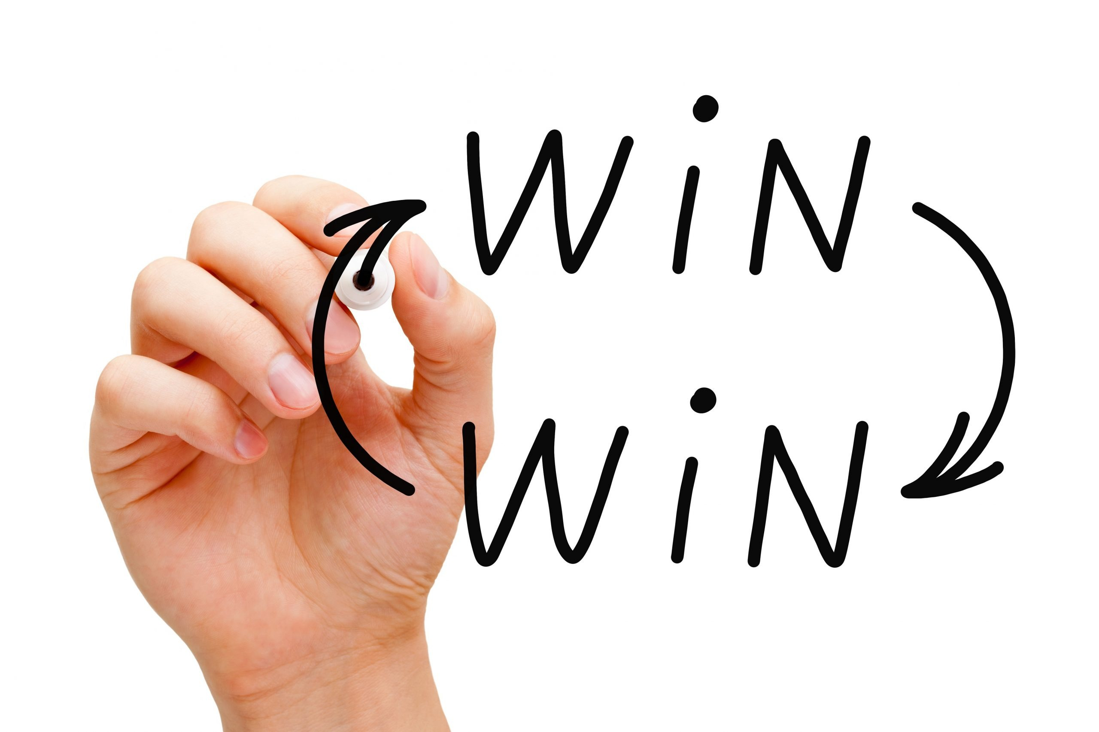
Cultural differences of negotiations
2. Negotiating attitude: Win-Lose or Win-Win?
Because of differences in culture, personality, or both, business persons appear to approach deal-making with one of two basic attitudes: that negotiation is either a process in which both can gain (win-win) or a struggle in which one side wins and the other side loses (win-lose). Win-win negotiators see deal-making as a collaborative, problem-solving process; win-lose negotiators view it as confrontational. As you enter negotiations, it is important to know which type of negotiator is sitting across the table from you. For example, whereas 100 percent of the Japanese respondents claimed that they approached negotiations as a win-win process, only 33% of the Spanish executives took that view.

Slide 8
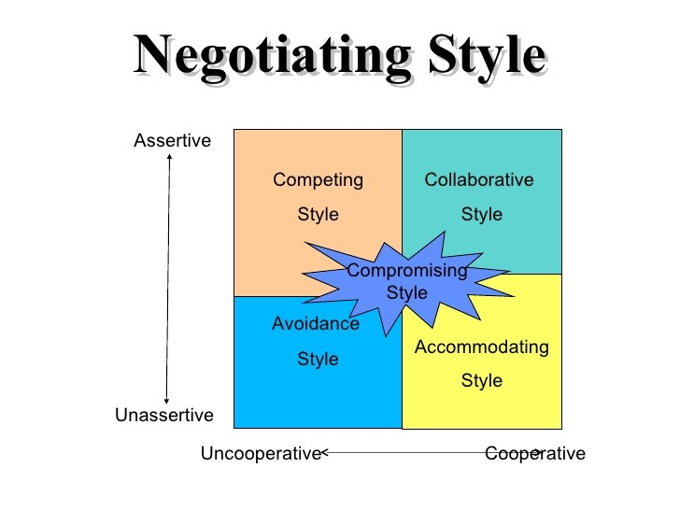
Cultural differences of negotiations
3. Personal style: Informal or formal?
Personal style concerns the way a negotiator talks to others, uses titles, dresses, speaks, and interacts with other persons. It has been observed, for example, that Germans have a more formal style than Americans. A negotiator with a formal style insists on addressing counterparts by their titles and refrains from questions touching on the private life. A negotiator with an informal style tries to start the discussion on a first-name basis, quickly seeks to develop a personal relationship with the other team. For an American, calling someone by the first name is an act of friendship and therefore a good thing. For a Japanese, the use of the first name at a first meeting is an act of disrespect.

Slide 9

Cultural differences of negotiations
4. Communication: Direct or indirect?
Methods of communication vary among cultures. Some emphasize direct and simple methods of communication; others rely heavily on indirect and complex methods. In a culture that values directness, such as the American or the Israeli, you can expect to receive a clear and definite response to your proposals and questions. In cultures that rely on indirect communication, such as the Japanese, reaction to your proposals may be gained by interpreting seemingly vague comments, gestures, and other signs. What you will not receive at a first meeting is a definite commitment or rejection. The confrontation of these styles of communication in the same negotiation can lead to friction.

Slide 10

Cultural differences of negotiations
5. Building an agreement: Bottom-up or top-down?
Related to the form of the agreement is the question of whether negotiating a business deal is an inductive or a deductive process. Does it start from an agreement on general principles and proceed to specific items, or does it begin with an agreement on specifics, such as price, delivery date, and product quality, the sum total of which becomes the contract? Some observers believe that the French prefer to begin with agreement on general principles, while Americans tend to seek agreement first on specifics. For Americans, negotiating a deal is basically making a series of compromises and trade-offs on a long list of particulars. For the French, the essence is to agree on basic principles that will guide and determine the negotiation process afterward.
The text is borrowed and modified from https://iveybusinessjournal.com/publication/negotiating-the-top-ten-ways-that-culture-can-affect-your-negotiation/#:~:text=Negotiators as of 4th November 2020

Slide 11
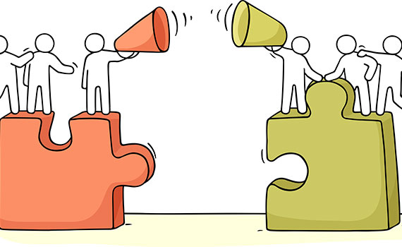
Cultural differences of negotiations
Say whether these statements are True or False according to the text:
1. The difference in culture between business executives can create obstacles that may influence the negotiating process.
2. For most of the Spanish respondents the main goal of negotiations was to build relations.
3. The desire to get to know each other better in advance may become a very good basis for beneficial negotiations for both parties.
4. Negotiation is the process in which both sides always win.
5. Japanese negotiators prefer win-win strategy.
6. Germans prefer less formal style of communication in contrast to Japanese negotiators.
7. Vague gestures and signs are quite typical to Americans in the process of communication.
8. During negotiations French prefer to concentrate on general principles in the contrast to Americans, who would concentrate on details.

Slide 12

Self-check
1. T
2. F. 74 percent of the Spanish respondents claimed their goal in negotiation was a contract.
3. T
4. F. There are usually two variants: win-win or win-lose.
5. T
6. F. Both Japanese and German negotiators prefer a very formal style of communication.
7. F. They are more typical to Japanese, Americans are more direct in their communication.
8. T

Slide 13
references
Marketing communication for 3rd-year students [Electronic resource] : the study e-book for students of specialty 075 “Marketingˮ / Igor Sikorsky Kyiv Polytechnic Institute ; comp. H.A. Kolosova, O.M. Narodovska. – Electronic text data (1 file: 229 KB). – Kyiv: Igor Sikorsky Kyiv Polytechnic Institute, 2021. – 88 p.
Negotiating: The Ways that Culture Can Affect Your Negotiation (2014). – Retrieved from: https://iveybusinessjournal.com/publication/negotiating-the-top-ten-ways-that-culture-can-affect-your-negotiation/#:~:text=Negotiators

Slide 14

Thank you for attention!

