Slide 1
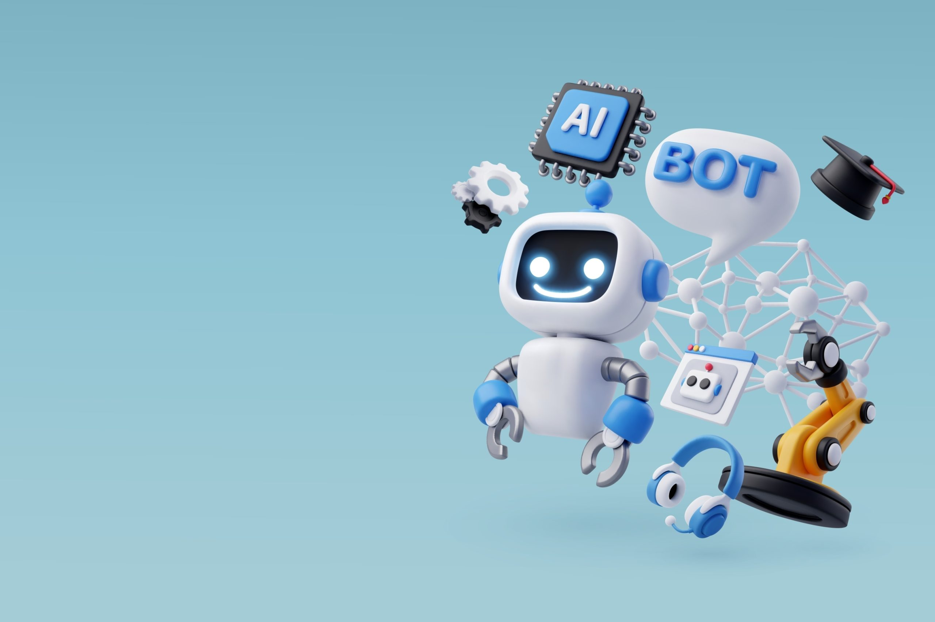
ROBOTICS

Slide 2
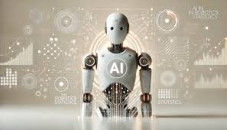
QUESTIONS
What is a robot? Can you think of any examples of robots you’ve seen?
Where do you think robots are used today?
How do you feel about robots? Are they helpful or possibly dangerous?

Slide 3
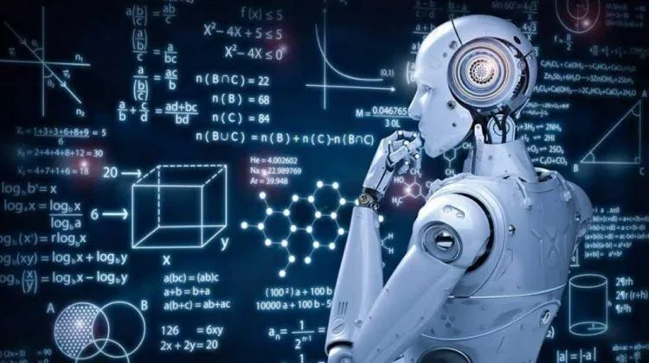
BRIEF EXPLANATION
What is Robotics?
Robotics is the study and use of robots, which are machines designed to perform tasks. Robots can be controlled by humans or operate independently using programs.
Where Are Robots Used?
Robots are used in various fields such as manufacturing, medicine, space exploration, and even household cleaning.

Slide 4
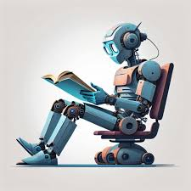
KEY TERMS
Robot: A machine that can perform tasks automatically, sometimes controlled by a person or a program.
Automation: Using machines to perform tasks without human help.
Artificial Intelligence (AI): The intelligence shown by machines to make decisions and learn from experiences.
Sensor: A device that detects and measures changes, such as light, heat, or movement, and sends this information to the robot.
Manufacturing: The process of making goods or products, often with the help of robots in factories.

Slide 5
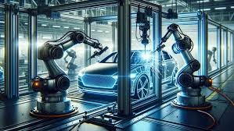
KEY POINTS
What Robots Do:
Robots can be programmed to perform many tasks, such as assembling cars, assisting doctors in surgeries, or even cleaning homes.
They can do tasks that are repetitive, dangerous, or require precision, which helps people stay safe and save time.
Types of Robots:
Industrial Robots: Used in factories for manufacturing tasks.
Medical Robots: Assist doctors in surgeries and patient care.
Service Robots: Help people in everyday tasks, like cleaning or delivering food.
Exploration Robots: Used in space or deep-sea exploration.

Slide 6
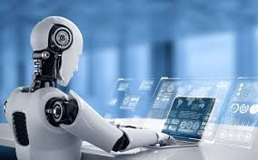
Advantages and Disadvantages of Robots:
Advantages:
Robots can work continuously without getting tired.
They can perform dangerous tasks safely.
Robots are often very precise.
Disadvantages:
Robots can be expensive to build and maintain.
They may replace some human jobs.
Programming robots can be complex.

Slide 7
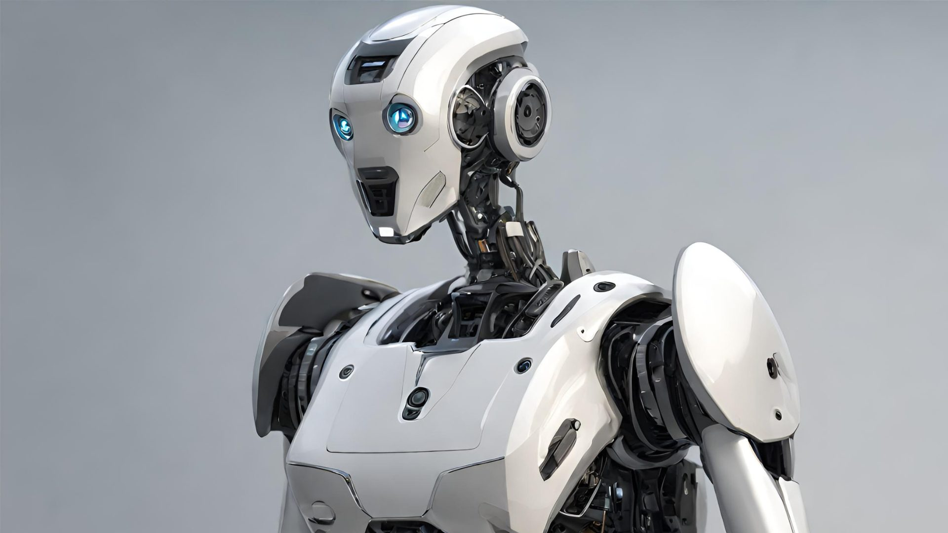
Discussion Questions
What are some jobs you think robots do better than humans?
Why do you think robots are used in places like factories or hospitals?
What are some advantages and disadvantages of having robots in everyday life?
How do you feel about robots replacing certain human jobs?
What new tasks do you think robots will do in the future?

Slide 8
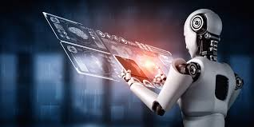
Conclusion and Recap
Robots are machines that can perform tasks automatically, often helping people by doing dangerous or repetitive tasks.
Robotics involves using robots for various tasks, such as manufacturing, medical care, and home assistance.
Robots have both advantages, like improving efficiency and safety, and disadvantages, like potential job loss and high costs.

