Slide 1

FINANCE AND BANKING
Created by Iryna Zhukevych
PhD in Pedagogical Sciences
Associate Professor

Slide 2
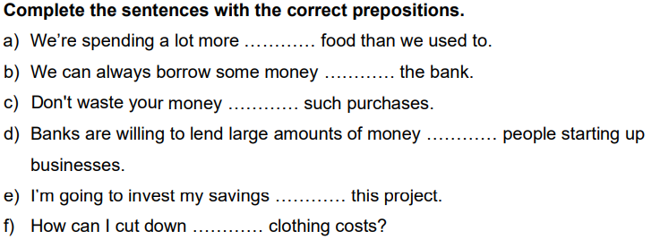
Are you a saver or a spender?

Slide 3

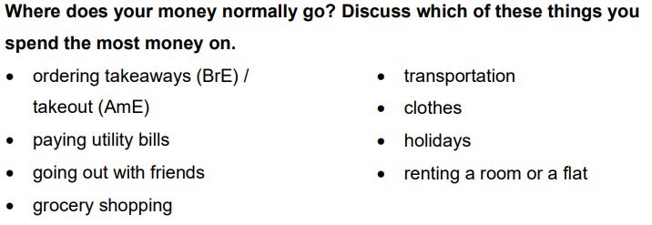
https://www.menti.com/alz2uqv8b3qp

Slide 4
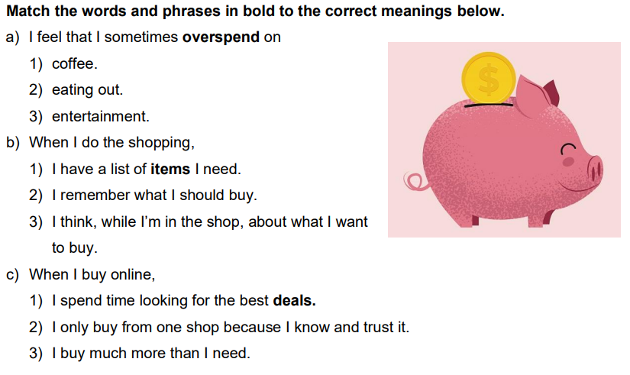

Slide 5
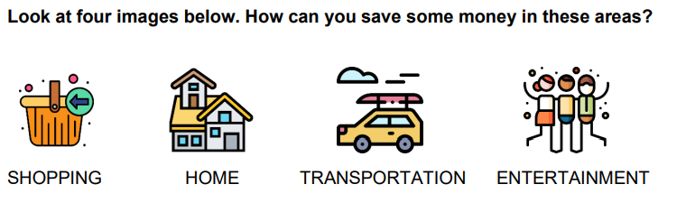

Slide 6

Watch an interactive video and answer the questions that will appear on the screen.
https://en.islcollective.com/english-esl-video-lessons/listening-comprehension/deep-listening-focus-on-meaning/are-you-a-saver-or-a-spender-how-to-save-money/236354

Slide 7
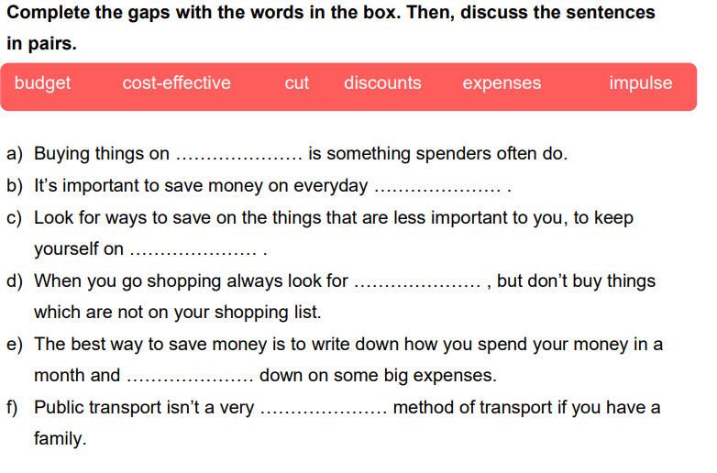

Slide 8

Steps for Money Management and Financial Planning
https://www.youtube.com/watch?v=CU4l_rs50Kk&t=33s
1. What is the main argument presented in the video?
2. How does the speaker support their claims? Provide specific examples mentioned in the video.
3. What implications do the ideas discussed in the video have for current practices in the field?
4. Describe any counterarguments presented in the video. How does the speaker address them?
5. Reflect on your own understanding of the topic before and after watching the video. What changed?
Це фото; автор: Невідомий автор; ліцензія: CC BY

Slide 9

How to Set Financial Goals | Step-by-Step Guide
https://www.youtube.com/watch?v=Duxo4xXeMec
Це фото; автор: Невідомий автор; ліцензія: CC BY

Slide 10

Market Leader Advanced
SB p.66-69. Audio 2.30-2.32
https://classroom.google.com/c/NzEzMTY3NDM0MzUx/m/NzEzMTY2NDE1OTkw/details

