Slide 1

Basic concepts in sociology
Created by Iryna Zhukevych
PhD in Pedagogical Sciences
Associate Professor

Slide 2

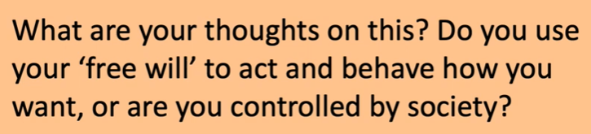

Slide 3
Watch the video about Sociology and do online exercises
https://www.liveworksheets.com/node/5945268

Slide 4
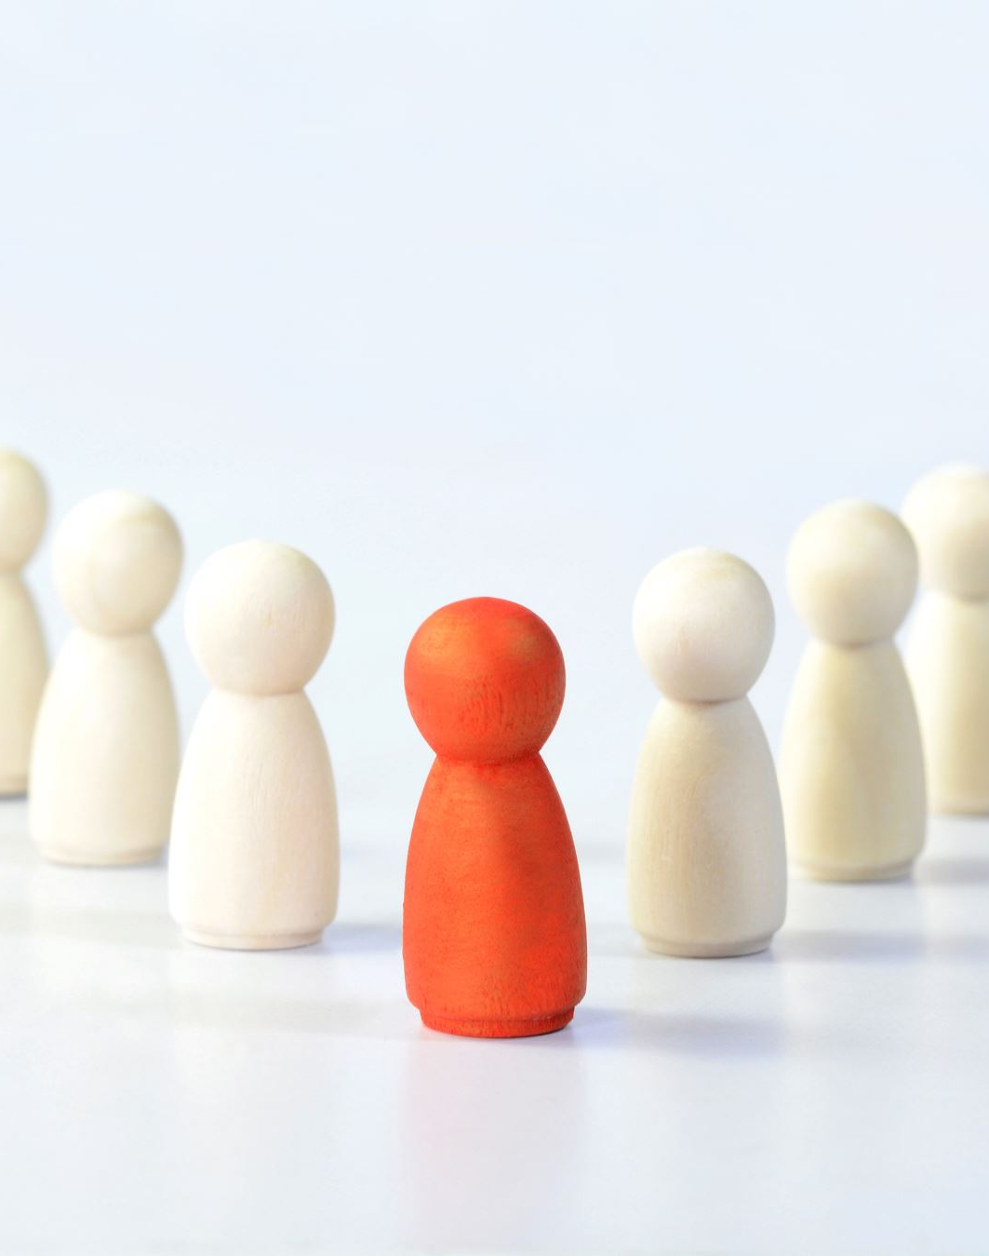
Sociology is the scientific study of human society and social behavior
Watch the video and consider the importance of understanding sociology in everyday life and making informed decisions.
https://www.youtube.com/watch?v=32KG_ba_NJc

Slide 5

Explain socialization as the process of learning to become a member of society.
Examples: Agents of socialization (e.g., family, university, media)
Discussion: How do we learn social norms and expectations?

Slide 6
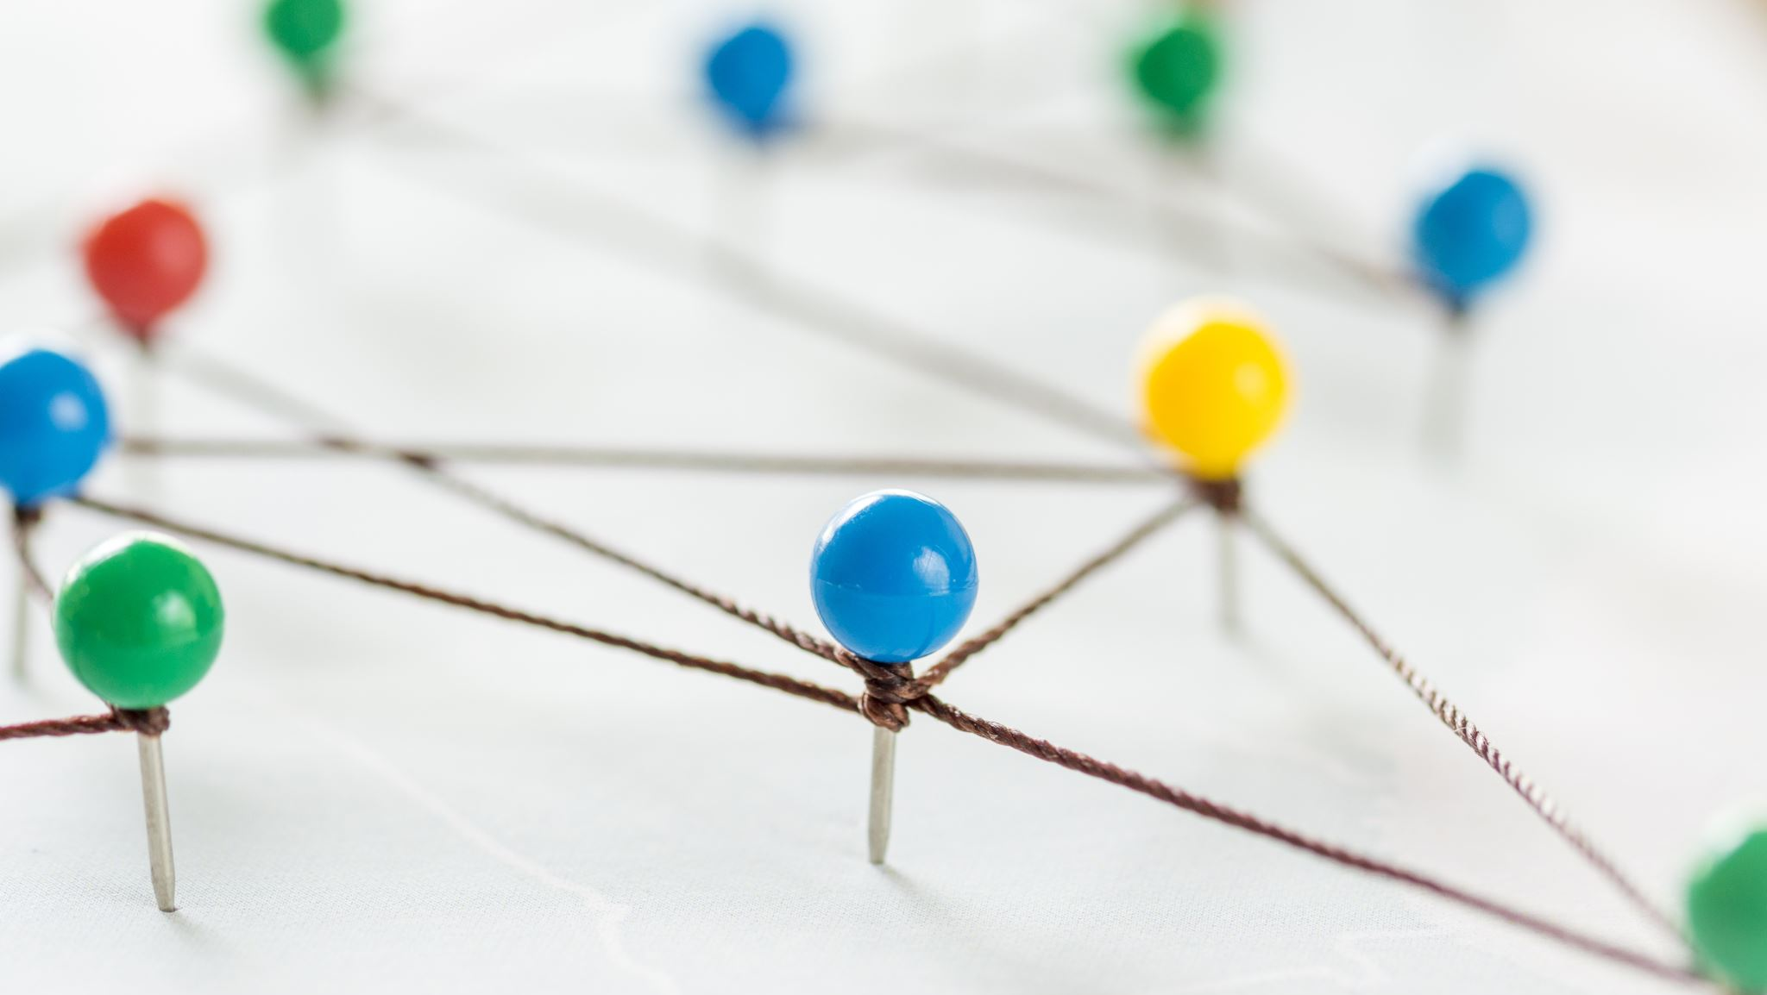
Choose the correct word to complete the sentence
https://www.liveworksheets.com/node/4689152

Slide 7
Watch the video about the experiment about what principles we need to design a fair society and answer the questions https://ed.ted.com/lessons/3-easy-steps-to-build-a-real-utopia-joseph-lacey
1. What is the primary purpose of the "veil of ignorance" as described by John Rawls?
a. To allow individuals to know their wealth
b. To ensure fairness in designing a society
c. To determine one's natural talents
d. To limit the influence of religion
2. According to Rawls, which of the following is NOT included in the primary goods?
a. Basic liberties
b. Opportunities
c. Political power
d. Wealth
3. What principle does Rawls propose to justify some level of wealth inequality?
a. The equality principle
b. The advantage principle
c. The difference principle
d. The freedom principle
4. Rawls believed that a just society could be achieved through which model?
a. Welfare capitalism
b. Property owning democracy
c. Marxist communism
d. Totalitarianism
5. Which philosopher critiques Rawls by suggesting that the difference principle unfairly ties society's progress to the worst-off?
a. John Stuart Mill
b. Ronald Dworkin
c. Martha Nussbaum
d. Friedrich Nietzsche

Slide 8

Game.
Speaking cards
https://wordwall.net/resource/78724353/sociology-and-marketing

Slide 9

Thanks for your attention and collaboration

