Slide 1
Present Tenses

Slide 2
Як часто
Present Simple
V+s (he, she, it)
Don’t
Doesn’t
Do
Does
+V
+V?

Slide 3
1. I (read) the newspaper every day.
2. She (like) computers.
3. They usually (go) to school by bus.
4. We (want) ice cream.
5. He (study) French, German and English.
6. You always(walk) very fast.
7. I (play) football and basketball.
8. She never (finish) her homework quickly!
9. It (work) very slowly.

Slide 4
1) Every day, regularly
Always 100%
Usually 90%
Often 70%
Sometimes 50%
Seldom (rarely) 10%
Never
0%

Slide 5
2) Timetable (plane, concert, lecture…)
Ex.: The Restaurant opens at 4.00.
3) Generally known fact
Ex.: The sun rises in the east.

Slide 6
Зараз
Present Continuous am/is/are + Ving am/is/are not + Ving
Am/is/are n + Ving?
He is writing now.
He is not writing
Is he writing?

Slide 7
I (read) the newspaper now.
She (go) to the cinema today.
We (want) ice cream now!
Listen! You (walk) very fast.
I (play) football this evening.
She still (do) her homework quickly!
Look! It (work) very slowly.

Slide 8
Now=at the moment
Today
Tonight
Still
This (day)
Look! Listen
Today I am writing a test.
2) Changing situation
1. He is recovering.
2.More and more people are buying cars.
3) Personal fixed plans
I‘m coming at 5 o‘clock.

Slide 9
REPETITION AND IRRITATION (ALWAYS)
The Present Continuous with 'always', 'constantly' expresses the idea that something irritating or upsetting often happens.
She is always coming to the office late.
He is constantly talking.
They're always complaining.

Slide 10
State Verbs
write
know
Now I am writing.
Now I know him.
love
like
hate
remember
forget
understand
belong

Slide 11
Результат
Present Perfect
Have/has + V3/ed
Have/has (not) + V3/ed
Have I (we, you) + V3/ed?
Has (He, she, it) + V3/ed?

Slide 12
I just (read)… the newspaper.
She never (watch) the films in the cinema today.
You already (write) this test.
I always (play)…football in evenings.
She still ( not do)…her homework.
Recently He (call) me.

Slide 13
I bought a car yesterday.
I have bought a car.
Just, already, yet (-,?)
Always, never,
still (-), today, this day
3) Ever?
4) So far
5) Recently (lately)
6) 2 times
7) It‘s the first time
8) Before
9) For, since (state verbs)

Slide 14
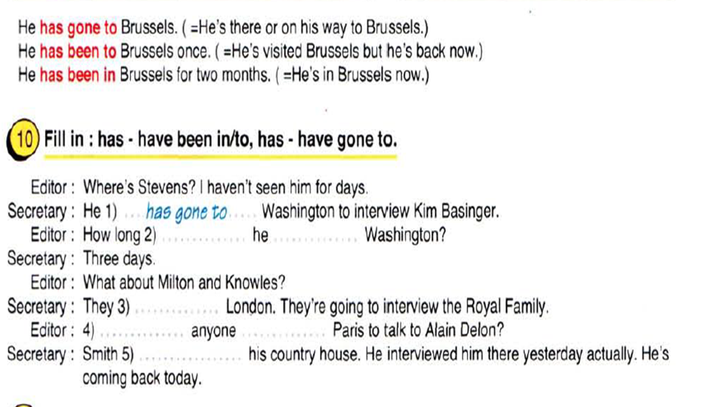
He has gone – поїхав (ще не повернувся)
He has been to – побував (вже повернувся)
He has been in – перебуває (протягом деякого часу)

Slide 15
Як довго
Present Perfect Continuous
Have/has + been + Ving. (+)
Have/has (not) + been + Ving (-)
Have (I, we, you) + been + Ving?
Has (he, she, it) + been + Ving?

Slide 16
I (read) the newspaper for 2 days.
She (watch) the films in the cinema since 7 o’clock.
Recently you (write) this test.
I am angry. I (argue) with my friends.
She (not do) her homework all day.

Slide 17
1.
For
Since
All day
Recently
How long
2.
He is tired, because he has been working (for 7 hours).

Slide 18
Present Simple
Present Continuous
Present Perfect
Present Perfect Continuous
He (work) We (run) They (hunt) I (sing) You (play) | She (buy) a car. Now already Never Still For Since 2020 Just

