Slide 1

Іntroduction to Legal Systems: Overview of Common Law and Civil Law Systems
Created by Iryna Zhukevych
PhD in Pedagogical Sciences
Associate Professor

Slide 2
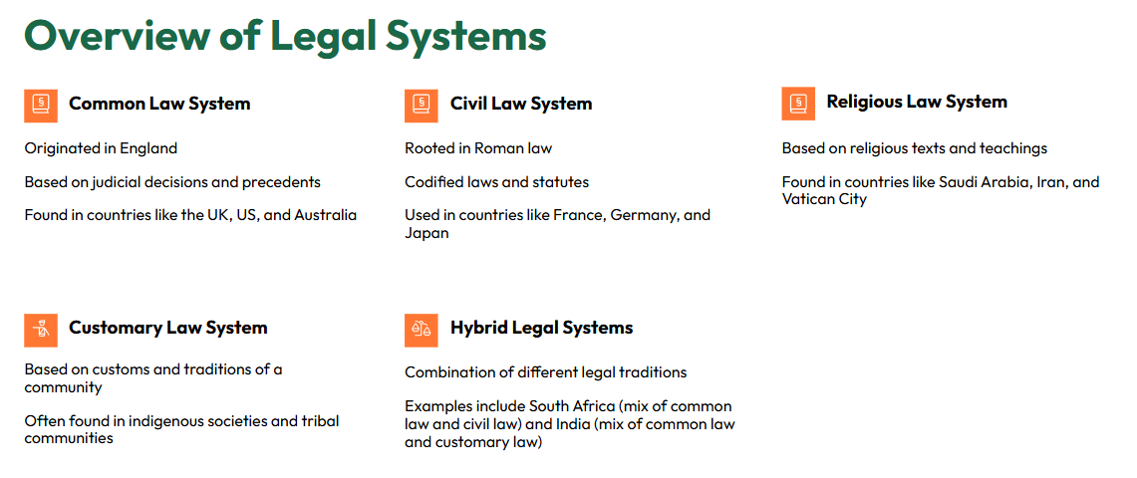

Slide 3
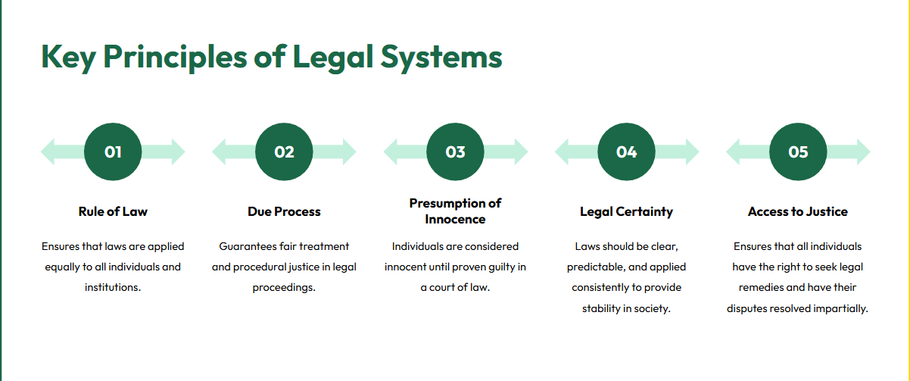

Slide 4
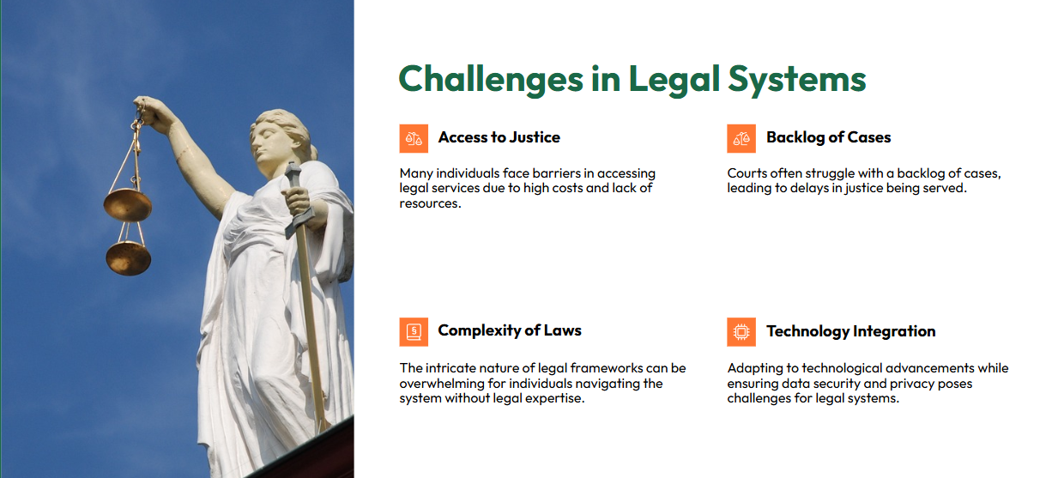

Slide 5


Slide 6

What is Common Law?
Common law is a legal system that originated in England, characterized by the reliance on judicial precedents and case law. It emphasizes the adversarial system, where judges play a critical role in interpreting laws based on previous rulings and societal needs.

Slide 7

What is Civil Law?
Civil law is a legal system rooted in Roman law, distinguished by its codified statutes. This system emphasizes written laws and regulations, with judges acting as investigators who apply these codified laws to resolve disputes.
Це фото; автор: Невідомий автор; ліцензія: CC BY-SA-NC

Slide 8
Pre-watching activity.
Video Highlight: Legal Systems in Action
https://www.youtube.com/watch?v=9_M4bNOxsYs
1
How do you think the legal system affects people's lives in your country?
2
Have you ever been involved in a legal situation? How did it make you feel?
3
Do you believe that having written laws is more effective than relying on judicial precedent? Why or why not?
4
In your opinion, what qualities make a good judge?
5
How important do you think it is for people to understand their legal rights?

Slide 9
After-watching activity
1
What is common law based on?
2
How did colonists bring England's common law to America?
3
Where does the law originate from in common law systems?
4
How do parties prove their cases in a common law system?
5
What is the primary source of law in civil law systems?
6
How are trials conducted in civil law systems different from common law systems?
7
What role does the civil law judge play during a trial?

Slide 10
Critical Thinking
Evaluate the strengths and weaknesses of both common law and civil law systems. Which system do you believe is more adaptable to changing societal needs, and why?
How do you think globalization and international trade have influenced the convergence or divergence of common law and civil law systems? Provide examples to support your answer.

