Slide 1

Success: the memory men.
Present and past ability.
Created by Iryna Zhukevych
PhD in Pedagogical Sciences
Associate Professor

Slide 2

Do you know anyone that has a very good memory for past events? What can they remember?

Slide 3
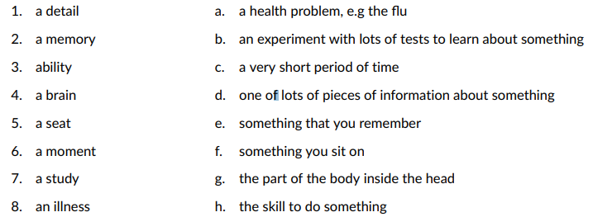
Match the words on the left to their definitions on the right.

Slide 4
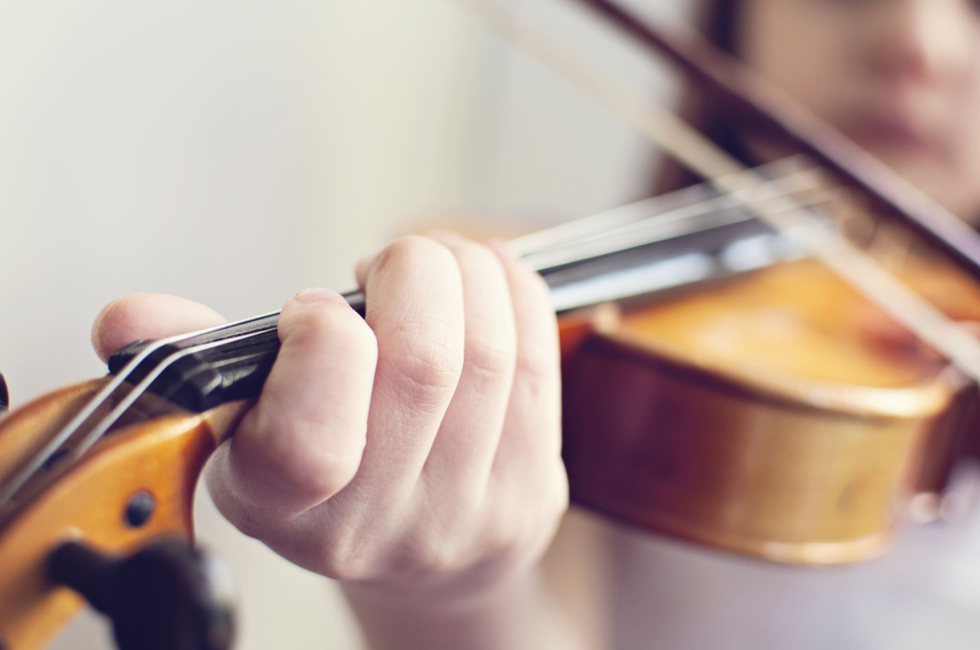
Debate the following question:
"Is success primarily determined by innate talent or hard work?"

Slide 5
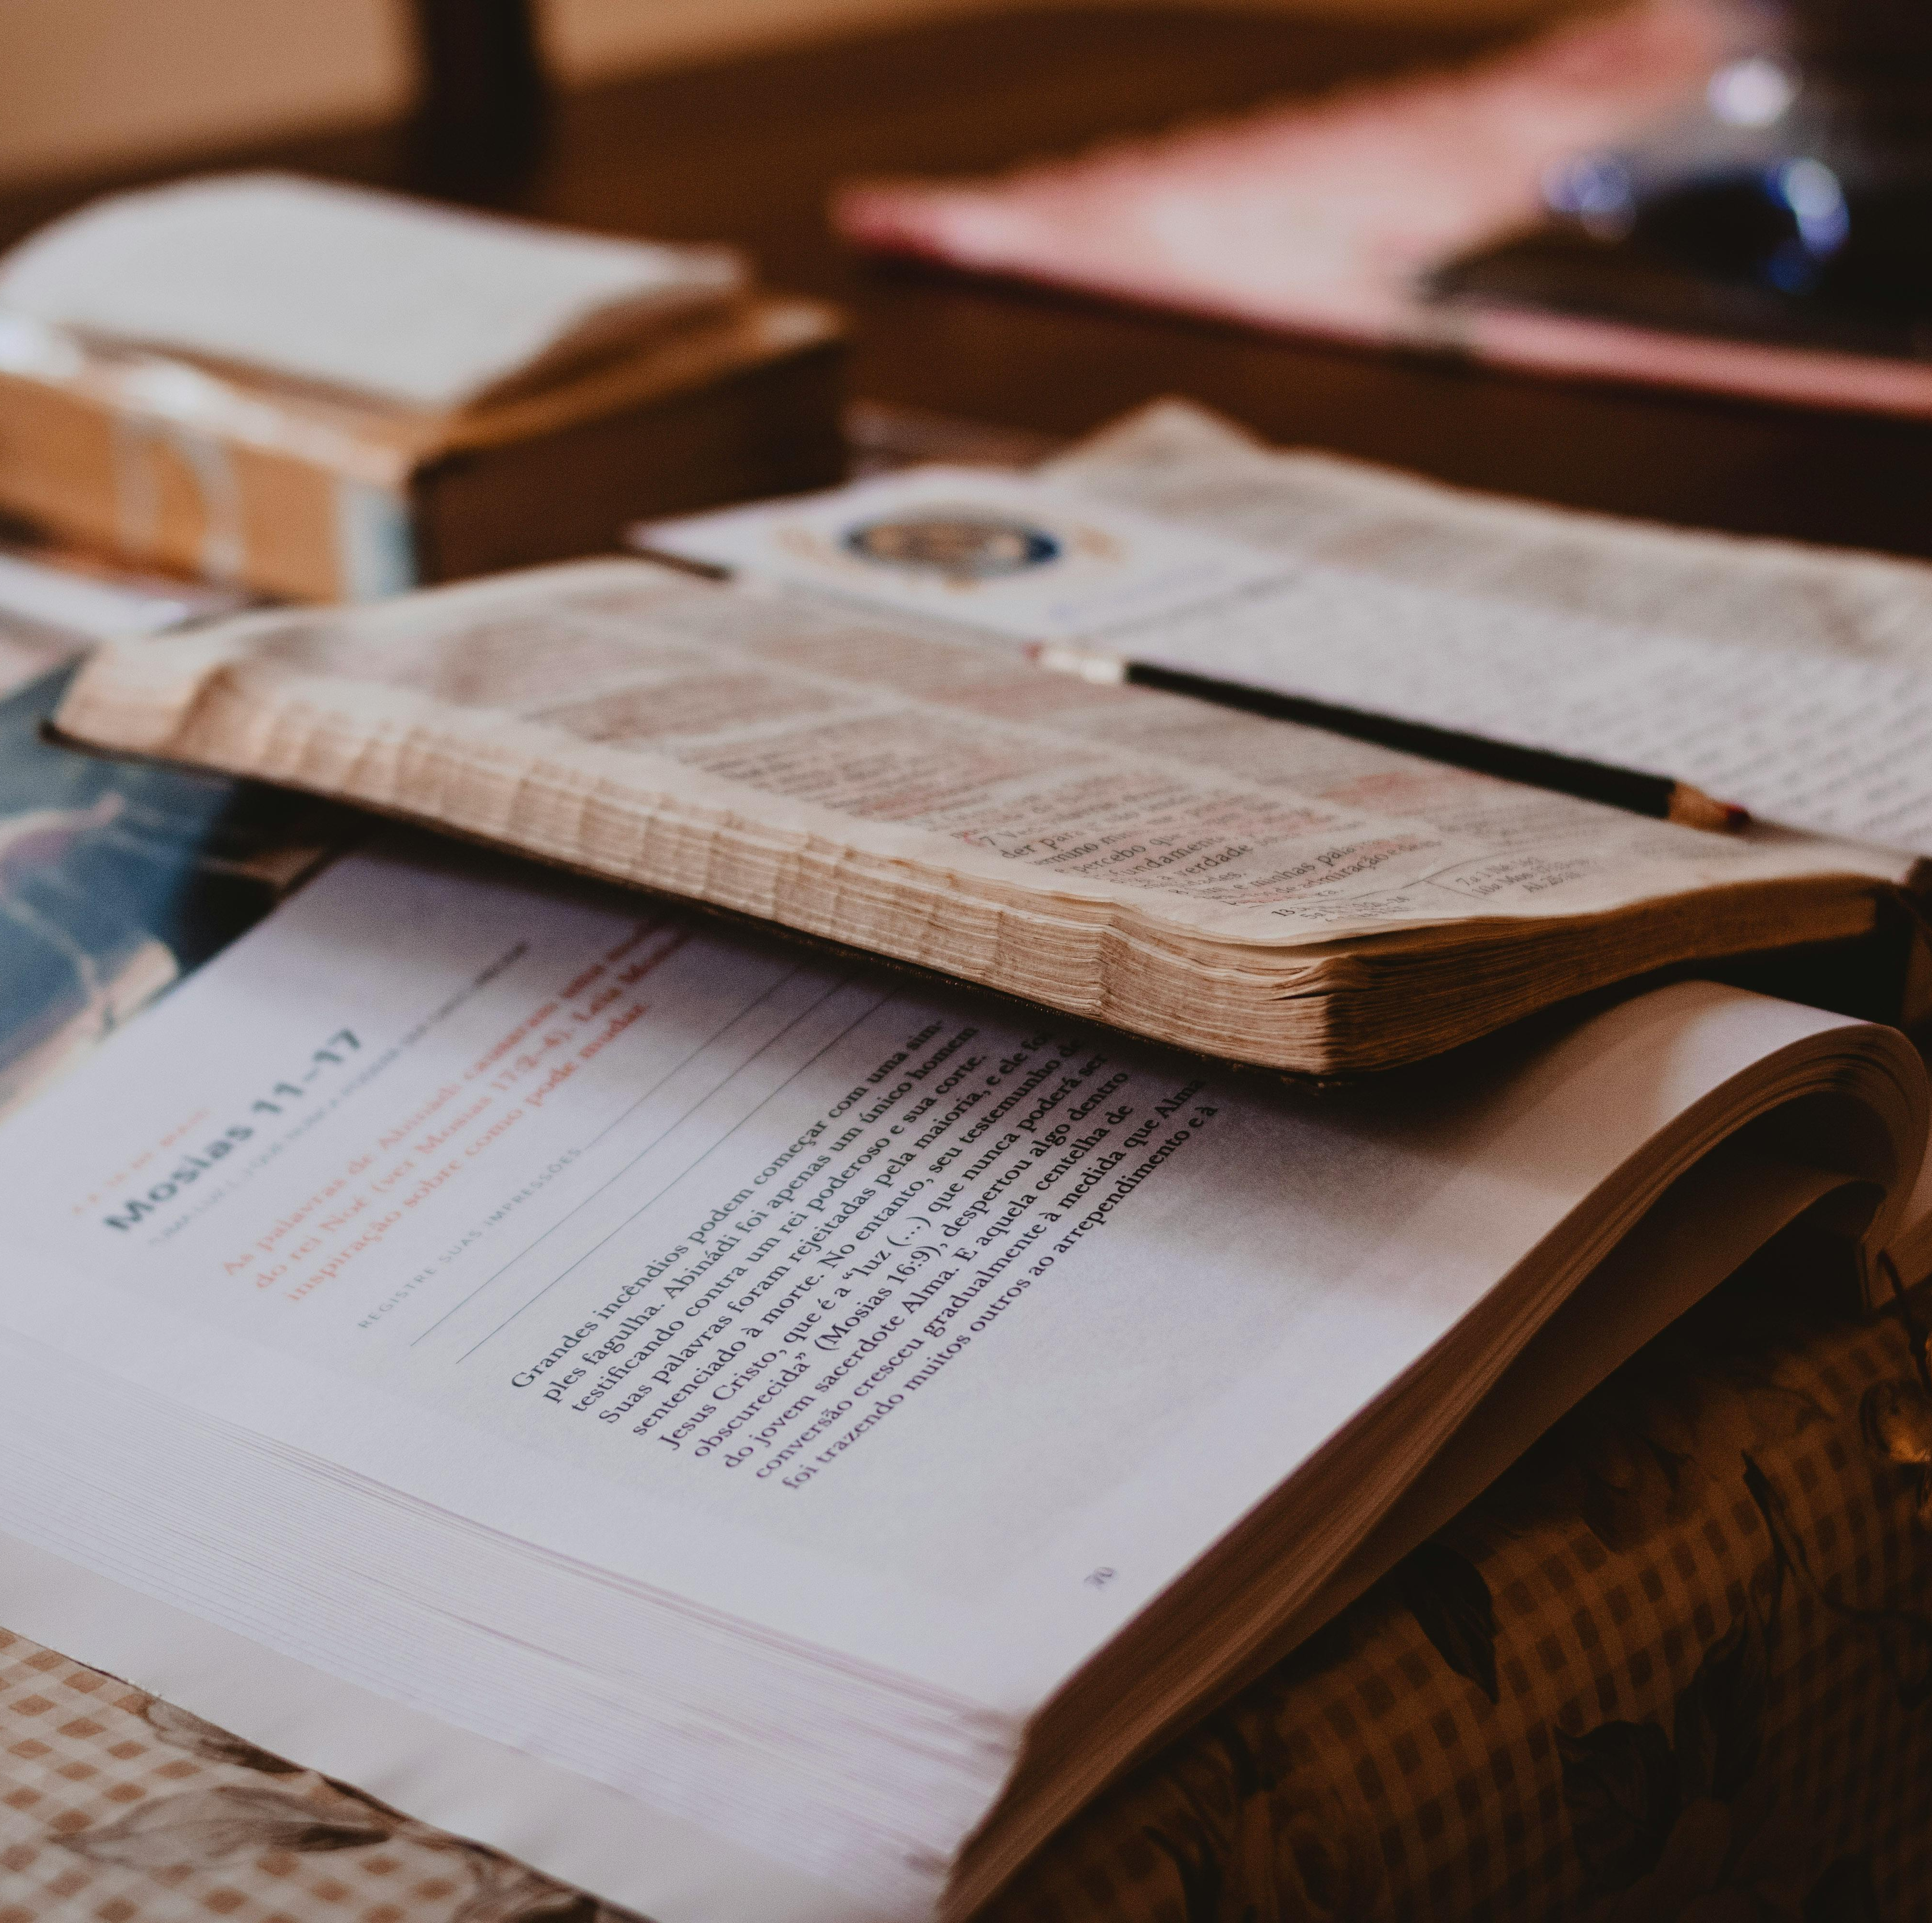
Student’s book. Speakout Intermediate
https://classroom.google.com/w/NzEwNzkyMDg4MzYw/tc/Njg2NDA4OTM4MDE2
p. 83, ex. 2-4

Slide 6

Workbook.
Speakout Intermediate
p. 48, ex. 1
https://classroom.google.com/w/NzEwNzkyMDg4MzYw/tc/Njg2NDA4OTM4MDE2

Slide 7
Grammar. Present and Past ability
Speakout. Intermediate
Student’s book p. 84, ex. 5-7
Workbook p. 48, ex. 2-3.

Slide 8

Celebrities' Hidden Talents
https://en.islcollective.com/english-esl-video-lessons/listening-comprehension/deep-listening-focus-on-meaning/celebrities-hidden-talents/648337
Це фото; автор: Невідомий автор; ліцензія: CC BY-SA

Slide 9

Speaking Cards
https://wordwall.net/resource/80399221/memory-and-abilities
Це фото; автор: Невідомий автор; ліцензія: CC BY-SA

