Slide 1

ADVERTISING
Created by Iryna Zhukevych
PhD in Pedagogical Sciences
Associate Professor

Slide 2
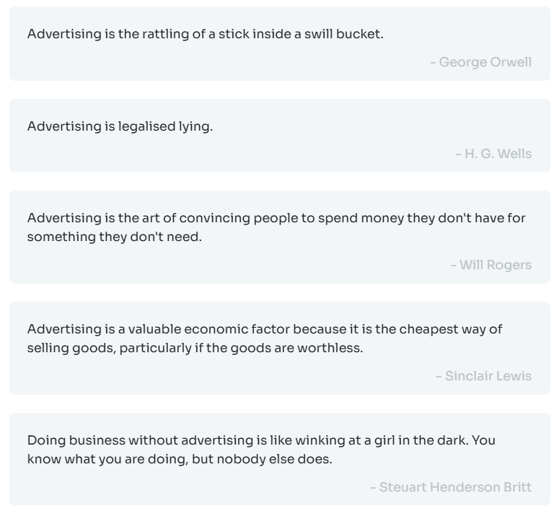
Read these quotes and choose one that you agree with the most!

Slide 3

Do you think the pros outweigh the cons? Why?
Pros:
1. Helps businesses reach new customers and sell their products.
2. Informs people about new services, deals, or events they might like.
3. Can create brand awareness and loyalty among consumers.
4. Supports free media platforms that rely on advertising for funding.
5. Encourages competition, which can lead to better quality products and prices.
Cons:
1. Can be annoying and disruptive, especially with too many ads.
2. May spread unrealistic expectations or stereotypes in society.
3. Often targets vulnerable audiences, such as children or those with low self-esteem.
4. Can be costly for small businesses with limited budgets.
5. Sometimes uses misleading information, making it hard for consumers to trust brands.

Slide 4

Why are advertisers tracking your emojis?
https://www.youtube.com/watch?v=RK1K78PyWDc

Slide 5
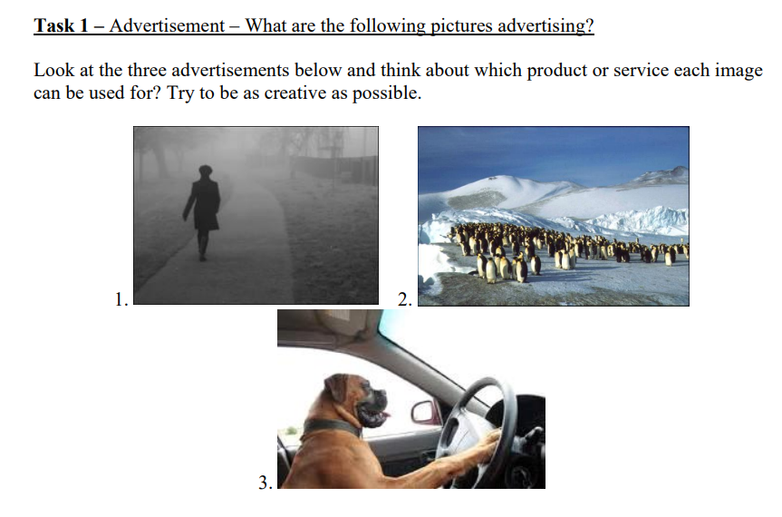

Slide 6
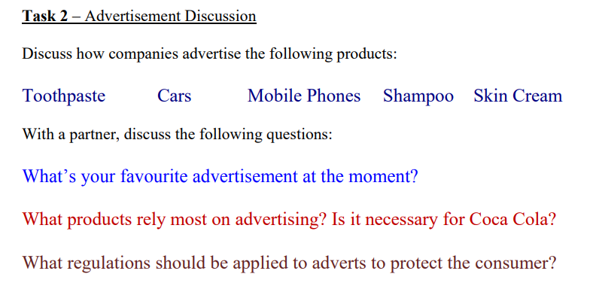

Slide 7

Watch the following advert by Coca Cola.
https://www.youtube.com/watch?v=ogetBqMgau0
Make a note of the following:
What is good and bad about the advert?
What advertising techniques do they use

Slide 8
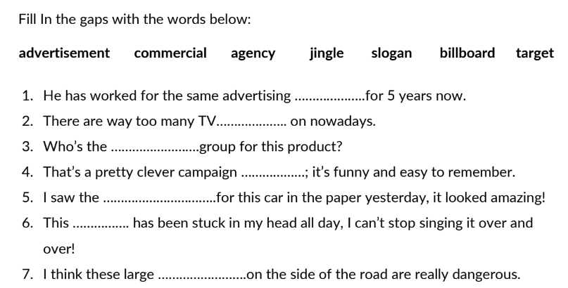

Slide 9

Practice
https://en.islcollective.com/english-esl-video-lessons/listening-comprehension/basic-listening-focus-on-hearing/advertisingmarketing/the-history-future-of-advertising/840956

