Slide 1

Academic integrity and plagiarism

Slide 2

Discussion Questions:
"What do you think academic integrity means?"
"Have you heard of plagiarism? What do you know about it?"
Academic integrity refers to the ethical guidelines and principles that govern academic work. It means being honest and responsible in your studies and giving proper credit to others’ work. Plagiarism, a violation of academic integrity, is using someone else’s words or ideas as if they were your own.

Slide 3
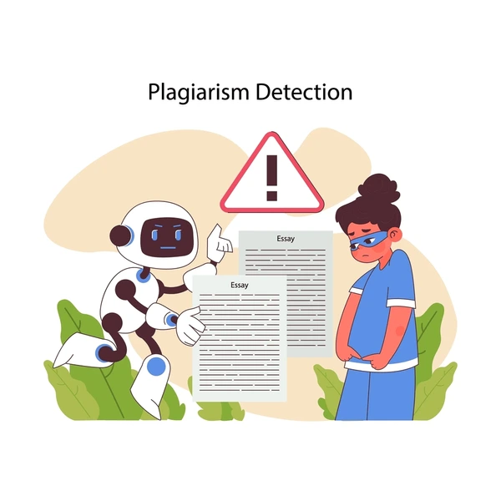
KEY TERMS
Academic Integrity: Honesty and fairness in academic work. Example: Completing an exam without cheating.
Plagiarism: Copying someone else’s work or ideas without giving credit. Example: Copy-pasting from the internet and claiming it as your own.
Citation: Giving credit to the source of the information. Example: Using MLA or APA format to cite a book.
Paraphrasing: Rewriting information in your own words while still giving credit to the source.
Self-Plagiarism: Reusing your previous work without permission or acknowledgment.

Slide 4

True or False Quiz
Plagiarism is allowed if you do not get caught. (False)
You must cite your source even if you only paraphrase it. (True)
Using your own words is the same as copying. (False)
Academic integrity is only important in university, not in the workplace. (False)

Slide 5
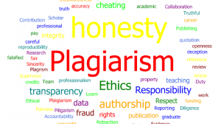
Strategies to Avoid Plagiarism
Discussion Questions:
"How can you avoid plagiarism when working on assignments?"
"What are some strategies to help you remember to cite sources?"
Suggested Strategies:
Cite as you write: Keep a list of sources as you research.
Use quotation marks: For any direct quotes, use quotation marks and give credit.
Paraphrase: Practice putting information in your own words.

Slide 6

Role-Play Scenarios
You find a perfect article online that explains the topic of your research paper. Should you copy it? What should you do?
A friend asks to see your assignment so they can “check their answers.” Would you show it to them? Why or why not?
You don’t have time to finish an assignment, but you have a similar paper you submitted last semester. Is it okay to reuse part of it?
You’re writing an essay and remember reading something similar in a book. Should you cite it?

Slide 7
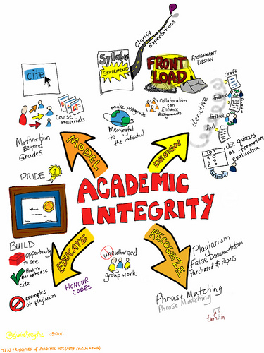
Wrap-Up and Review
True or False Questions
It’s okay to use someone’s words without a citation if you change some words. (False)
Academic integrity is only important in high school and university, not in work. (False)
Rephrasing someone else’s idea in your own words without citation is plagiarism. (True)

Slide 8

Conclusion
Summarize Key Points: Review the importance of academic integrity, ways to avoid plagiarism, and the key terms discussed.
Reflection Questions:
“Why do you think academic integrity is important for your future studies or career?”
“What steps will you take to ensure your work is honest and original?”

