Slide 1

Negotiating Sales
Created by Iryna Zhukevych
PhD in Pedagogical Sciences
Associate Professor

Slide 2
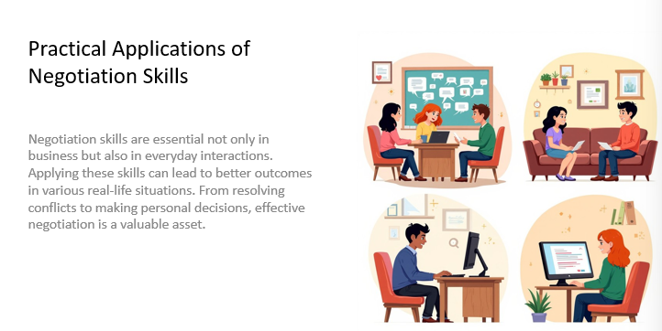

Slide 3
Market Leader. Advanced
SB. p. 78-79
Audio 2.45-2.46

Slide 4
Market Leader. Advanced
WB p. 51
Audio 23-25

Slide 5

How to Confidently Negotiate a Higher Salary: Salary Negotiation Tips to Get a Raise!
https://www.youtube.com/watch?v=XCp8IS3BZpk&t=3s
What does it mean to request a pay rise? Think of any similar phrases.

Slide 6

Practice
https://www.youtube.com/watch?v=-3mFnAk9sbw

Slide 7

A FEW GOLDEN RULES TO SUCCESSFUL
NEGOTIATIONS
https://www.englishclub.com/business-english/negotiations-process.php

Slide 8


Slide 9
Remember, as Roger Fisher and William Ury said:
'A good negotiation is not about winning or losing;
it’s about reaching a win-win solution.’

Slide 10

Thanks for your attention and collaboration!

