Slide 1
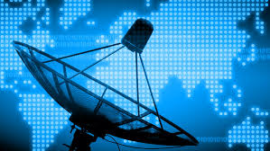
Radar Systems
Understanding the Basics and Applications of Radar Technology

Slide 2
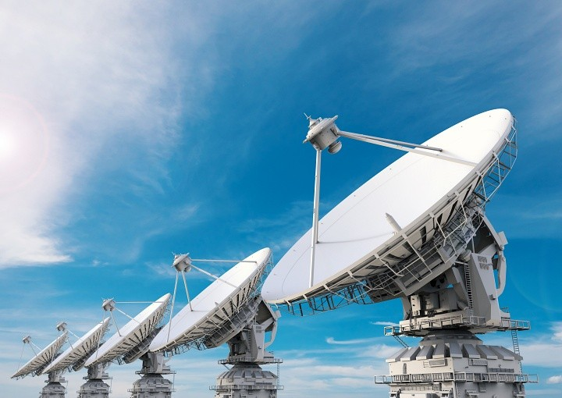
What is a Radar System?
Radar (Radio Detection and Ranging) is a system that uses radio waves to detect objects, measure distances, and track movements. It’s used in various applications such as aviation, weather monitoring, and military operations.

Slide 3
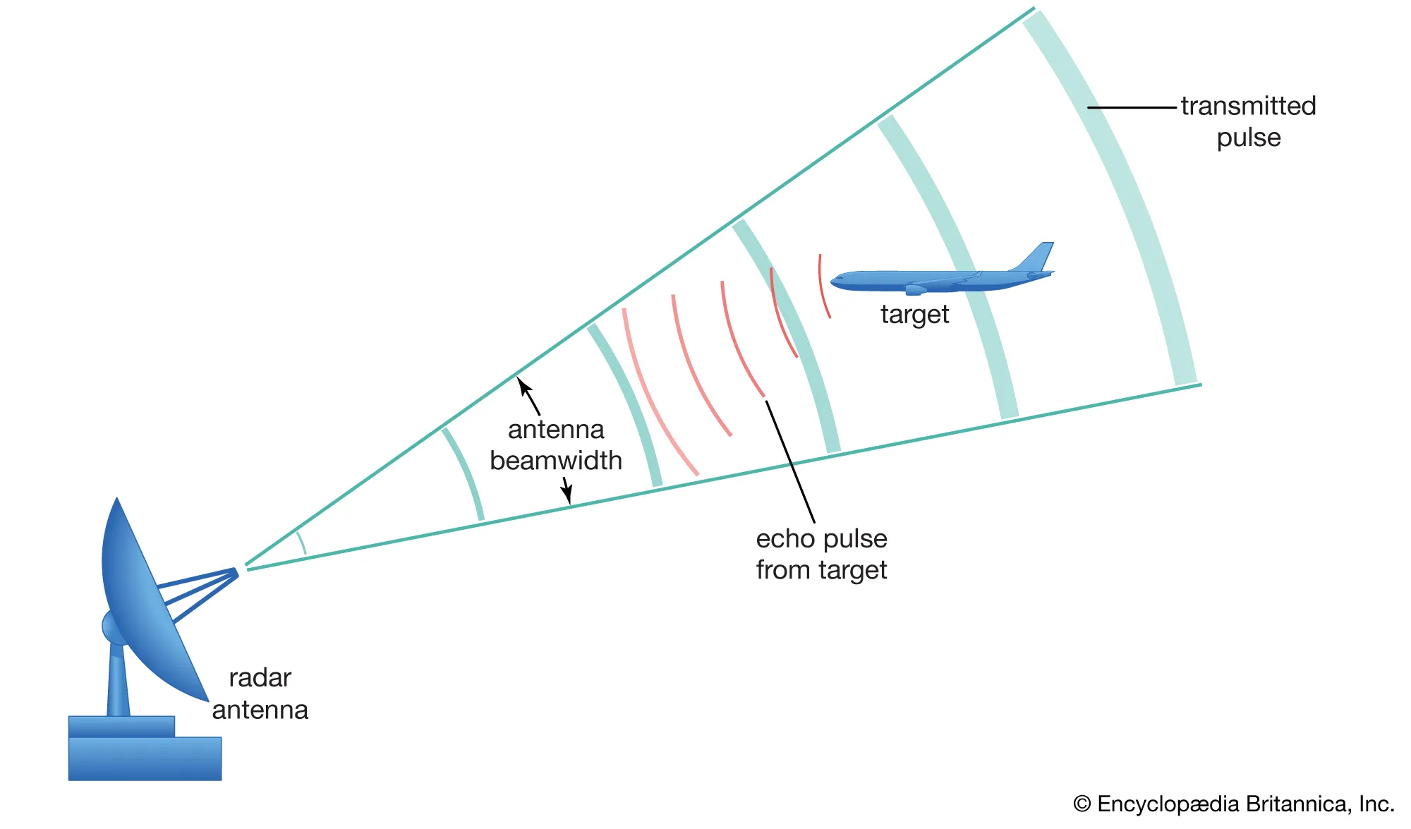
How Does Radar Work?
Radar systems send out radio waves that bounce off objects. The system measures the time it takes for the waves to return, calculating the distance, speed, and size of the object.

Slide 4
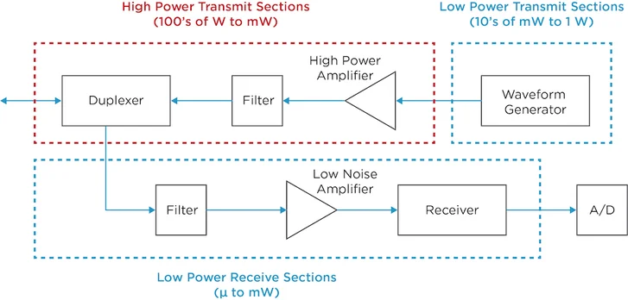
Components of a Radar System
1. Transmitter: Sends out radio waves.
2. Receiver: Detects the reflected waves.
3. Antenna: Sends and receives radio signals.
4. Display: Shows the data about objects detected.

Slide 5
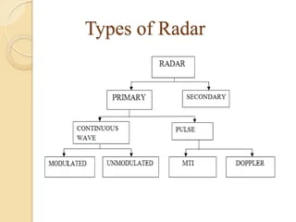
Types of Radar Systems
1. Pulse Radar: Sends out pulses of radio waves and measures the return time.
2. Continuous Wave Radar: Continuously sends out waves and measures Doppler shifts.
3. Phased Array Radar: Uses multiple antennas to scan large areas quickly.

Slide 6
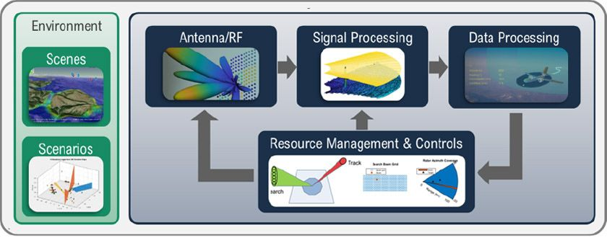
Applications of Radar
Radar is used in:
1. Aviation for air traffic control.
2. Weather monitoring to track storms.
3. Military operations for detecting aircraft and ships.
4. Automotive industry for collision avoidance systems.

Slide 7
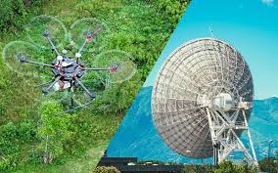
Advantages and Limitations of Radar
Advantages:
1. Can detect objects in all weather conditions.
2. Works over long distances.
Limitations:
1. Susceptible to interference.
2. Can have difficulty detecting small or stealth objects.

Slide 8
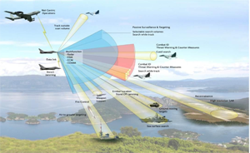
The Future of Radar Systems
Future radar systems will include advancements in precision and detection capabilities, integrating AI for smarter tracking, and expanding into new areas such as autonomous vehicle navigation and space exploration.

