Slide 1
Relative clauses
Складнопідрядні речення

Slide 2
PLAN
Який ????
2. The house (which/that) they bought is beautiful.
The students who failed the exam can sit it again in May.
3. Which, that, who????
4. Whose/Who‘s
5. The teacher who teaches maths is popular in the school.
Mr Jones, who teaches maths, is popular in the school.

Slide 3
Який
Who
(that)
Which
(that)
This is a book which/that I read yesterday.
The man who/that is calling now is my dentist.

Slide 4
Relative adverbs
Time | When (in/on/at which) | August is a month when a lot of tourists visit the place
Place | Where (in/on/at which) | That’s the hotel where the President is staying.
Reason | Why (for which) | Lack of money is the reason (why) we are not going on holiday.

Slide 5
Fill in: when, where, why, who, which, that or whose.
Jean Crowder, 1) _____ is 65, has a fascinating job. She works at a leisure centre, 2) _____ she teaches aerobics at classes 3) _____ attract women of all ages. Jean, 4)_____ slim figure and fashionable hairstyle make her look younger, first attended a keep-fit class 45 years ago 5) _____ she was a student. Then she heard about a class 6) _____ needed an instructor. That's 7) _____ she started this particular career. Jean's classes, 8) _____ last one hour, include dance and step exercises. Jean has some tips for those 9) ______ wish to stay young.

Slide 6
I met a girl who / that is from Paris.
That‘s a girl (who / that) I met yesterday.
I spoke to a man _____ I had met before.
I know a man _____ is a lawyer.

Slide 7
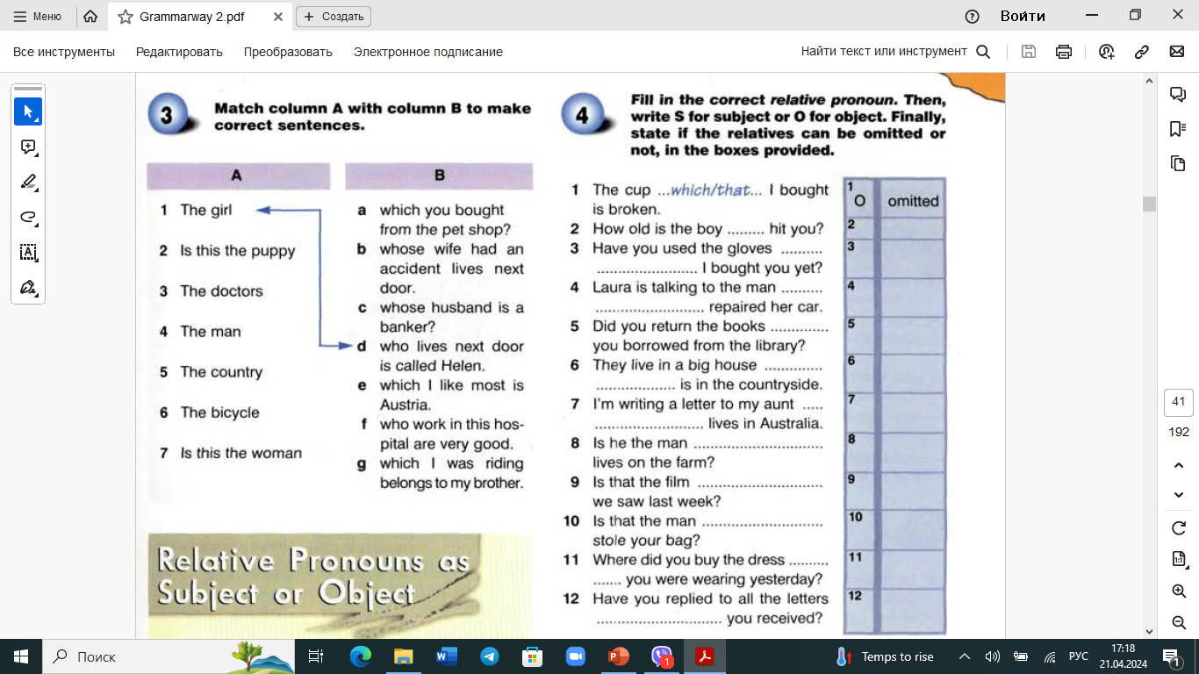

Slide 8
Whose
Who‘s
Чий
Who has
Who is
This is man whose house was bought yesterday.
This is man who’s run 20 km.
This is man who’s got a big house.

Slide 9
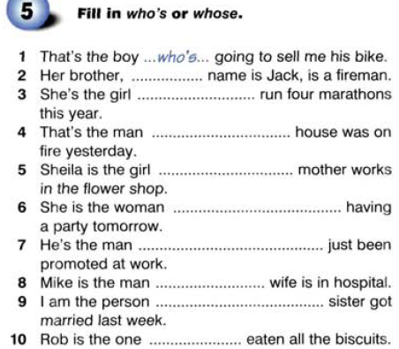

Slide 10
The house in which she lives is in Kyiv.
(formal-not usual)
The house which she lives in is in Kyiv.
(less formal)
The house she lives in is in Kyiv.
(more usual)
That‘s the boy with whom I shared the room.
The meeting to which I went was very boring.

Slide 11
Defining / non-defining clauses
1) People who / that park illegally should be fined.
2) David, who works hard, got a promotion.
, who / which / that ,
Вставне (неважливе речення з додатковою інформацією)

Slide 12
