Slide 1
Takeovers and mergers
Created by Iryna Zhukevych
PhD in Pedagogical Sciences
Associate Professor

Slide 2


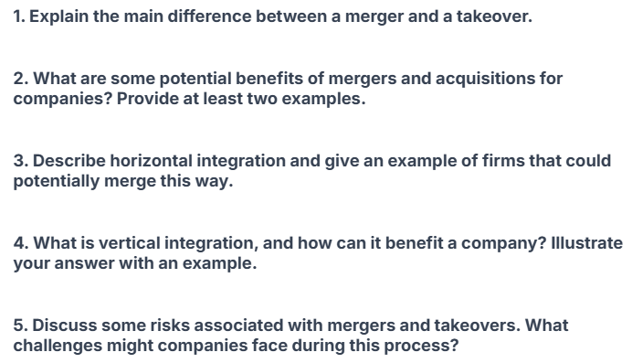

Watch the video and discuss the following questions
https://www.youtube.com/watch?v=h-NMPulJpco

Slide 3


Mergers vs. Takeovers Explained
Mergers involve the combination of two firms to form a new entity, often resulting in shared ownership and management.
Takeovers occur when one company acquires another, usually resulting in a change in ownership and control.
Mergers are typically consensual arrangements between equals, while takeovers can sometimes be hostile and unwanted by the target company.
The regulatory scrutiny can vary; mergers may require in-depth antitrust reviews, while takeovers might face less oversight in certain cases.
Photo by Pexels
Cultural integration is often smoother in mergers due to shared goals, while takeovers may face challenges in aligning different corporate cultures.

Slide 4






Pros of Mergers
Key Benefits
Considerations
Increased market power enables firms to influence prices and supply, creating a competitive advantage in the industry.
Potential loss of jobs might occur as companies streamline operations, affecting employee morale and community stability.
Reduced competition leads to greater profitability as firms can set higher prices without the pressure from rivals.
Regulatory scrutiny may arise, leading to legal challenges and delayed merger processes, impacting business strategy.
Shared resources, such as technology and talent, lead to operational efficiencies and cost savings, improving overall performance.
Cultural integration issues can cause conflicts and hinder collaboration, affecting the intended benefits of the merger.

Slide 5
Watch the video and do after-watching activity
https://www.youtube.com/watch?v=L8y6X786tFs

Slide 6
Understanding Mergers and Acquisitions
1. Mergers and Acquisitions (M&A) involve combining two or more companies into a single entity.
2. In a merger, one company typically purchases another company.
3. The merger between T-Mobile and Sprint took place in 2019.
4. Cultural clashes can lead to failure in M&A deals.
5. Dell Technologies was formed as a result of a merger with EMC Corporation.
6. Acquisitions can help firms diversify their operations.
7. Facebook's acquisition of WhatsApp was an example of a merger of equals.
8. The merger between Daimler Benz and Chrysler was ultimately considered successful.
9. Regulatory issues can prevent M&A deals from going through.
10. A key benefit of M&A is market contraction.

Slide 7
Pros of Takeovers
Advantages of Takeovers
Disadvantages of Takeovers
Takeovers can accelerate growth by allowing companies to expand rapidly without starting from scratch in new markets.
Access to new technologies is often achieved through takeovers, which can enhance innovation and efficiency in operations.
Takeovers provide opportunities to eliminate competition, leading to increased market share and pricing power in the industry.

Slide 8

Future of Mergers and Acquisitions
Explore the upcoming trends in the landscape of mergers and takeovers. This slide presents potential growth areas, industry shifts, and the influence of technology on future deals.
Photo by Pexels

Slide 9
Fill in the blank with the correct words. antitrust, efficiencies, takeover, integration, mergers
A __ occurs when one company gains control of another by purchasing a significant portion of its stock.
__ are the result of two companies combining to form a single entity.
One of the main benefits of mergers is the potential for __, which can reduce operational costs.
__ concerns can arise when a merger or takeover significantly reduces competition in the market.
Cultural __ can be a major challenge in the integration process after a merger.

Slide 10
SPEAKING CARDS
https://wordwall.net/resource/80727010/takeovers-and-mergers

