Slide 1
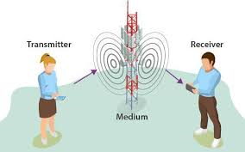
Radio Communication Systems
Understanding How Radio Waves Power Global Communication

Slide 2
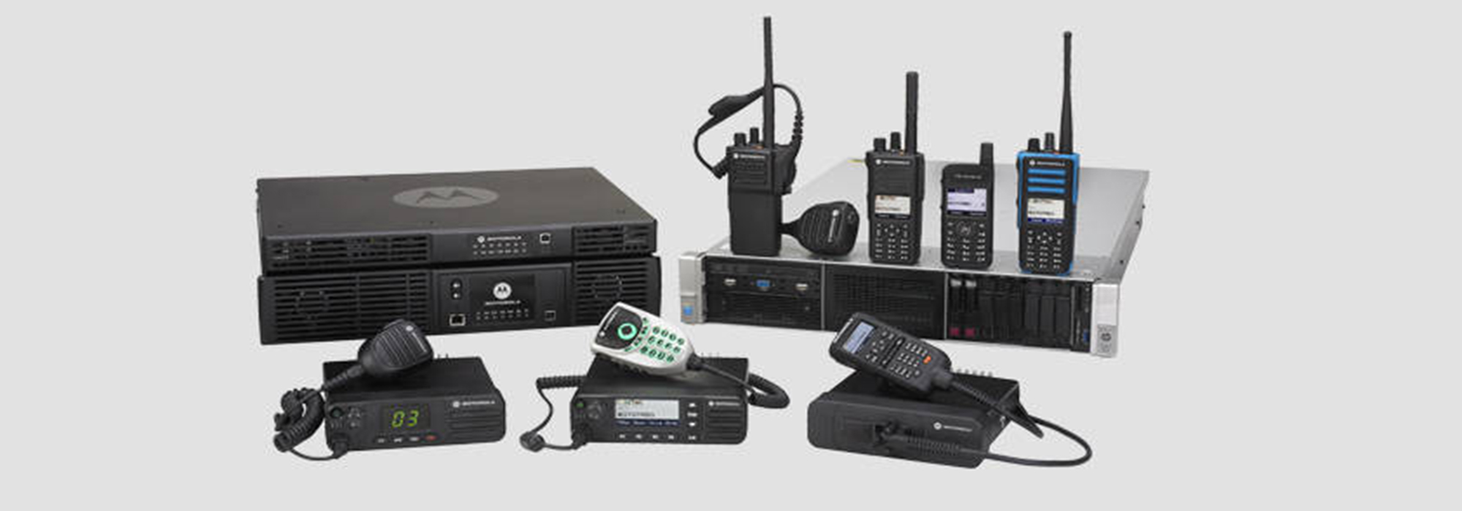
What is a Radio Communication System?
A radio communication system transmits data using radio waves. These systems include components like transmitters, receivers, and antennas, and are vital for wireless communication.

Slide 3
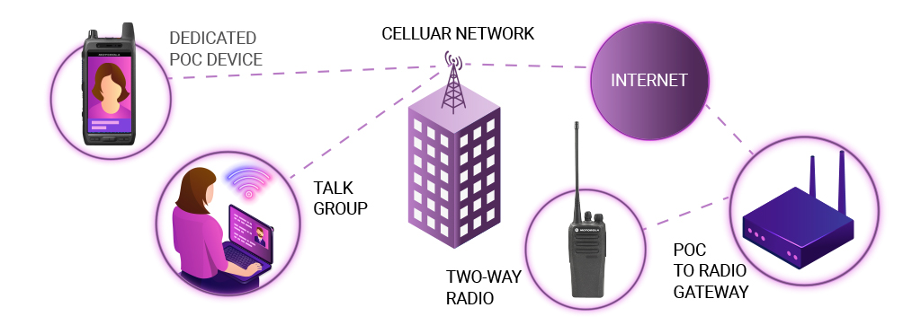
How Do Radio Waves Work?
Radio waves are electromagnetic waves that carry signals over long distances. They are produced when electric current flows through a conductor, like an antenna, and are captured by receivers.

Slide 4
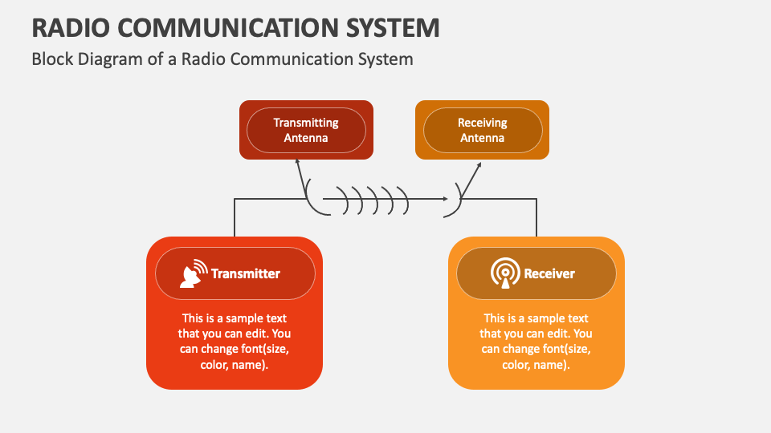
Components of Radio Communication
1. Transmitter: Sends the signal.
2. Receiver: Receives the signal.
3. Antenna: Transmits and receives radio waves.
4. Modulation: Converts data into radio signals.

Slide 5
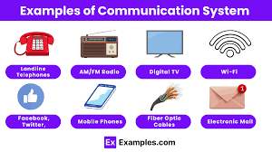
Types of Radio Communication Systems
1. AM and FM Radio
2. Cellular Networks
3. Satellite Communication
4. Wi-Fi and Bluetooth

Slide 6
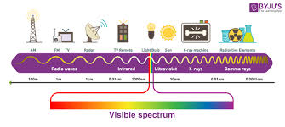
Radio Waves and Frequency
Radio waves are classified by their frequency. Low-frequency waves, like AM radio, travel far, while high-frequency waves, such as those used for Wi-Fi and 5G, provide faster data transmission.

Slide 7
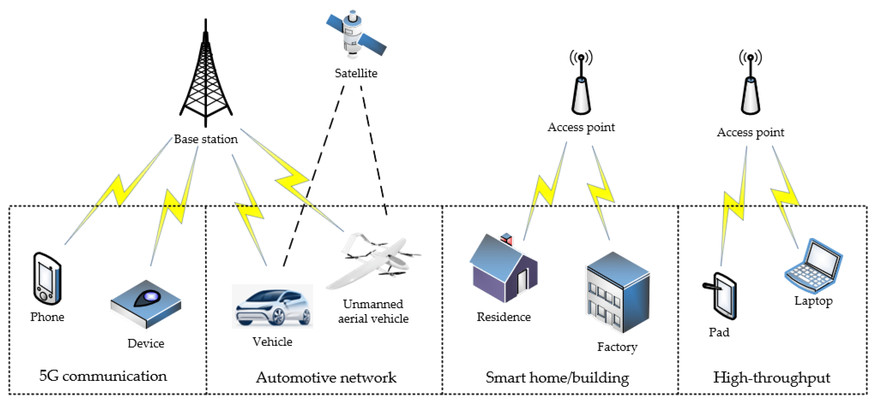
Applications of Radio Communication
Radio communication is used in:
1. Broadcasting (Radio and TV)
2. Mobile Phones
3. Internet (Wi-Fi)
4. GPS and Navigation

Slide 8
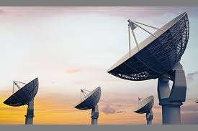
Future of Radio Communication
The future of radio communication includes advanced 5G networks, Internet of Things (IoT) devices, and satellite communication technologies, improving global connectivity and data transfer speeds.

