Slide 1
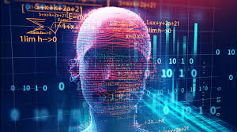
INTRODUCTION TO COMPUTER SCIENCE

Slide 2
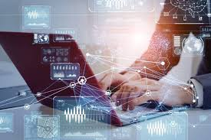
Tech Timeline
List major technological breakthroughs you know (e.g., invention of the internet, rise of AI, etc.).
Create a timeline and discuss how computer science has evolved.
Which breakthrough do you think had the biggest impact?
What is (if there is) a scary part about that? Does anything concern you?
What question would you like to be asked about computer science?

Slide 3
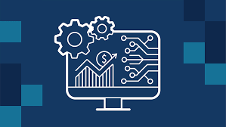
Discussion Questions
How does computer science impact industries like healthcare, finance, and education?
What is the role of programming languages in IT? Which do you think is most useful?
How has cloud computing changed the way businesses operate?
Why is cybersecurity critical in today's digital world?
What ethical challenges arise from AI and automation?

Slide 4
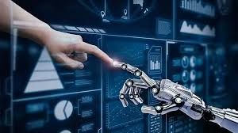
Speaking Topics
"The Future of Quantum Computing"
"Cybersecurity Threats and How to Prevent Them"
"AI and Job Automation: Should We Be Worried?"
"The Role of Open Source Software in IT"
"Why Every IT Student Should Learn Data Structures & Algorithms"

Slide 5

Key Terms and Basic Definition
Computer Science – Study of algorithms, data structures, and computing systems.
Programming Languages – C, Python, Java, etc., used to develop software.
Data Structures – Ways to store and organize data (arrays, linked lists, etc.).
Algorithms – Step-by-step problem-solving procedures.
Artificial Intelligence (AI) – Machines that learn and make decisions.
Networking – Connecting systems to share resources.
Cybersecurity – Protection of digital systems and data.
Software Development Lifecycle (SDLC) – Phases in software creation.
Operating Systems – Software that manages hardware (Windows, Linux).
Cloud Computing – Using remote servers for data storage and processing

Slide 6
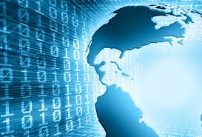
Advantages & Disadvantages of Computer Science
Advantages
Automation increases efficiency & productivity
Improves global communication & networking
Powers industries (healthcare, finance, education)
Allows scalable business solutions (cloud, AI)
Disadvantages
Job displacement due to AI & automation
Privacy & data security concerns
High dependency on technology & cyber risks
Ethical concerns with AI decision-making

Slide 7

Task: "Build the IT System of the Future"
Imagine you are an IT consultant in 2035.
Design a new software, AI, or cybersecurity solution that solves a global problem.
Describe the system, how it works, and its benefits.

Slide 8
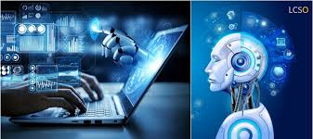
Conclusion
Final Thought: "Computer science is not just about coding—it’s about solving problems and shaping the future."

