Slide 1
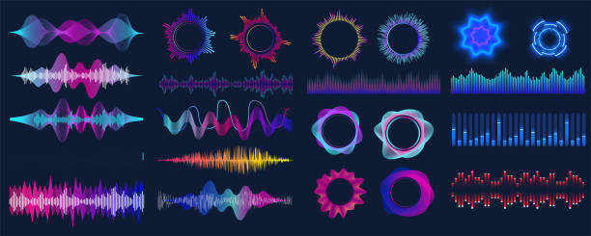
Radio Waves
Understanding Electromagnetic Communication

Slide 2
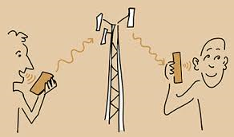
What Are Radio Waves?
Radio waves are a type of electromagnetic radiation with long wavelengths. They are used to transmit information over distances without wires.

Slide 3
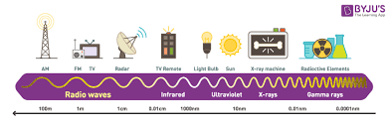
Key Characteristics of Radio Waves
• Travel at the speed of light
• Can pass through various materials
• Carry information in the form of waves

Slide 4
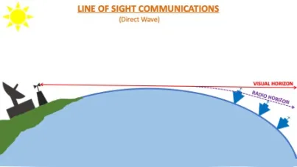
How Radio Waves Are Produced
Radio waves are created when an electric current flows through a conductor, such as an antenna. The antenna then emits these waves, which travel outward in all directions.

Slide 5
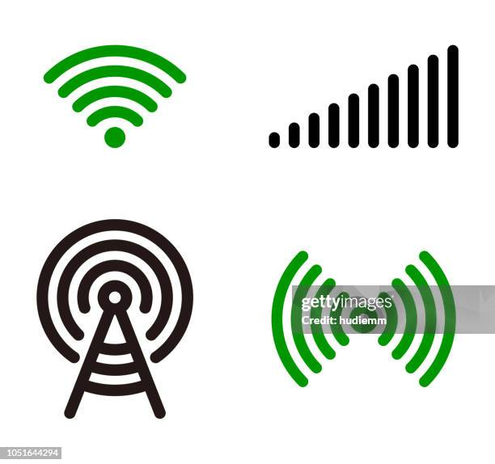
Types of Radio Waves
Radio waves are classified by their frequency:
• Low-frequency waves (e.g., AM radio)
• High-frequency waves (e.g., FM radio, Wi-Fi)

Slide 6
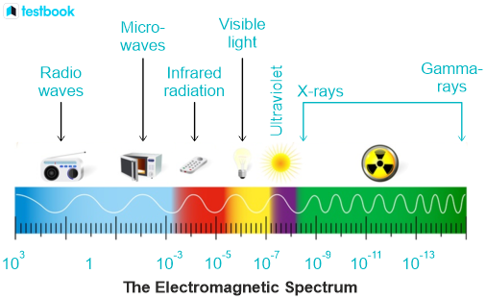
How Radio Communication Works
A transmitter changes data into radio waves, which are sent through the air. A receiver then picks up the radio waves and converts them back into data or sound.

Slide 7
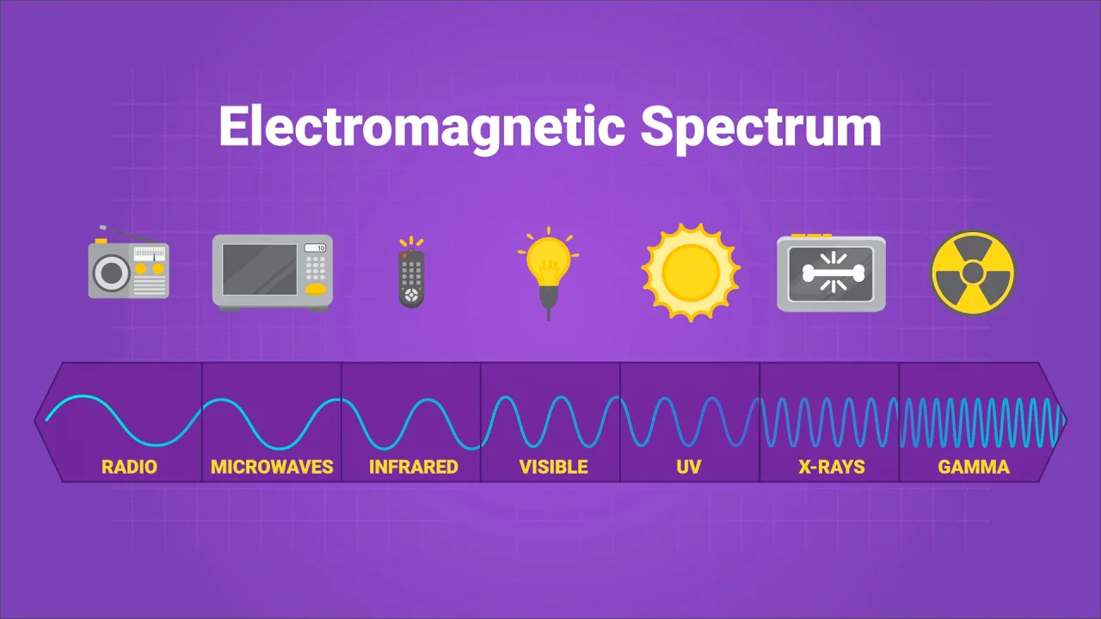
Applications of Radio Waves
Radio waves are used in many modern technologies, including:
• Radio broadcasting
• Mobile phones
• Wi-Fi networks
• Satellite communication

Slide 8
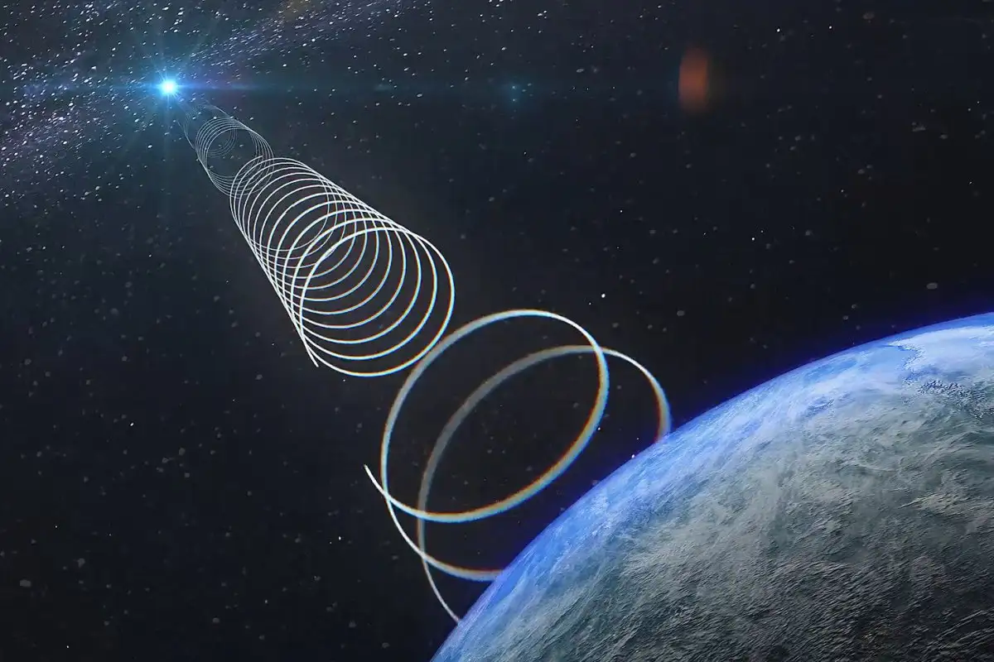
The Future of Radio Waves
With advancements in technology, radio waves will continue to play a crucial role in new communication systems, such as 5G networks and the Internet of Things (IoT).

