Slide 1
Past tenses

Slide 2
Past Simple
Ved/II
didn‘t V
Did__V?
He wrote
He didn‘t write
Did he write?
Yesterday
Last week
3 days ago
When I was 5
In 1988
X, X, X

Slide 3
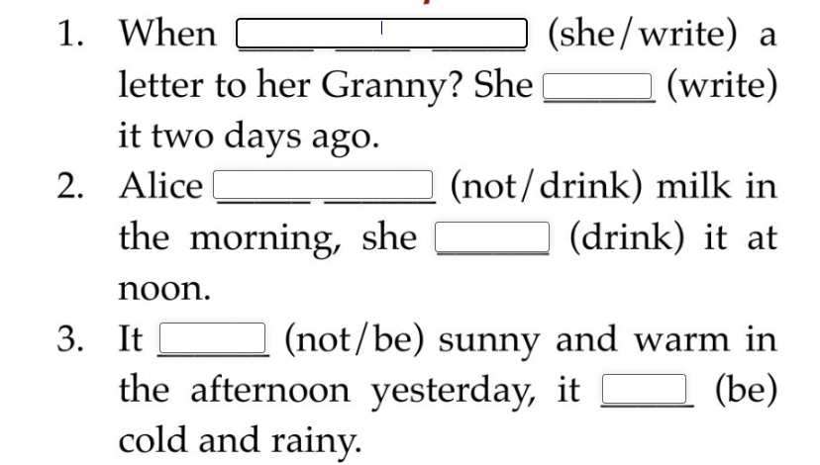
Your aunt (phone) last week.
He (choose) a car last Monday.

Slide 4

Past Continuous
Was/were (not) Ving
1) At 3 o‘clock yesterday I was reading a book.
2) While I was reading, my mother came.
P.C.
P.S.
P.C.
P.C.
3) While I was reading, my mother was cooking.

Slide 5
Your aunt (phone) at 5 o’clock last week.
He (choose) a car while you were at work.
It started to rain yesterday as we (have) a picnic.
Where you (go) when I met you?

Slide 6
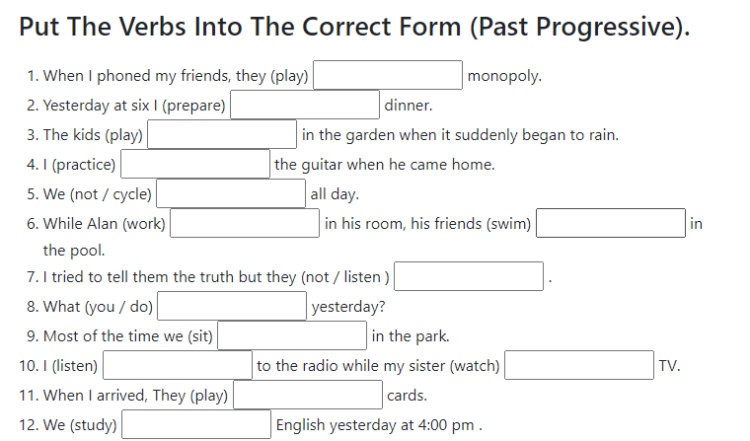

Slide 7
Past Perfect
Had VIII/ed
Had not VIII/ed
Had we VIII/ed
….. by 5 o‘clock
before Friday
until morning
3) After X, X.
After I had cooked dinner, I went out.
2) X X
When I came into the class, the lesson had started.
He (write) a letter
We (start) learning English

Slide 8
Past Perfect Continuous
Had been Ving
Had not been Ving
Had we been Ving
For
All day/morning
I was tired because I had been working.
I (speak) for 3 hours
We (drive) since the morning

