Slide 1
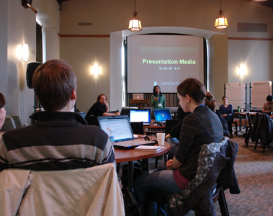
Effective Presentation Skills
Created by Iryna Zhukevych
PhD in Pedagogical Science
Associate Professor
Це фото; автор: Невідомий автор; ліцензія: CC BY-SA

Slide 2

Effective presentation is much more than just presenting your ideas or delivering a speech.
It is about skillful communication and relating to the audience - whether the audience is a few people or a large gathering.

Slide 3

Let’s review an outline of presentation skill training
https://www.usingenglish.com/teachers/lesson-plans/view-presentation-skills-training/

Slide 4

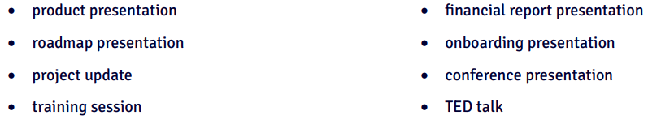
Look at the list of presentations and think about one you have seen recently.
Name three things you remember from it.

Slide 5

Discuss the following questions
How often do you listen to other people’s presentations?
How often do you give presentations? How do you feel about presenting something? Have you ever done it in English?
How do you prepare for a presentation? Do you have any tips or tools for creating a great presentation?
What are the key elements of a successful presentation?

Slide 6
Order the statements to make a presentation. Then, rewrite the beginnings of the statements using five phrases in the boxes on the previous slide.
Now, about some numbers. They show that remote working companies using the collaboration tools that I mentioned before have seen a 450% increase in keeping talented employees and a 20 to 30% increase in productivity.
1
For example, I’ll show you one of the features: Slack’s integration with Trello. It lets teams quickly move from discussion to creating and assigning tasks.
2
This slide shows that we have analyzed tools like Slack, Zoom and Trello. The features users consider most helpful include real-time messaging, file sharing, video calls, and task management.
3
To finish, I’d like to say that it is important that we start using collaboration tools to make our work more effective and bring our teams closer together.
4
My presentation is about how we can use collaboration tools to make remote working more effective.
5

Slide 7
Watch a video [https://www.youtube.com/watch?v=avew5rVAwi0 ] and complete the statements with one word.
During a presentation, you should be clear because if people don’t understand you, you cannot do the presentation ___________ .
If you want people to understand your presentation, use ___________ language.
When you prepare your presentation, make sure it doesn’t sound like a(n) ___________ paper.
Try first presenting to someone who doesn’t have any knowledge of your ___________ .

Slide 8
Discuss the questions.
What do you think about the tips from the video (using simple language, using a conversational tone, practicing on somebody who doesn’t know your topic)? Have you ever used any of the tips?
Can you think of more tips to make sure a presentation is clear?
Imagine you have decided to do some exercises to improve your presentation skills. Which of the exercises would you try? Why?
- practice tongue twisters
- practice in front of the mirror
- talk for a minute about a random object
- do breathing exercises

Slide 9
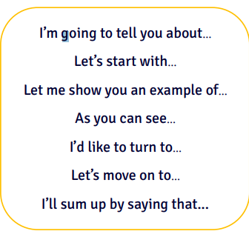
Think of a work-related task, real or imaginary, and present it using at least three phrases from the box. Use the points listed below to help you prepare what to say.
1. task description
2. process
3. progress/results
4. challenges
5. what you learnt

Slide 10

Watch the video and answer the following questions
https://www.youtube.com/watch?v=edIctUyd4RQ
What does the speaker suggest is the most important accessory one can wear in life?
Describe how the speaker views confidence in terms of its development.
According to the speaker, how should one deal with their flaws?
What is the speaker's perspective on diversity in society?
Reflect on a moment in your life when you asked yourself, "How did I get here?" What factors contributed to your current situation?
In what ways does the speaker suggest we can empower each other in daily life?
Why does the speaker believe taking risks is essential for personal growth?
What does the speaker identify as their biggest achievement? Why is this significant to them?
How does the speaker define purpose in life? What role does ambition play in achieving it?
What does the speaker mean when they say, “Excellence is the pursuit of my life"? How does this relate to discipline?

