Slide 1
Cultural differences in business
Hanna Kolosova
Ph.D., Associate Professor,
Department of English language for Humanities, FL,
Igor Sikorsky Kyiv Polytechnic Institute
For ESP students

Slide 2
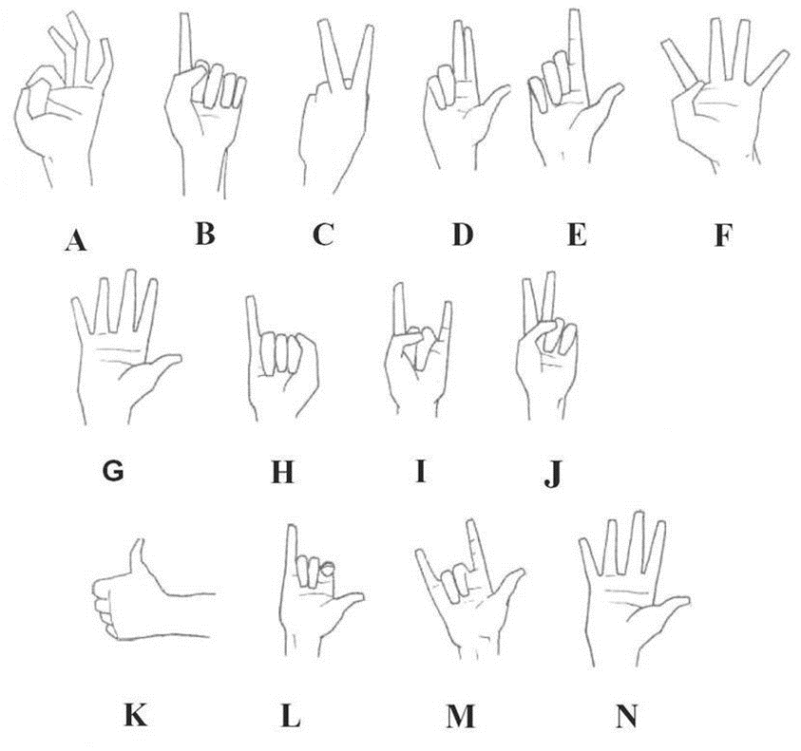
Cultural test. Part 1
Look at the picture below and say what do the gestures from the picture mean in your country. Then read information below about what these gestures mean in different countries and discuss them with the partner.

Slide 3
Cultural test. Part 1
H. Bali: bad
Japan: woman
South America: thin
France: You can't fool me!
I. Malta and Italy: protection against the Evil Eye (when pointed)
South America: protection against bad luck (when rotated)
J. Greece: Go to Hell!
The West: two
K. Europe: one
Widespread: hitchhike; good; OK
Japan: man; five
L. Holland: Do you want a drink?
M. USA: I love you
N. The West: ten; I surrender
Widespread: I'm telling the truth.
A Europe and North America: OK
Tunisia, France, Belgium: zero; worthless
Japan: money; coins
B. Western countries: one; excuse me!; As God is my witness; No! (to children).
C. USA: two
Germany: victory
France: peace
Ancient Rome: Julius Caesar ordering five beers
D. Europe: three
Catholic countries: a blessing
E. Europe: two
Britain, Australia, New Zealand: one
USA: Waiter!
F. Western countries: four
G. Western countries: number 5
Everywhere: Stop!

Slide 4
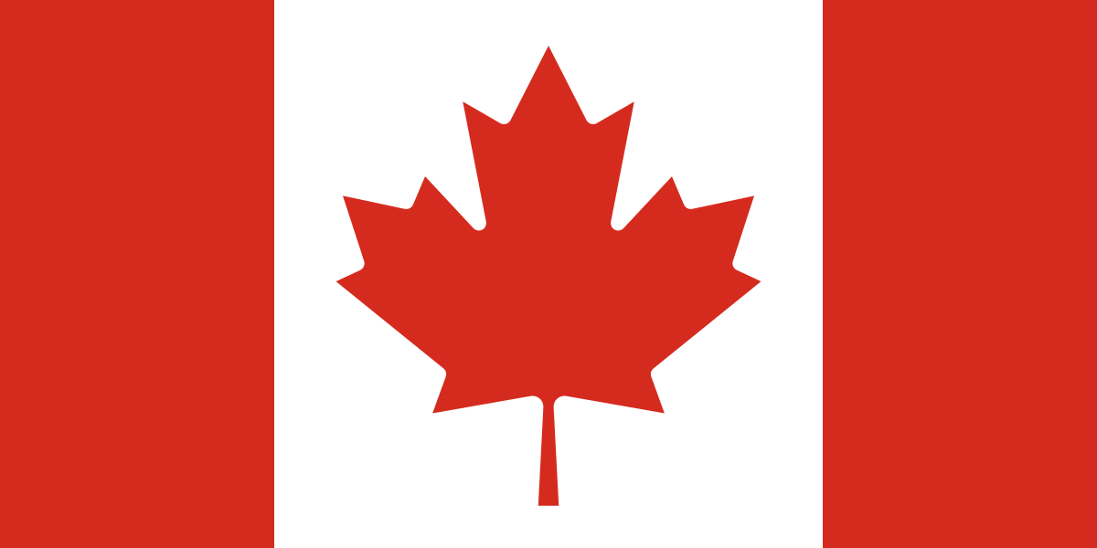
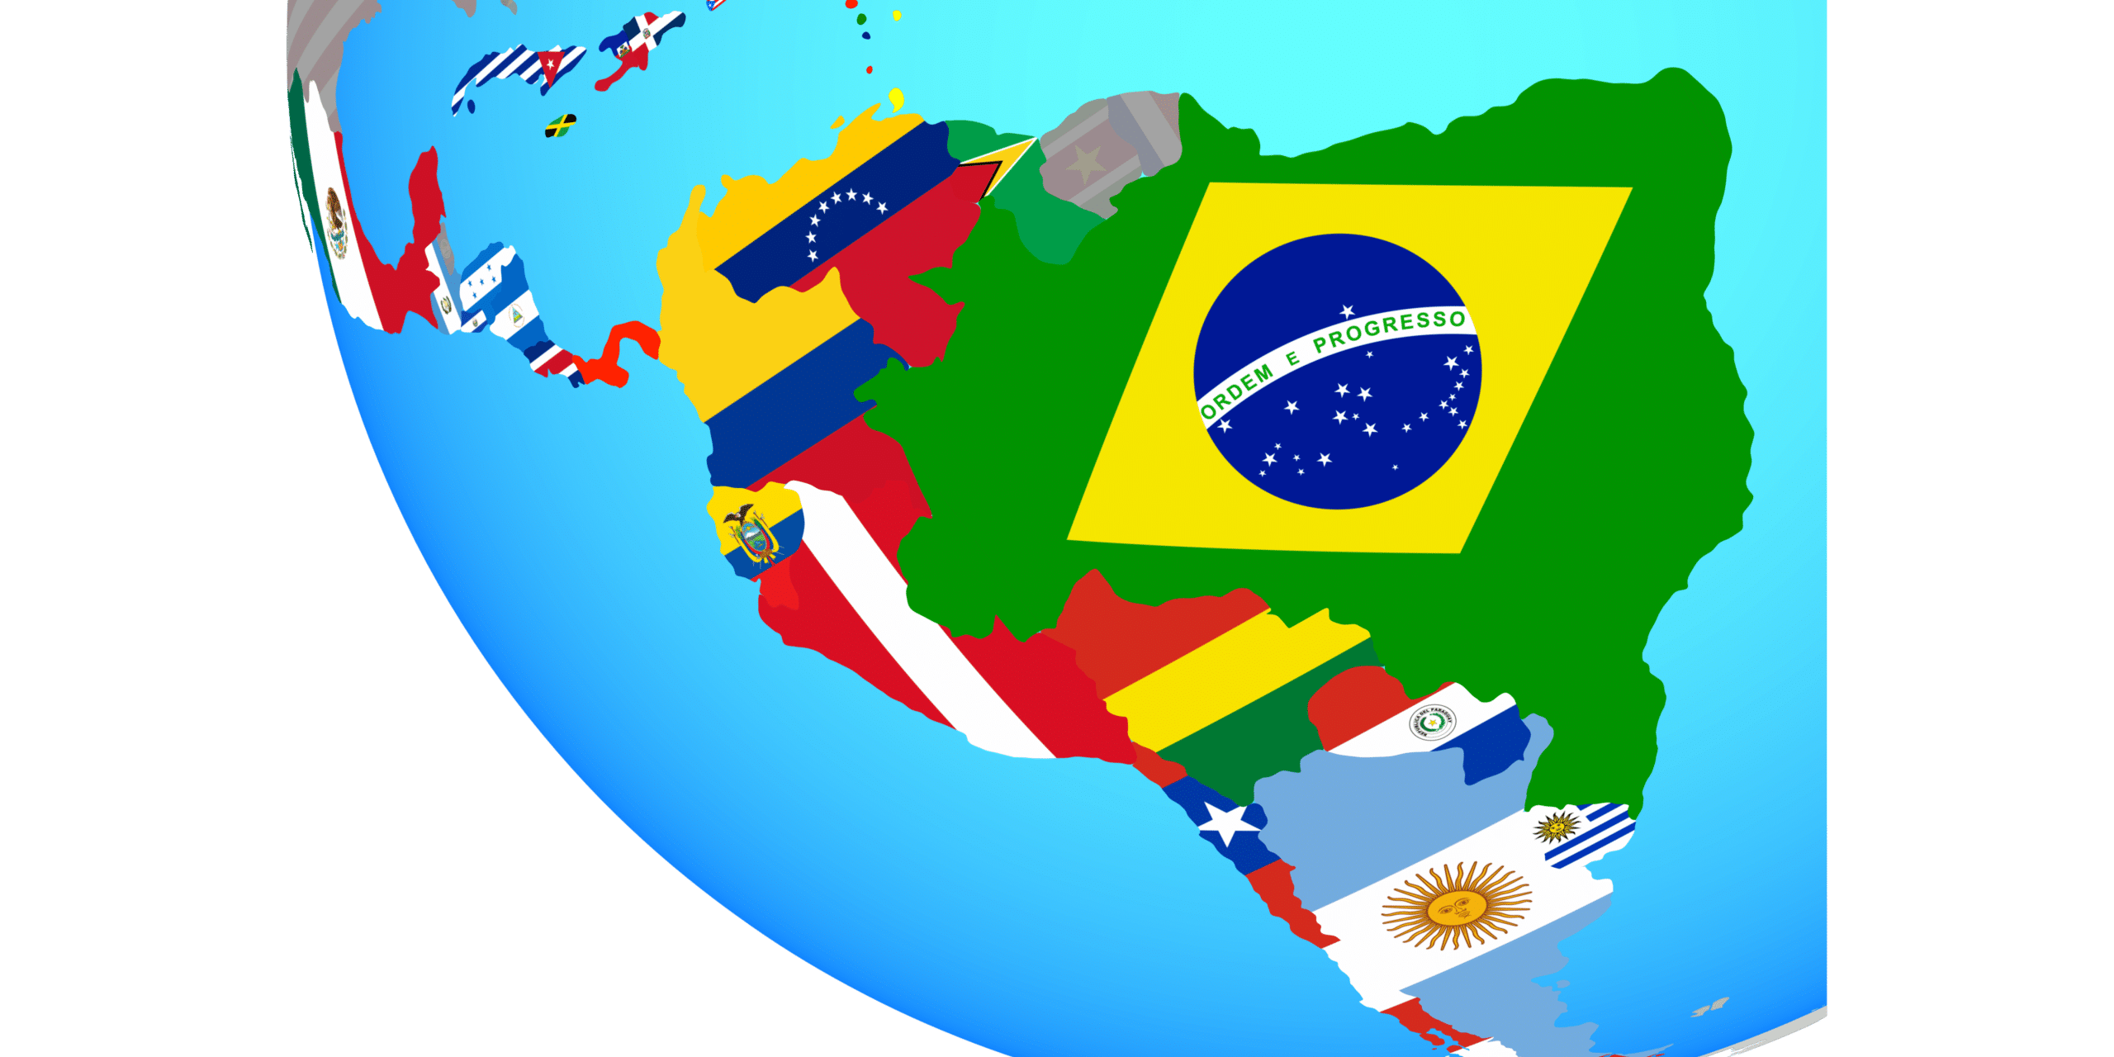
How to dress for business meetings in different countries?
Countries of Latin America
When traveling to South America, one needs to note that it is the proper apparel that can be critical to the success of one’s business endeavor. The business garment should be conservative and modest, but simultaneously made of top-notch textiles and reflect current trends in fashion. Interestingly, a dark three-piece suit is considered as an indispensable attribute of the higher management.
Canada
By examining Justin Trudeau, the prime minister of Canada, we may figure out that Canadians dress more conservatively and formally than their US neighbors. However, some of their dress codes may vary depending on the region. For instance, people from Vancouver are more casual in the way they dress, while entrepreneurs from Toronto draw inspirations from Britons, who are more conservative in this regard.

Slide 5
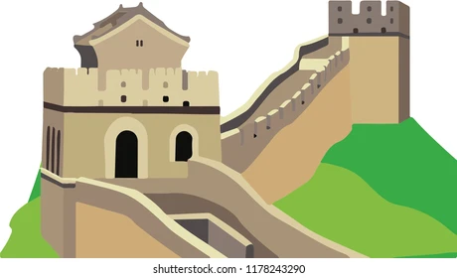
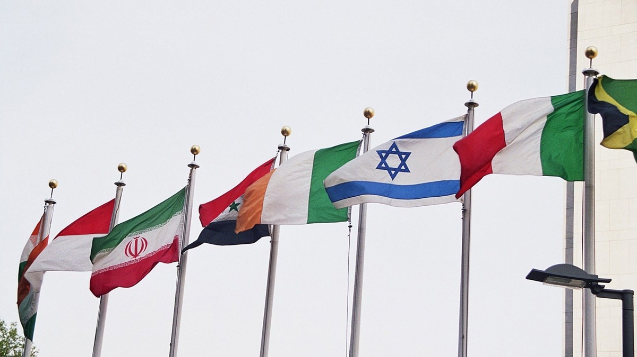
How to dress for business meetings in different countries?
China
When in Asia, it’s reasonable to take China as one’s reference point. In daily situations, the apparel should be simple, modest and classic. It’s not recommended to show off your wealth with clothing, although a high-end watch is an advisable investment. Women should avoid clothes that expose arms and the back, as well as deep cleavage or extravagant jewelry, or too strong make-up. In the summer, men can allow themselves good trousers and a shirt without a tie.
Muslim countries
With a number of exceptions (e.g. Morocco, Lebanon), one has to keep in mind that the dress code in Muslim countries is extremely conservative. The body must not be exposed, while in countries such as Iran, Saudi Arabia or the United Arab Emirates, one has to wear a hijab to cover the hair, ears, cleavage and breasts. Women should not expose their body.

Slide 6
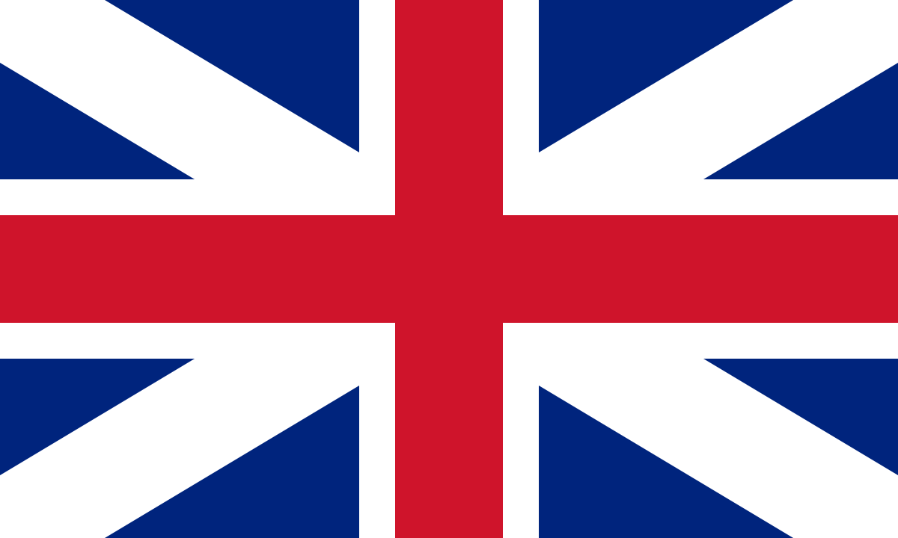
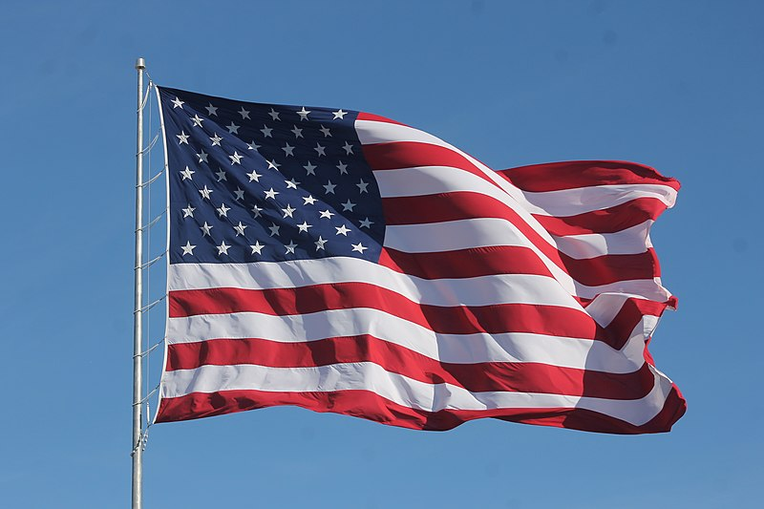
How to dress for business meetings in different countries?
USA
The American dress code is primarily defined by how successful somebody is. The perfectly cut, custom-tailored suit of a Wall Street financier will serve as the best example. When going on a business trip to the USA, it is always reasonable to go for elegant simplicity and adjust to the dress code specified in the invitation.
Great Britain
When you go to Great Britain, there’s an easy correlation to remember: the larger the city, the more formal apparel is required. British men often use different tie designs to indicate their affiliation to various groups (e.g. university graduates, members of clubs). It’s also very popular here to follow the instructions on invitations such as black tie or white tie. Apart from classic garments, the English frequently put on clothes made of tweed or wool – especially when the meeting is less official.
The text is borrowed and modified from http://businessandprestige.pl/how-dress-for-business-meetings-in-different-countries-across-the-globe/ as of 20th October 2020

Slide 7
Cultural test. Part 2
Say whether these statements are True or False according to the information that you already have read:
The white suite is important attribute of the senior management in Latin America countries.
According to the text Canadians prefer not so formal outfits to the business meetings than businessmen from USA.
In China it is not appropriate to demonstrate the wealth with the clothes.
Muslim countries do not follow any dress code while doing business.
In USA, the level of success is often demonstrated with the help of expensive suits.
In Great Britain, it does not matter from what region you are or to what group you belong to when it comes to outfits.

Slide 8
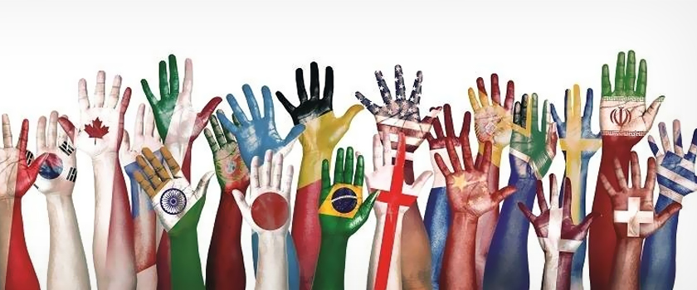
Cultural test. Part 2
False
False
True
False
True
False

Slide 9
Referenes
Dominika Job. (2006). How to dress for business meetings in different countries across the globe? ‒ Retrieved from: http://businessandprestige.pl/how-dress-for-business-meetings-in-different-countries-across-the-globe/

Slide 10
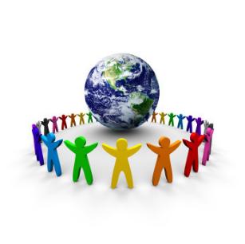
Thank you for attention!

